Slide 1
Hypercapnic Respiratory Failure

Slide 2
Admission 1, 2, 3
CHEST 2017; 152(6):1318-1326
best reference to explain her physiology, probably.
Clinic Patient

Slide 3
What is the concentration of CO2 in Coca-Cola
https://chemistry.stackexchange.com/questions/9067/what-is-the-carbon-dioxide-content-of-a-soda-can-or-bottle
2.2g CO2 -> 1mol/44 g CO2 = 0.05 mol = 50 mmol
50 mmol / 355 mL (equivalent to 12oz)=> 140 mmol/L
Rule #1 – when you’re more carbonated than Coca Cola, that’s bad
Notes:
This is achievable as the bicarbonate buffering system functionally increases the amount of CO2 that can be seqeuestered in the blood, in comparison to soda which relies on increased pressure (~3 atm) to dissolve CO2)

Slide 4
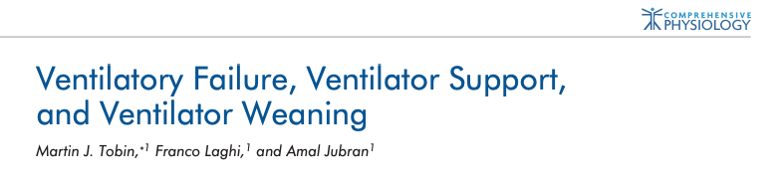
Key References
Nunn’s Physiology and West’s Respiratory Physiology
Notes:
Tobin, M. J., Laghi, F., & Jubran, A. (2012). Ventilatory Failure, Ventilator Support, and Ventilator Weaning. Comprehensive Physiology. doi:10.1002/cphy.c110030

Slide 5
Section 1: PaCO2 Kinetics and Control
CO2: The exhaust of life: O2 + C6H12O6 -> H2O and CO2
Any values of PaCO2 above 46 mmHg is abnormal – though transient elevations up to 50 mmHg may be encountered in ‘normal people’ doing breathe holds. West: held within 3mmHg always, possibly slightly higher in sleep. (10mmHg is the threshold for noct vent)
Mean normal PCo2 is 38.3 mmHg with 95% (2 SD) range being +/- 7.5 mmHg
Normals defined by 95% normal range, similar to other values (Nunn’s).
42 mmHg is the ULN of PaCO2 in SLC (Denver; Lee Brown) – measured 33.9+/-2.2 in men and 32.8 +/-3 mmHg in women. pH identical
Respiratory failure: defined as failure to maintain normal arterial blood gas partial pressures.
Notes:
“Important to note than PaCO2 over 44 mmHg is not synonymous with hypoventilation - as it could also be due to increased VCO2 (from exercise, increased work of breathing, weight gain, hyperthermia, carbohydrate utilization, hyperthyroidism, etc.)”
(Also the issue of metabolic acid-base disorder and compensation)
Ventilatory control law
Statement of law
Whipp’s law (2008)During moderate exercise, V̇_{E} increases only to levels commensurate with the level of pulmonary CO₂ exchange required for Pa_{CO2} regulation. In particular, the system seems to “know” that when V_{D}/V_{T} is reduced, V̇_{E} “needs” to increase less per unit V̇_{CO2} to effect its regulatory function
Comroe’s law (1965)The lung is designed to eliminate CO₂ in a CO₂-free medium, air. When CO₂ is added to the inspired air, it clogs the mechanism for CO₂ elimination, and Pa_{CO2} must rise
Elevation: https://www.atsjournals.org/doi/full/10.1164/ajrccm.160.5.9806006
0.24 mmHg/yr decrease in PO2 (or increase in gradient) – hence Age/4 rule of thumb.
Precited O2: Predicted Pa_{O2} using our reference equation (Pa_{O2} = 0.1834 Pb − 0.2452 age − 31.453
The emergence of photosynthetic organisms 3 billion years ago increased the PO2 levels in the atmosphere and allowed the evolution of organisms that use glucose and O2 to produce ATP through mitochondrial electron transport and oxidative phosphorylation

Slide 6
PaCO2 stable despite a wide range of VCO2
Why is this so tightly regulated?
Thought experiment – VA = K * VCO2 / PaCO2
Ventilation is metabolically expensive (work of breathing = 2% of O2 at rest, but increases hugely with exercise or pathology)
The same pH can be achieved at any PaCO2 by adjusting the bicarbonate: pH = 6.1 + log [ HCO3 / (0.03 * pCO2) ]
Why doesn’t the body operate with with a PaCO2 of 70? (and an HCO3 of 44 = pH 7.42) This would be metabolically advantageous.
Especially in states where the work (power) of breathing is higher - such as lung disease
Notes:
54 - Cunningham DJC, Robbins PA, Wolff CB. Integration of respiratory responses to changes in alveolar partial pressures of CO2 and O2 and in arterial pH. In: Cherniack NS, Widdicombe JG, editors. Handbook of Physiology, Section 3. The Respiratory System. Volume II: Control of Breathing, part 2, Bethesda, MD: Am Physiol Soc, 1986, pp. 475-528.
Gamblegram = the ion stacked diagrams that would be relevant for showing renal compensation

Slide 7
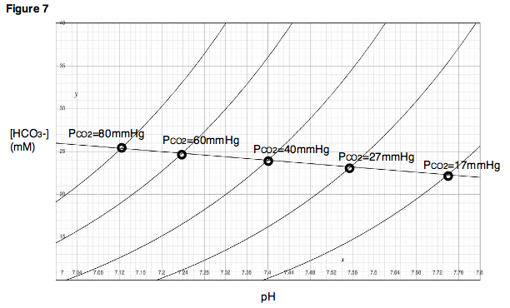
Davenport diagram
Notes:
graphical demonstration of the Henderson–Hasselbach relationships
Can do any combination of CO2 and pH by modifying bicarbonate.

Slide 8
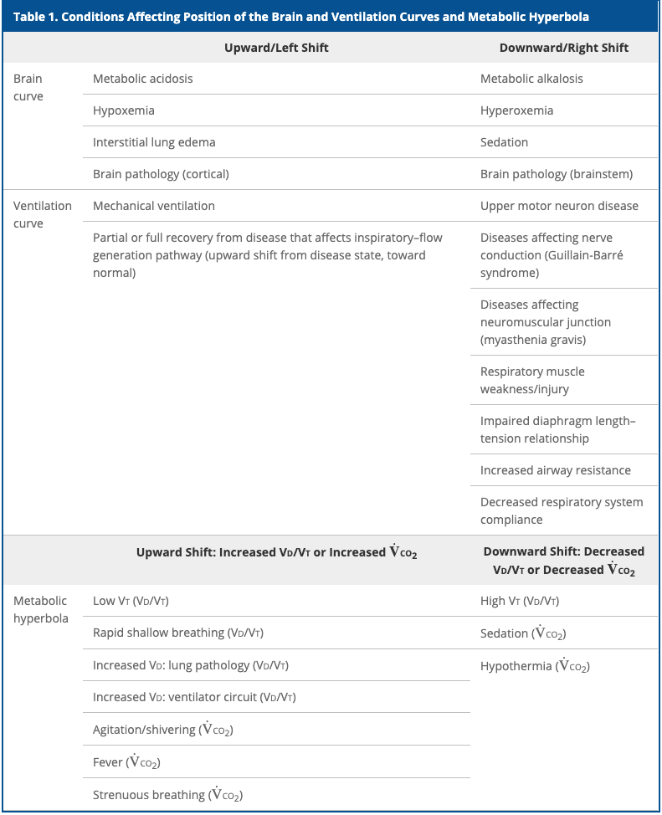
Notes:
Citation? Control of Ventilation? AnnalsAts or AJRCCM style – can you sustain what you need?

Slide 9
Why doesn’t PE cause hypercapnia?
PaCO2 = K * VCO2 / VE (1-Vd/Vt)
In healthy subjects, the control components and mechanical system can handle a wide variety of inputs without PaCO2 changing:
PaCO2 changing ALWAYS must indicate either a failure of the control system (won’t breathe), the mechanical system (can’t breathe), or both to respond to a stressor
Things that lead an inability of the respiratory system to cope can include load on respiratory muscles or reduction in their strength; or an increase in demand (deadspace, VCO2)

Slide 10
Vd/Vt, VCO2 changes = not the whole story
PaCO2 = K * VCO2 / VE (1-Vd/Vt)
VE is a dependent variable which the control system changes to keep PaCO2 the same
A change in Vd/Vt or VCO2 can be a stressor on the system, but in the absence of huge extremes (e.g. 2,4 Dinitrophenol overdose) is not the cause itself (unless control system is offline - on vent)
How huge can system compensate?
VCO2 – based on average VO2 max stress test data – should tolerate 8.8x resting VCO2 (in 70kg 63y/o female) prior to decompensating if that is the only abnormality
Even at VO2max 10 ml/kg/min
Vd/Vt – 89% (by re-arranging and solving, equiv to the above - PaCO2 = K * VCO2 / VE (1-Vd/Vt)
This is why a PE won’t cause hypercapnia except when a patient is on the vent.
Notes:
VO2 max of a normal person
If we assume a max VO2 stress test result for an average 70kg, 60-year-old female = VO2 at peak 1.66 L/min (24.5 mL/kg/min) – historically, 3.5 mL/min/kg = 1 met… so max: 7 mets
For reference 80kg 63 y/o male 2.38 L/min, 28.8 ml/kg/min.
From CHEST 2021 Canada reference. CHEST 2021; 159(5):1922-1933
Thus VCO2 max with RER ~1.1 (maximal test) = 1.82 L/min ( 7.7 mets )
Plus the normal ventilatory threshold 15%+ = 2.093 L/min ( 8.86 mets ) VCO2 should be able to be handled by a normal respiratory system in an avg 63y/o without a change in CO2 (ignoring improvements in V/Q mismatching)
Even if VO2 max is only 50% of predicted, that’s still a large range of deadspace / VCO2 that the pulmonary system can handle unless there is a mechanical impediment.

Slide 11
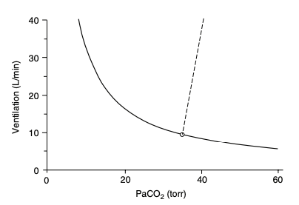
PaCO2 = K * VCO2 / VE (1-Vd/Vt)
(re-arrangement of PaCO2 = k * VCO2 / VA)
If you hold VCO2 and Vd/Vt constant, you get the metabolic hyperbola (solid line) which relates PaCO2 to Ve
Notes:
Tobin comprehensive physiology
Controller system sensitivity can be evaluated by forcing an increase in PaCO2 and measuring a subsequent increase in Ve – straight line, where change in Ve per mmHg paCO2 = sensitivity.
-normal range in healthy adults is 0.5 to 8.0 L/min/mmHg (1.5-5.0 in 80% of subjects) (269) - 269 - Tobin MJ, Gardner WN. Monitoring of the control of ventilation. In: Tobin MJ, editor. Principles and Practice of Intensive Care Monitoring. New York: McGraw-Hill, Inc., 1998, pp. 415-464

Slide 12
Sensitivity of the controller system to CO2: The PCO2/Ventilation Response ‘Curve’
The straight/dashed line is the amount that the respiratory system will respond to an increase in PaCO2 (slope = change in Ve / change in PaCO2)
Ventilation = S (PCO2– B), where S is slope, B is the intercept at zero ventilation.
Steeper slope = more sensitive, flatter = less sensitive
Normal range 0.5-8.0 L/min/mmHg (wide range)
80% of subjects have a response between 1.5 and 5 L/min/mmHg (118)
Notes:
118. Irsigler GB. Carbon dioxide response lines in young adults: The limits of the normal response. Am Rev Respir Dis 114: 529-536, 1976
313. Younes M, Georgopoulos D. Control of breathing relevant to mechanical ventilation. In: Marini JJ, Slutsky AS, editors. Physiological Basis of Ventilator Support. New York: Marcel Dekker, Inc., 1998, pp. 1-73.
(306) – Younes M. Mechanisms of ventilatory failure. Current Pulmonology 14: 243-292, 1993a.

Slide 13
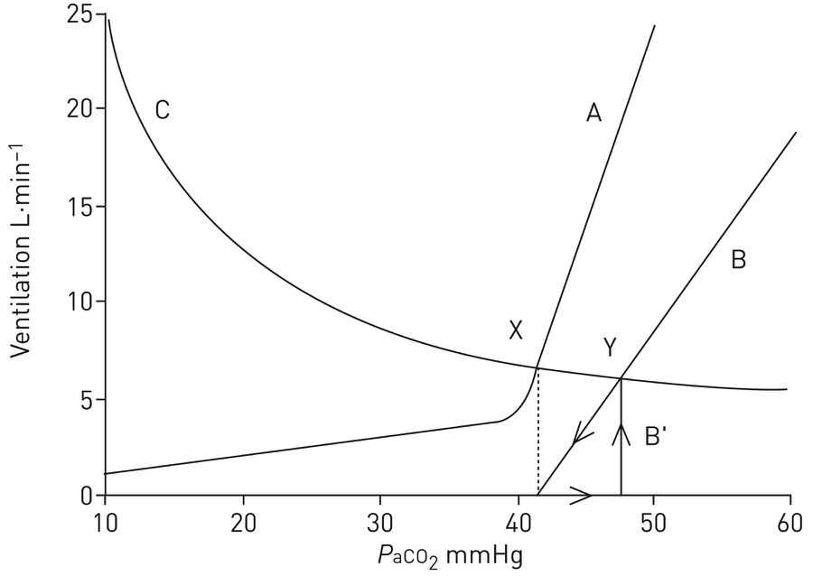
Example: Normal(A) -> Opiate(B)
Notes:
This diagram demonstrates how opiates can induce apnoea at the same arterial carbon dioxide tension (P_{aCO2}) as before opioid administration (dotted line) and also demonstrates that significant reductions in the hypercapnic ventilatory response (HCVR) only cause small changes in steady-state P_{aCO2}. Curve A represents the normal ventilatory response to CO₂ in an awake individual, demonstrating that ventilation is maintained at very low P_{aCO2} levels and that apnoea does not occur. Line B represents a 50% depression of the HCVR caused by opioid administration. A notable difference between curve A and line B is that in B, apnoea can occur. Note also that in this case, P_{aCO2} must rise to steady-state values (i.e. along the x-axis) for breathing to recommence (line B′). Curve C represents the CO₂ excretion hyperbola and demonstrates how changes in ventilation affect P_{aCO2}. Point X represents the awake state and point Y represents opioid-depressed breathing. Despite a 50% depression of the HCVR, the CO₂ changes only relatively modestly, illustrating the limited utility of single measurements of CO₂ in assessing respiratory depression. Reproduced and modified from [27] with permission from the publisher.
From https://erj.ersjournals.com/content/51/3/1702531#ref-8
Note: in this case, the opiate only caused a ~7 mmHg increase in PaCO2 despite a 50% reduction in sensitivity of the hypercapneic ventilatory response.
That is not always true.

Slide 14
Modifiers of response
Higher oxygen = flatter
Metabolic acidosis = steeper and left shifted
Notes:
From Nunn and Lamb’s

Slide 15
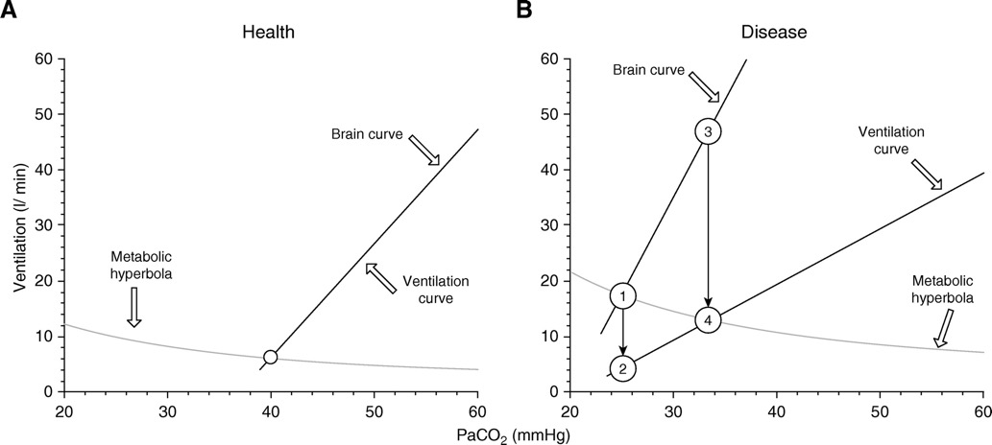
“Can’t breathe” – dissociation between drive and resulting ventilation”: corollary discharge
Brain Curve (Ve that would occur if the system were intact) and Ventilation curve (actual Ve)
Dissociation of brain curve and ventilation is a major contributor to dyspnea
Notes:
Graphical representation of the metabolic hyperbola and brain–ventilation curve of a healthy human. The intersection of the metabolic hyperbola and ventilation curve (open circle) determines the steady-state Pa_{CO2} and V.V.e (40 mm Hg and 6.2 L/min, respectively). (Note that these mathematically described curves and relationships are simplified presentations of experimental data, with the aim being to facilitate understanding of the effects of critical illness and mechanical ventilation on respiratory drive, and cannot be directly applied to compute the ventilatory demands of a critically ill patient.) (B) This human develops severe pneumonia, causing increased V.V.co₂ and Vd/Vt, which moves the metabolic hyperbola upward, and hypoxemia, which moves the brain curve to the left and increases its slope. Owing to increased respiratory system elastance, a given respiratory center output per minute (RCO/min) results in a lower V.V.e; thus, the slope of the ventilation curve is shifted downward. A dissociation of the ventilation curve from the brain curve occurs. In the presence of a dissociation, any change in Pa_{CO2} alters the RCO/min (mainly due to change in respiratory drive, RCO per breath) as much as the brain curve dictates, and any change in RCO/min can only change the actual ventilation as much as the ventilation curve dictates. Assuming for simplicity that the change in respiratory system elastance, and thus the deviation of the ventilation curve, occurs abruptly, the RCO/min corresponds initially to point 1 (V.V.e, 17.5 L/min), whereas the actual V.V.e drops to point 2 (4.5 L/min). This decrease in ventilation leads to a gradual increase of Pa_{CO2}, which in turn stimulates the respiratory center. The RCO/min progressively increases along the brain curve (from point 1 to point 3), following the increase in Pa_{CO2}. In parallel, this increase in RCO/min results in an increase in the actual V.V.e along the ventilation curve (from points 2 to 4). When RCO/min (point 3) results in an actual V.V.e at the intersection of the ventilation curve and the metabolic hyperbola (point 4), a steady state occurs; Pa_{CO2} stabilizes; and respiratory drive, RCO/min, and V.V.e do not increase further. Although the brain’s ventilation demands (46 L/min) are not met (actual V.V.e, 13 L/min), respiratory drive and RCO/min do not increase further because the CO₂ stimulus is constant.
Air hunger is the most prominent sensation in severe dyspnoea (Stevens et al. 2019); it is the extremely uncomfortable sensation that arises when ventilation (sensed via stretch receptors) fails to meet demand (conveyed by corollary discharge from brainstem to cerebral cortex) (Abstract Figure). Under conditions of fixed mechanical ventilation, air hunger can be induced by hypoxia and/or hypercapnia in proportion to level of chemoreflex stimulation of ventilation (Moosavi et al. 2003).

Slide 16
Breath Holds
PaCO2 causes an irresistibly strong urge to breathe in individuals with normal respiratory systems
on room air, typically near 50 mmHg (diaphragmatic contractions occur at PaCO2 ~46-49)
on supplemental oxygen, can tolerate much longer (highly trained apneass can increase their conventional breakpoint to critical hypoxia, which is 20-30 mmHg O2)
can be extended by rebreathing gas (the sensation of air hunger is partially mediated by lack of movement in / out)
Notes:
Comprehensive physiology breath hold diving paper
Recall:
Any values of PaCO2 above 46 mmHg is abnormal – though transient elevations up to 50 mmHg may be encountered in ‘normal people’ doing breathe holds. West: held within 3mmHg always, possibly slightly higher in sleep. (10mmHg is the threshold for noct vent)

Slide 17
Central respiratory chemoreceptors likely trigger non-respiratory effects of CO2 because hypercapnia evokes no adverse sensation, emotional or otherwise, in patients with congenital central hypoventilation syndrome (CCHS) who lack a respiratory chemoreflex but have normal intellect and sensory perception (Shea et al., 1993; Weese-Mayer et al., 2010).
Notes:
Shea, S.A., Andres, L.P., Shannon, D.C., Guz, A., and Banzett, R.B. (1993).
Respiratory sensations in subjects who lack a ventilatory response to CO2.
Respir. Physiol. 93, 203–219.
Weese-Mayer, D.E., Berry-Kravis, E.M., Ceccherini, I., Keens, T.G., Loghmanee,
D.A., and Trang, H.; ATS Congenital Central Hypoventilation Syndrome
Subcommittee (2010). An official ATS clinical policy statement: Congenital
central hypoventilation syndrome: genetic basis, diagnosis, and management.
Am. J. Respir. Crit. Care Med. 181, 626–644.

Slide 18
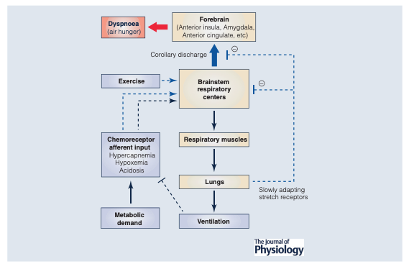
DOI: 10.1113/JP280769

Slide 19
Drive to breath
3 sources:
Chemical drive – related to changes in arterial PO2 (NOT oxygen saturation), arterial and brain PCO2 and pH. Mediated by central and peripheral chemoreceptors.
Metabolic drive – related to metabolic rate and mediated by unknown mechanisms (e.g. how the Ve increases in CPET before blood gases change)
Wakefulness drive – disappears during sleep, such that a minor PaCO2 drop in presence of normoxia produces a central apnea during sleep or anesthesia
Anesthesia: (86).
Note: voluntary / supratentorial factors can increase this
Notes:
Wakefulness drive to breath ensures that you continue to ventilate some even when PaCO2 below the set point during the day, but this goes away when you sleep (hence the possibility of central apneas - which don’t occur when awake - duh)
86. Fink B, Hanks E, Ngai S, Papper E. Central regulation of respiration during anesthesia and wakefulness. Ann N Y Acad Sci U S A 109: 892-900, 1963.
According to https://www.cell.com/neuron/pdf/S0896-6273(15)00676-5.pdf – metabolic drive may be mediated by reflexes from muscle groups, though unclear which neural circuits involved.

Slide 20
Anatomy
1. central medullary rhythm/pattern generator and integrator (brainstem) - primarily in the pre-Botzinger complex and pontine raphe. Bilateral (thus, not destroyed by acute ischemic stroke in the absence of catastrophe)
2. Sensory inputs Chemoreceptors –
carotid body (peripheral - sense a variety of stimuli such as O2 levels)
medulla (central – responds to H+ in the CNS ECF, linear increase in VA to increase in H+ in CSF - whose changes are moderate by active H+ transport at the BBB - generally reflective of PaCO2 because this can diffuse. CSF HCO3- buffers response. ).
Stimulation of the peripheral chemoreceptors increases the slope of the central H+ receptors (meaning, a given increase in H+ will result in a larger increase in ventilation). Note: carotid BODY (chemoreceptor) =/= carotid sinuses (baroreceptors, blood pressure)
3. precise synchronous distribution of motor output to the respiratory musculature of the upper airway as well as the chest and abdominal walls (via C3-4-5, phrenic keeps the diaphragm alive).
Notes:
DOI: 10.1183/09031936.00048514

Slide 21
Ventilatory Control
Central Chemoreceptors | Ventral surface of medulla | Responds to H+ in ECF of CNS – this equilibrates with CO2 in blood (no charge) moreso than pH in blood. CSF HCO3 lessenss response. No O2 sensing. Slower response
Peripheral Chemoreceptors | Carotid and Aortic bodies. Aortic body contributes to sympathetic and cardiovasc response | Respond (rapidly) to PaO2, PaCO2, and pH
When CO2 and pH diverge? E.g. metabolic acidosis (DKA) does generate increased ventilation – but it is mediated at the PERIPHERAL receptors (pH sensors) not central (CO2 sensor, except in extreme acidosis where BBB becomes slightly more permeable)
Notes:
“The CB senses PCO2 and H1 in arterial blood, contributing to 20–30% of the reflex regulation of CO2-H1 levels in response to hypercapnic acidosis, while the central chemoreceptors are responsible for the other 70–80%”(presumably, this is in healthy individuals at sea level)
However, the CB chemosensory discharge also increased in response to isohydric hypercapnia (304 Iturriaga R, Mokashi A, Lahiri S. Dynamics of carotid body response in vitro in the presence of CO2-HCO3 . Role of carbonic anhydrase J Appl Physiol (1985) 75: 1587–1594, 1993. doi:10.1152/jappl.1993. 75.4.1587.) – thought related to drop in intracellular pH (even with normal blood pH) due to carbonic anhydrase
(from https://journals-physiology-org.ezproxy.lib.utah.edu/doi/pdf/10.1152/physrev.00039.2019).
Taken together, the evidence points to two major mechanisms underlying hypoxiai nduced tachycardia: 1) selective inhibition of CB chemoreceptor-induced cardiac parasympathetic activity by the lung inflation reflex and 2) an aortic chemoreceptor induced increase in cardiac sympathetic nerve activity and/ or inhibition of parasympathetic activity.
***does the impact of carotid body mediated complications vary with elevation?

Slide 22
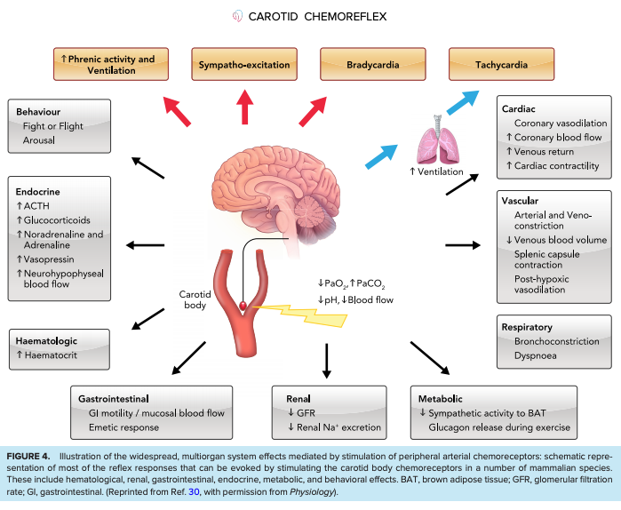
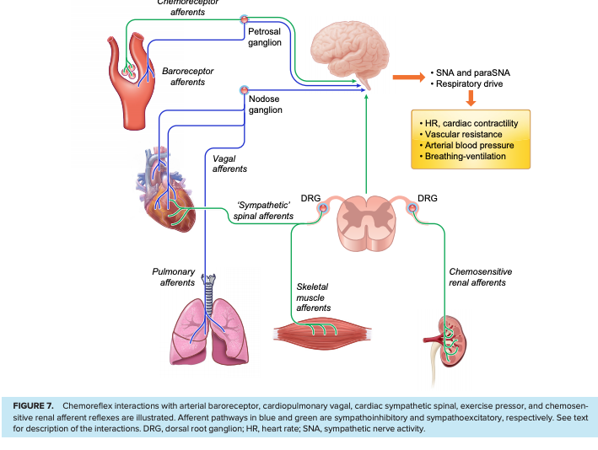
Notes:
https://journals-physiology-org.ezproxy.lib.utah.edu/doi/pdf/10.1152/physrev.00039.2019

Slide 23
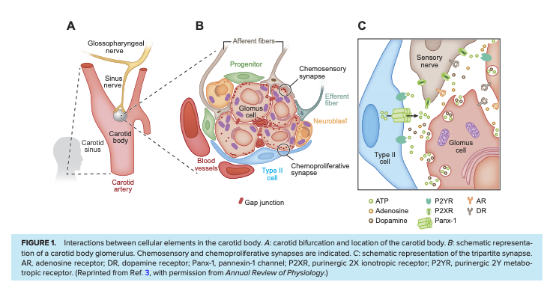
Carotid Body Phys
Glomus/type 1 cells surround blood (sense O2 by unclear means, and transmit it by L-type ca dep excitatory transmission) and Glial origin cells/type 2. Transmit to CNS by glossopharyngeal nerve
Hypoxemia or hypercapnia or acidemia -> more CB discharge -> reflex hyperventilation, increased vagus output (brady), sympathetic activity (muscules, splanchnic, renal vascular beds)
Senses PaO2, not CaO2, SaO2 or SpO2
Sympathetic overactivity is one mechanism for OSA and CHF effects on other organs
Notes:
The CB (also called ganglion minutum, carotid corpuscule, carotid ganglion, glomus caroticum, and carotid gland)
https://journals-physiology-org.ezproxy.lib.utah.edu/doi/pdf/10.1152/physrev.00039.2019
Some tonic hypoxic discharge (as 100% o2 will decrease ventilation – Dejours Test
In humans the mean dimensions of the CB are 2–3 mm and a mean weight of 18–20 mg. Despite the relatively small size, the CB has the highest blood flow (1.0–2.0 L/min/100 g) reported for any organ
, despite great efforts over the last 50 years, the exact nature of the oxygen sensor still remains elusive (for recent reviews, see Refs. 9, 10, 12, 14, 16, 19). Several hypotheses have been proposed to explain O2 sensing in the CB. The “metabolic hypothesis” argues that the O2 sensor is linked to oxidative phosphorylation metabolism in type I cells. The “membrane hypothesis” proposes that the sensors are molecules closely associated with K1 channels present in the type I cell membrane.
. Recent studies have provided evidence that the tachycardia may be independent of the ventilatory response to hypoxia, is mediated by parasympathetic inhibition, and is unlikely to be baroreflex mediated (371, 372) –
371. Paleczny B, Seredynski R, Tubek S, Adamiec D, Ponikowski P, Ponikowska B. Hypoxic tachycardia is not a result of increased respiratory activity in healthy subjects. Exp Physiol 104: 476–489, 2019. doi:10.1113/EP087233.
372. Siebenmann C, Ryrsø CK, Oberholzer L, Fisher JP, Hilsted LM, Rasmussen P, Secher NH, Lundby C. Hypoxia-induced vagal withdrawal is independent of the hypoxic ventilatory response in men. J Appl Physiol (1985) 126: 124–131, 2019. doi:10.1152/japplphysiol. 00701.2018.
The direction and magnitude of the blood pressure response depend on multiple factors, including the severity and duration of the hypoxemia, the balance between sympathetic-mediated vasoconstriction and the direct hypoxemia-induced vasodilation, the magnitude of the ventilatory response
Similar to the CB chemosensory potentiation induced by CIH, it is well known that chronic sustained hypoxia (i.e., high altitude) progressively increases carotid baseline chemosensory discharges and responses to hypoxia (488, 489). In addition, long-term exposure to sustained hypoxia produces hypertrophy and/or hyperplasia of type I cells and enlarges the CB (490–493). ET1 and its receptors have been involved in CB enlargement induced by sustained hypoxia (52, 488, 494).

Slide 24
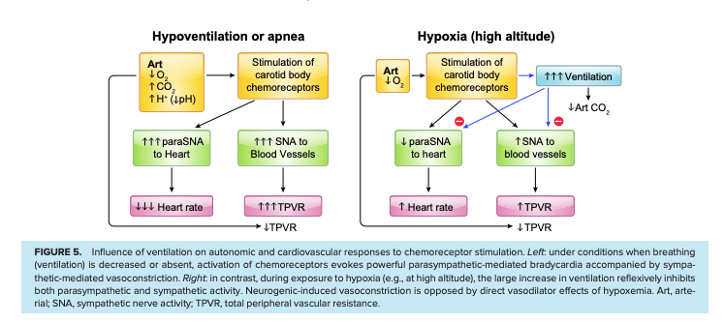
Mechanisms of Peripheral Chemo cont to phys
Brady during Hypoxemic PEA?
Caused by carotid body mediated chemoreflex parasympathetic discharge – protective to decreased myocardial O2 demand
Aortic bodies can sense CaO2 in addition to PaO2 – this mediates some of the physiologic responses to anemia and CO poisononing, though exact mechanisms not entirely understood.
Notes:
https://journals-physiology-org.ezproxy.lib.utah.edu/doi/pdf/10.1152/physrev.00039.2019

Slide 25
Mechanism is due to negative feedback with:
controller = respiratory centers, neurons, and muscles that achieve alveolar ventilation
Response in this: termed controller gain - Defined as the amount that minute ventilation changes in response to a change in PaCO2 (HCVR) or O2 (HVR)
controlled system = pulmonary gas-exchange organ
Response in this: termed plant gain. Defined as the amount that CO2 will change from a given change in ventilation.
Notes:
Interestingly, fever causes tachypnea, while metabolic acidosis, hypoxemia, and hypercapnia generally cause increases in tidal volume
➔ Thus, physiologic states where obstruction (and prolonged expiration) limit the ability to breathe quickly – fever may be particularly poorly tolerated?

Slide 26
Mechanism of activation (central)
Thus, two facts are clearly established: activation of serotonergic raphe neurons stimulates ventilation and full effects of CO2 on breathing require ongoing activity of raphe neurons
https://www.cell.com/neuron/pdf/S0896-6273(15)00676-5.pdf
=> on this line, Buspirone has been shown to ameliorate chemoreflex in CSA associated with HF in this phase 2 randomized trial
Giannoni A, Borrelli C, Mirizzi G, Richerson GB, Emdin M, Passino C. Benefit of buspirone on chemoreflex and central apnoeas in heart failure: a randomized controlled crossover trial. Eur J Heart Fail 2020 23(2):312-320.
Notes:
Interestingly, Busprione (5h-HT1a presynaptic receptor agonist) decreases the chemoreceptor reflex sensitivity and decreased central apnea index by 80% - “a randomized, placebo-controlled, cross-over phase II trial has investigated its efficacy on CA in patients with systolic HF (6)” - Giannoni A, Borrelli C, Mirizzi G, Richerson GB, Emdin M, Passino C. Benefit of buspirone on chemoreflex and central apnoeas in heart failure: a randomized controlled crossover trial. Eur J Heart Fail 2020 23(2):312-320.

Slide 27
Citations 52-57
Notes:
52.Aubier M, Murciano D, Fournier M, Milic-Emili J, Pariente R, Derenne JP. Central respiratory drive in acute respiratory failure of patients with chronic obstructive pulmonary disease. Am Rev Respir Dis 1980;122:191–199.Abstract, Medline, Google Scholar
53.Doorduin J, Nollet JL, Roesthuis LH, van Hees HW, Brochard LJ, Sinderby CA, et al. Partial neuromuscular blockade during partial ventilatory support in sedated patients with high tidal volumes. Am J Respir Crit Care Med 2017;195:1033–1042.Abstract, Medline, Google Scholar
54.Holle RH, Schoene RB, Pavlin EJ. Effect of respiratory muscle weakness on P0.1 induced by partial curarization. J Appl Physiol 1984;57:1150–1157.Crossref, Medline, Google Scholar
55.Borel CO, Teitelbaum JS, Hanley DF. Ventilatory drive and carbon dioxide response in ventilatory failure due to myasthenia gravis and Guillain-Barré syndrome. Crit Care Med 1993;21:1717–1726.Crossref, Medline, Google Scholar
56.Moosavi SH, Topulos GP, Hafer A, Lansing RW, Adams L, Brown R, et al. Acute partial paralysis alters perceptions of air hunger, work and effort at constant P_{CO2} and V.V._{E}. Respir Physiol 2000;122:45–60.Crossref, Medline, Google Scholar
57.Mendonca CT, Schaeffer MR, Riley P, Jensen D. Physiological mechanisms of dyspnea during exercise with external thoracic restriction: role of increased neural respiratory drive. J Appl Physiol (1985) 2014;116:570–581.Crossref, Medline, Google Scholar

Slide 28
Hypoxia & Hypercapnia Ventilatory Responses
Chemoreflex sensitivity = overall, is comprised of HVR (hypoxic ventilatory response) and HCVR (hypercapnic ventilatory response) – can be measured by a rebreathing test (or breath hold, below)
The ventilatory response to PaO2 is hyperbolic, being almost flat in the high PaO2 range and the slope increases progressively as PaO2 decreases (313)

Slide 29
Chemoreceptor response time
Peripheral – corresponds to circulation time – half-time to response is 10s
Transit time ~6 seconds
Peripheral = fine tuning / rapid response. People survive fine with carotid body removal (likely more important in hypoxic patients)
Central chemoreceptor – requires diffusion CNS – 75s response time
Responsible for roughly 80% of ventilation in health
responsible for steady state PCO2
Notes:
313 - Younes M, Georgopoulos D. Control of breathing relevant to mechanical ventilation. In: Marini JJ, Slutsky AS, editors. Physiological Basis of Ventilator Support. New York: Marcel Dekker, Inc., 1998, pp. 1-73.
For what its worth: changes in Ve are mainly changed by Vt, not RR
However, if mechanical constraints limited ability to change Vt, RR will pick up the slack.
In healthy individuals, the respiratory drive changes minimally with mild hypoxemia (Pa_{O2}, 60–70 mm Hg), but at lower Pa_{O2}, it increases progressively with hypoxemia (48, 50). Although Pa_{O2} is a relatively weaker modulator of respiratory drive than Pa_{CO2}, Pa_{O2} may significantly affect the respiratory drive through changes of the ventilatory response to Pa_{CO2} (37, 50, 51).

Slide 30
Central vs peripheral chemoreceptors
Bilateral denervation of the carotid bodies (e.g. b/l endarderectomy) leads to ABSENCE of hypoxemia drive to breath AND blunting of H+ response to breathe.
(Dahan A, Nieuwenhuijs D, Teppema L. Plasticity of central chemoreceptors: effect of bilateral carotid body resection on central CO2 sensitivity. PLoS Med 2007; 4: e239.; Rodman JR, Curran AK, Henderson KS, et al. Carotid body denervation in dogs: eupnea and the ventilatory response to hyperoxic hypercapnia. J Appl Physiol 2001; 91: 328–335.)
Conversely, adaptation to elevation (lower inspired o2 -> thus we increase VA to lower co2 and allow for more O2) requires the carotid bodies to be functioning.
Carotid body doesn't increase VA slope in response to hypoxemia until PaO2 <55-60 mmHg. Consequence (and question): anemia, Carbon monoxide inhalation do NOT cause hyperventilation.
Hypoxemic response also involves increase in CO to avoid tissue hypoxia.
Plasticity occurs in several circumstances: e.g. hypoxemia will lead to an increase in O2 sensitivity at peripheral chemoreceptors that persists for several days after normoxia is restored.
Long term facilitation occurs after intermittent hypoxemia -> carotid sensitization -> sustained adrenergic activity (may be responsible for some of the daytime changes seen in obstructive sleep apnea)
Notes:
==> possible mechanism for why things like RAAS blockade or hyperaldosteronism may be linked to OSA?

Slide 31
Rebreathing test: measures HCVR
Steady state method = increase inspired CO2 and then wait for 4-5 mintues for steady state and measure Ve – repeat. Time consuming
Rebreathing: rebreathe from 7%CO2 containing bag with 50% oxygen for 4 minutes (this keeps O2 high enough)
Ventilation is plotted against the PCO2 in the bag – easier to do but corresponds to steady state method.
EtCO2 and EtO2 generally taken to reflect arterial levels.
Rebreathing > Stead state for reproducibility
https://openres.ersjournals.com/content/4/1/00141-2017
Note: P0.1 occlusion has been validated to approximate this.
Notes:
Comroe’s Law: lung is designed to eliminate CO2 in a CO2-Free medium. When CO2 is added to the inspired air – PaCO2 must rise.
https://www.ncbi.nlm.nih.gov/pmc/articles/PMC3889173/
The apparent breakdown of such homeostatic regulation in the classic hypercapnic ventilatory response during CO₂ breathing (Duffin, 2005), Poon (2011) suggests that the latter condition may reflect a shift of equilibrium in an underlying ‘homeostatic competition’ between the respiratory controller’s conflicting goals to minimize both the chemical and mechanical costs (or “discomforts”) of breathing (among other homeostatic and non-homeostatic goals that compete for use/disuse of the respiratory apparatus)
However, for inhaled CO₂ levels > ~3% the CO₂-clogging effect becomes increasingly challenging and the controller must now balance the benefit of maintaining Pa_{CO2} homeostasis against the mounting respiratory effort required to cope with the elevated V˙iCO2 level

Slide 32
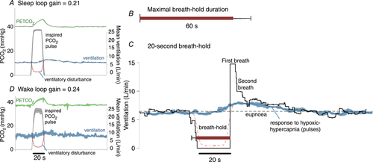
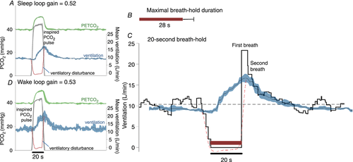
Sensitivity of controller system can also be measured with breath holds
https://physoc.onlinelibrary.wiley.com/doi/full/10.1113/JP276206
High chemoreflex sensitivity on top
Low chemoreflex sensitivity on bottom
Notes:
A – low
inspired pulses of hypoxic–hypercapnic gas (14% O₂–6% CO₂) cause an increase in end-tidal () that then elicits a chemoreflex ventilatory response. In this example, the ventilatory response is small. Traces shown are the ensemble average of multiple pulses administered during sleep (black line represents mean, coloured shading represents 95% confidence interval). Dashed red line illustrates the calculated ventilatory disturbance (i.e. the calculated drop in ventilation that would cause the observed rise in , see Sands et al. 2017b); by design, the pulse is approximately equivalent to apnoea (ventilation = 0). Loop gain is taken as the ventilatory response to this disturbance (Fourier analysis, Sands et al. 2017b). B, maximal breath-hold duration was long (60 ± 11 s, mean ± SD) in this participant (see A). C, ventilation during spontaneous 20 s breath-holds. Ventilation falls to zero and, at breath-hold termination (time = 0), there is a period of ventilatory recovery. Note the first recovery breath is much larger than subsequent breaths (15 L/min; 230% of eupnoea). The second breath is considerably smaller (10 L/min; 154% of eupnoea) and is more in line with the ventilatory response to hypoxic hypercapnia (pulses; 135% eupnoea, shown superimposed, from A). The first recovery breath was considered to be particularly influenced by factors beyond chemical stimuli. D, inspired pulses during wakefulness appear remarkably similar to those during sleep.
B- high
A, inspired pulses of hypoxic–hypercapnic gas elicit a large chemoreflex ventilatory response in this example, thus a greater value of loop gain is measured (response/disturbance). Traces shown are the ensemble average of multiple pulses administered during sleep (black line represents mean, shading represents 95% confidence interval). Dashed line illustrates the calculated ventilatory disturbance. B, maximal breath-hold duration was short (28 ± 7 s, mean ± SEM) in this participant (see A). C, ventilation during spontaneous 20 s breath-holds (ensemble average). Note the first recovery breath is larger than subsequent breaths (23.5 L/min; 229% of eupnoea). The second breath response is smaller but still high (17.5 L/min; 170% of eupnoea) and is more in line with the ventilatory response to hypoxic hypercapnia (pulses; 192% eupnoea, shown superimposed, from A). Just as seen in Fig. 2, the breaths after the first recovery breath appear consistent with the response to chemical stimuli. D, inspired pulses during wakefulness appear remarkably similar to those during sleep.

Slide 33
Breath holds
“However, the strong associations observed, by us and others (Stanley et al. 1975; Trembach & Zabolotskikh, 2017), indicate that variability in maximal breath-hold duration generally reflects variability in loop gain more than it reflects variability in the “breaking-point” (i.e. the change in chemical drive that triggers voluntary breath-hold termination)”
=> amount of desaturation depends on lung volume, position (supine vs standing = larger FRC)
Notes:
Second, it is not clear whether loop gain is a fixed underlying trait or can be confounded by concomitant alterations in airway patency, gas exchange abnormalities and sleep/wake state. Third, the impact of therapeutic intervention on loop gain are unknown
Summary of other ways to measure loop gain
Can you measure loop gain clinically?
One of the ways to talk about the impaired hypoxic or hypercapneic drive to breath in OHS is as a decrease in loop gain
-yes, methods: https://www.atsjournals.org/doi/full/10.1164/ajrccm.163.5.ed1101c
‘These findings support a role of obesity-dependent reduced lung volume and increased plant gain as a mechanism increasing loop gain in OSA patients.’ – correlated with FRC
https://www.frontiersin.org/articles/10.3389/fneur.2018.00896/full - reivew of loop gain
Loop gain increased in Obesity generally:
“in most OSA patients the main factor affecting plant gain is functional residual capacity. Reductions in lung stores of either CO₂ or O₂ will increase plant gain, because smaller tidal volumes will produce greater fluctuations in alveolar gas tensions. Thus reduced functional residual capacity increases plant gain (12, 13).“ – thus, obesity is expected to increase plant gain
12 Dempsey JA, Smith CA, Przybylowski T, Chenuel B, Xie A, Nakayama H, et al. The ventilatory responsiveness to CO₂ below eupnoea as a determinant of ventilatory stability in sleep. J Physiol. (2004) 560:1–11. doi: 10.1113/jphysiol.2004.072371
13 Khoo MC. Determinants of ventilatory instability and variability. Respir Physiol. (2000) 122:167–82. doi: 10.1016/S0034-5687(00)00157-2
But opposite in those with hypercapnia
obesity increases sensitivity to hypercapnia (44, 65), and inclusion of chronically hypercapnic patient in which CO₂ sensitivity is depressed (66).
44 Narkiewicz K, Kato M, Pesek CA, Somers VK. Human obesity is characterized by a selective potentiation of central chemoreflex sensitivity. Hypertension (1999) 33:1153–8. doi: 10.1161/01.HYP.33.5.1153
65 Yuan H, Pinto SJ, Huang J, McDonough JM, Ward MB, Lee YN, et al. Ventilatory responses to hypercapnia during wakefulness and sleep in obese adolescents with and without obstructive sleep apnea syndrome. Sleep (2012) 35:1257–67. doi: 10.5665/sleep.2082
66 Verbraecken J, De Backer W, Willemen M, De Cock W, Wittesaele W, Van de H. Chronic CO₂ drive in patients with obstructive sleep apnea and effect of CPAP. Respir Physiol. (1995) 101:279–87. doi: 10.1016/0034-5687(95)00037-E

Slide 34
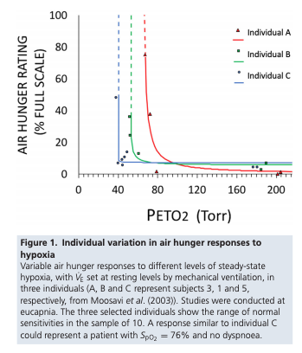
Individual Variation in ventilatory response
“Ventilatory responses vary markedly with up to 10-fold differences in isocapnic hypoxic and hypercapnic responses (McGurk et al. 1995; Swenson et al. 1995). “
Note: hypoxic vent response can take a more prominent role in altitude and chronic lung disease – but generally does not influence ventilation under normoxic conditions.
Notes:
J Physiol Silent Hypoxemia in COVID 19
Similarly, in the setting of exercise:
“For example, Sun and colleagues (23) report that the variability in the V̇ E/V̇ CO2 slope for normal-weight men and women who are similar in age to the patients in the present study is ~3.0”
Sun XG, Hansen JE, Garatachea N, Storer TW, Wasserman K. Ventilatory efficiency during exercise in healthy subjects. Am J Respir Crit Care Med 2002;166:1443–1448.
Signaling from the peripheral and central chemoreceptors in response to changes in arterial Pco₂, pH and PO₂, like that of HPV (49), varies 5-fold to 10-fold among healthy individuals (69, 70).
69 .Swenson ER, Duncan TB, Goldberg SV, Ramirez G, Ahmad S, Schoene RB. Diuretic effect of acute hypoxia in humans: relationship to hypoxic ventilatory responsiveness and renal hormones. J Appl Physiol (1985) 1995;78:377–383.Crossref, Medline, Google Scholar
70 .McGurk SP, Blanksby BA, Anderson MJ. The relationship of hypercapnic ventilatory responses to age, gender and athleticism. Sports Med 1995;19:173–183.Crossref, Medline, Google Scholar

Slide 35
What things modify the sensitivity of the control system + mechanical system?
respiratory stimulants such as medroxyprogesterone or acetazolamide (244-246). Or Almitrine (carotid chemoreceptor stimulant)
Is Acetazolamide a stimulant, or just moves the metabolic hyperbola?
https://pubmed.ncbi.nlm.nih.gov/25323235/ - acetazolamide (n=11; ΔLG -0.20±0.06, p=0.005) does change loop gain – primarily changes plant gain
O2 also changes loop gain (n=11; mean±sem change in loop gain (ΔLG) -0.23±0.08, p=0.02)
Buspirone decreases it
Opiates, sleep, analgesia decrease HCVR
The ventilatory response to CO2 is enhanced in the presence of hypoxia and/or metabolic acidosis – low pre-existing HCO3 (313)
Decreased by narcotics and sleep. Decreased by sleep deprivation (Cooper KR, Phillips BA. Effect of short-term sleep loss on breathing. J. Appl. Physiol. 1982; 53: 855–8.)
Pain does not affect the slope of the HVR and HCVR
Testosterone increased HCVR, finasteride/leurprolide decrease (https://journal.chestnet.org/action/showPdf?pii=S0012-3692%2821%2900108-2)
“Abdallah and colleagues 45 have recently shown that a single dose of fast-acting, oral morphine in dyspneic patients with COPD was associated with improvements in dyspnea (intensity and unpleasantness) and exercise tolerance but with considerable variation in response between subjects.”
Notes:
244 Skatrud JB,Dempsey JA. Relative effectiveness of acetazolamide versus medroxyprogesterone acetate in correction of chronic carbon dioxide retention. Am Rev Respir Dis 127: 405-412, 1983b.
245. Skatrud JB, Dempsey JA, Bhansali P, Irvin C. Determinants of chronic carbon dioxide retention and its correction in humans. J Clin Invest 65: 813-821, 1980.
246. Skatrud JB, Dempsey JA, Iber C, Berssenbrugge A. Correction of CO2 retention during sleep in patients with chronic obstructive pulmonary diseases. Am Rev Respir Dis 124: 260-268, 1981.
From: https://www.cell.com/neuron/pdf/S0896-6273(15)00676-5.pdf
In brief, RTN generates a considerable portion of the drive to breathe during non-REM sleep. During REM sleep, the contribution of RTN is reduced but still present, REM-off aminergic systems are generally silent, and breathing frequency is regulated by unknown mechanisms. Drugs that selectively activate RTN neurons could, in principle, be useful to treat central sleep apnea syndromes and periodic breathing that are prevalent during nREM sleep
https://pubmed.ncbi.nlm.nih.gov/25323235/ suggests acetazolamide does actually lower loop gain
More on acetazolamide: 6 . Raurich JM , Rialp G , Ibáñez J , Llompart-Pou JA , Ayestarán I . Hypercapnic respi-ratory failure in obesity-hypoventilation syndrome: CO2 response and acetazol-amide treatment eff ects . Respir Care . 2010 ; 55 ( 11 ): 1442 - 1448 .

Slide 36
How is this useful? Needs to lead to a prediction
Will supplemental O2 increase exercise capacity in non-hypoxemic COPD individuals with air trapping? (by decreasing chemoreflex sensitivity, as opposed to direct effects on hypoxia)
Yes (because it has very little to do with the PaO2 – though patients who are hypoxemic will have an especially steep HCVR curve)
Increased exercise capacity is not directly related to tissue hypoxemia.
Would other things that influence the loop gain work?
Will opiates increase exercise capacity in patients with dynamic hyperinflation? Yes (though potential to worsen hypercapnia)
Notes:
Slowing the respiratory rate thereby reduces dynamic hyperinflation-related constraints on VT, allowing a larger VT, which improves the VD/VT. Low-dose opiates also improve exercise capacity by nearly 20% in COPD patients by blunting the ventilatory reflexes to hypoxaemia and hypercapnia [100]. By limiting excessive increases in respiratory rate, opiates reduce the ventilatory demand for a given workload and reduce dynamic hyperinflation in addition to diminishing dyspnoea perception for a given V′E [100].
Citation 100 from https://erj.ersjournals.com/content/erj/51/2/1700860.full.pdf
Note:
From https://journals-physiology-org.ezproxy.lib.utah.edu/doi/pdf/10.1152/physrev.00039.2019
The surgical CB resection developed by Nakayama was extensively used in Japan from 1945 to 1960 to relieve the perception of dyspnea associated with bronchial asthma in young subjects. Nakayama (548) reported the effects of unilateral or bilateral CB resections to relieve the sensation of air hunger in a large number of patients (>3,900) with bronchial asthma.
Suspected mechanism: blocking peripheral chemoreflex response -> less hypercapnic and hypoxemic ventilatory responses. “Thus, bilateral resection of the CBs in humans resulted in a permanent elimination of the hypoxic ventilatory responses in normocapnic conditions (552).” - Since the main role played by the CB chemoreceptor in humans is to control respiratory gases, several concerns regarding the potential deleterious effect of bilateral CB ablation have been raised (354, 451, 543, 553, 554).

Slide 37
Exercise
In light aerobic exercise, the gain of the hypercapnic ventilatory reflex is unchanged (Forster et al., 2012).
Classically taught as not involving the central chemoreceptors – however, they may be involved (through non-CO2 means)
during intense anaerobic exercise, when blood lactate accumulation occurs, breathing increases even further.
VCO2 can increase 30-fold with high-intensity exercise, reflecting both the high rate of skeletal muscle CO2 production and acid titration of CO2 stores. (Comp Phys 2012) – the acidification of the tissue beds (even if not due to contraction of muscle) leads to increased mobilization of CO2 stores.
Note: sustained, and elderly this is probably lower (see calculation earlier)
Notes:
Forster, H.V., Haouzi, P., and Dempsey, J.A. (2012). Control of breathing during exercise. Compr. Physiol. 2, 743–777.

Slide 38
Exercise
Isocapneic hyperpnea: very precise regulation of Va compared to VCO2 at various work rates (and among individuals with very different body size; and, unlike O2, it does not change with age). Interestingly, this can still be achieved after denervation of carotid bodies (at least at moderate work rates) - suggesting the primary mechanism involve sensors in the lungs and central control.
1. Anticipatory, feed forward mechanism: allows increase in VA to occur prior to drop in pH (increase in CO2).
2. Muscles provide feedback (blocking muscle afferents with curare lowers Va similar to drop from intrathecal fentanyl - interestingly this blockage can improve exercise performance in those with COPD)

Slide 39
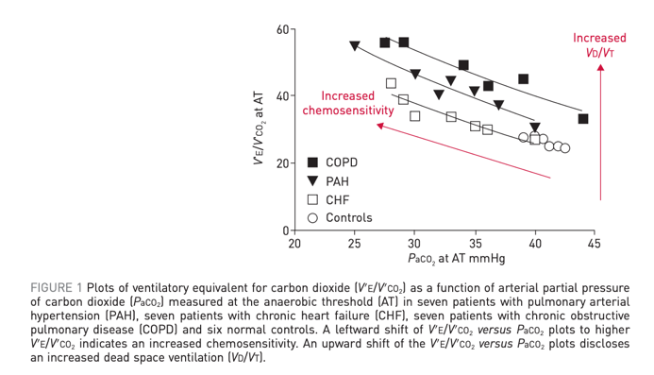
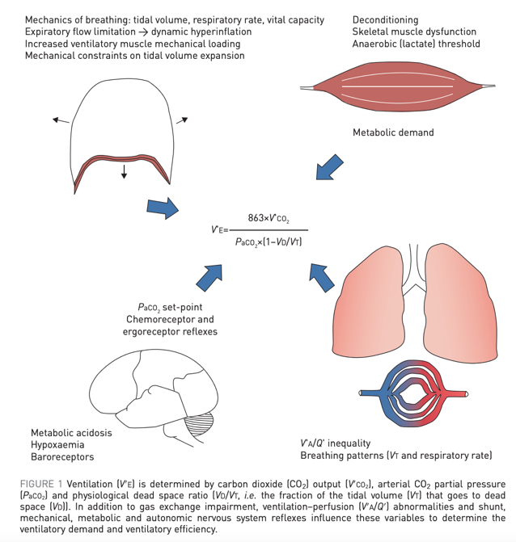
Relation of VE/VCO2 to HCVR
Exercise: depends on both metabolic drive (poorly understood) and chemical drive (aka chemoreflex from central and peripheral baroreceptors)
VE/VCO2 depends on the direction and magnitude of change in PaCO2 with increasing exercise intensity and Vd/Vt
Notes:
. If PaCO2 is driven down by a high ventilatory stimulation from sensitised peripheral chemoreceptors, baroreceptors or by ergoreceptors in skeletal muscle, the slope of the V′E/V′CO2 relationship will increase. The arterial CO2 set-point itself is influenced by factors such as metabolic acidosis, hypoxaemia, baroreceptors in the pulmonary vasculature and sympathetic nervous system hyperactivity
https://erj.ersjournals.com/content/erj/51/2/1700860.full.pdf for this whole slide
----
https://erj.ersjournals.com/content/erj/51/2/1702517.full.pdf

Slide 40
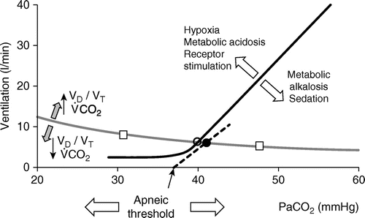
Wakefulness drive to breath
Defined in absence… the hockey stick (a maintained low level of ventilation) goes away when you go to sleep.
An increase in PaCO2 and/or hydrogen ion (with or without hypercapnia) results in an increase in the respiratory motor output (313).
The aforementioned responses to hypercapnia and hypoxemia occur in mechanically ventilated patients irrespective of whether they are awake or asleep (313). Responses to hypocapnia, however, occur only during sleep (and anesthesia) (86, 243)
Notes:
--[ ] might this have some implication to how you ventilate a patient with compensated hypercapnia?
https://www.atsjournals.org/doi/full/10.1164/rccm.201903-0596SO
243 - Skatrud JB, Dempsey JA. Interaction of sleep state and chemical stimuli in sustaining rhythmic ventilation. J Appl Physiol 55: 813-822, 1983a.
Wakefulness drive to breath = a stimulus to keep breathing at some Ve even when the CO2 is below the apneic threshold (the flat part of the hockey stick)
- It is also affected by pH and PaO2

Slide 41
How does this relate to central apneas?
Def: 10s pause. Synd requires 5+ central events /hr and 50+% of all events.
Either: high loop gain, or decreased central neuron output (e.g. narcotics/ataxic breathing - leads to decreases in HCVR)
Apneic threshold = PaCO2 below which breathing stops during sleep. ~33-35 mmHg at sea level; presumably lower at elevation
PaCO2 to terminate an apnea ~1-4 CO2 higher than PaCO2 to start an apnea
Hypoxemia (e.g. elevation, ILD) -> physiologic hyperventilation lowers the PaCO2 baseline.
As PaCO2 baseline is closer to Apneic threshold (= called the CO2 reserve), CSAs become more common.
Occurs in NREM predominantly; much less common in REM
CO2 rebreathing (increased FiCO2) will eliminate central apneas by increasing the CO2 reserve (elevating PaCO2 by Comroe’s law).

Slide 42
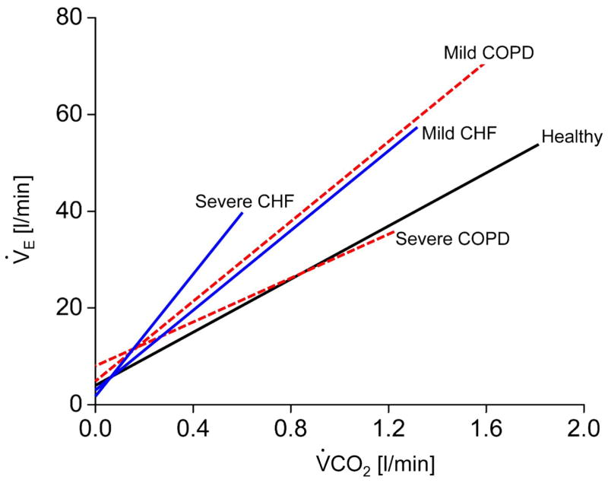
Part 2: Mechanisms of Hypercapnia
Why are patients with COPD more prone to hypercapnia than patients with CHF, despite both having poor V/Q matching and pulmonary mechanics?
CHF patients perceive an increase in VCO2 in excess of the additional Ve needed to compensate for the deadspace fraction. This also happens in mild COPD
In severe COPD, VE required and MVV are close (dynamic hyperinflation, flow limitation) and CO2 cannot be defended
Why does CO2 raise during rebreathing (increased FiCO2), but not during increases in VCO2?

Slide 43
Why might hypercapnic respiratory failure commonly result from sleep disordered breathing?
1. Loss of the wakefulness drive to breath
2. Lower chemoreflex sensitivity
Numerous studies have documented blunted responsiveness to CO2 during sleep attributable to both an increase in the set point for CO2 and to a decrease in the ventilatory response slope to increasing PCO2. 7–11 (from doi:10.1016/j.jsmc.2014.05.014 )
In addition to changes in body mechanics making the reserve smaller
This occurs first/mostly in REM (both because drive and mechanics are most altered)
REM sleep hypoventilation is the first to develop, as ventilation in this stage of sleep is dependent on only the diaphragm and the central drive to breath. (normal PaCO2 increased 4-6 mmHg)
So more properly, anything cause daytime hypercapnia is likely to show up as nocturnal hypercapnia first.
Notes:
Relation of sleep to overall hypercapneic failure: (https://onlinelibrary.wiley.com/doi/full/10.1111/resp.12376)
the main reason for the particular vulnerability to hypoventilation during sleep is that sleep is associated with diminished ventilatory drive, particularly during rapid eye movement (REM) sleep

Slide 44
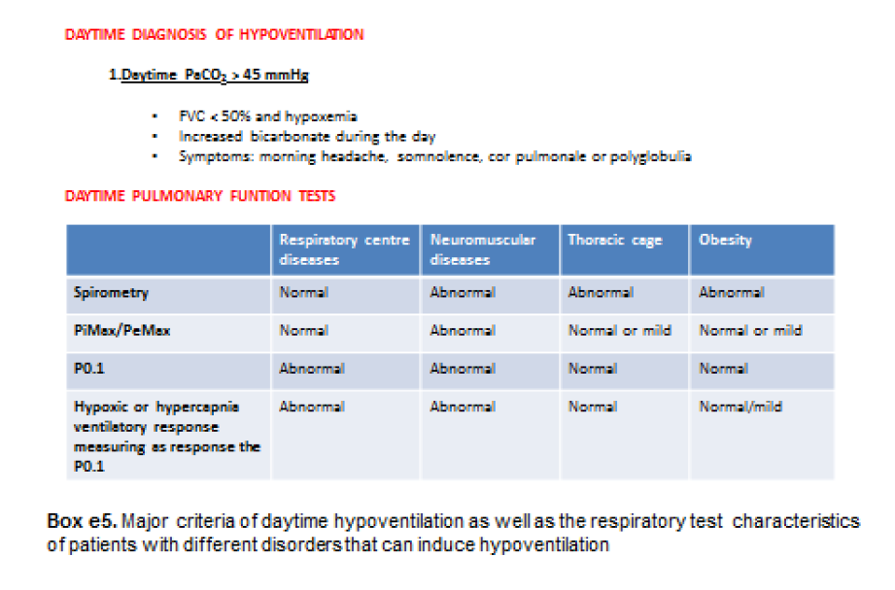
Nocturnal hypoventilation: 10 mmHg increase in PaCO2 compared to daytime.

Slide 45
OHS as a model disease

Slide 46
Rate of accumulation of CO2
--Apneic Oxygenation in Man 1959 -> rate of accumulation is 3-4 increase in mmHg per minute in the acute setting
No changes in bicarbonate (ie. this is all acute)
https://pubmed.ncbi.nlm.nih.gov/13825447/
From this, you ought to be able to calculate how long it takes to reach steady state… though Vd would change with the size of the bicarbonate buffering system.
CO2 stores - Farhi LE and Rahn H. Dynamics of changes in carbon dioxide stores. Anesthesiology 21: 604–614, 1960.
Notes:
Be used to estimate the kinetics of CO2 changes – similar to creatinine clearance (analogous to CO2 clearance in the lungs)
(with a conceptual difference being changes in production)

Slide 47
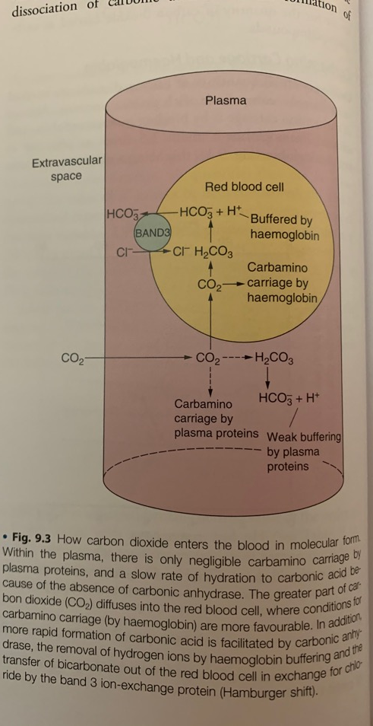
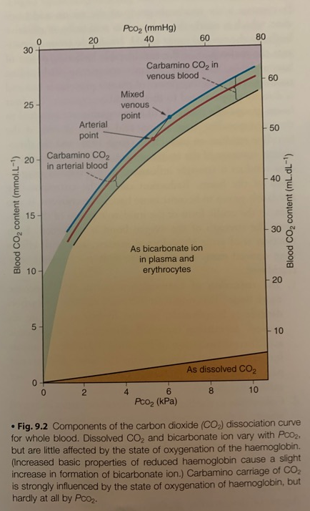
CO2 sequestration in the body:
Carried in blood as dissolved (small), carabamino compounds (some), and bicarbonate ion (majority see to the right)
Over longer term, CO2 will be sequestered in bone as CaCO3, and other tissues
120L volume CO2 (100x greater than oxygen)
Notes:
The term “serum bicarbonate” is not strictly accurate because the chemical methods measure all CO₂ liberated from the serum. Some laboratories use the more correct term “total serum CO₂” to describe measured serum bicarbonate. It is important to note that bicarbonate represents 96% of total serum CO₂, and the remainder is mostly dissolved CO₂
(From https://www.ncbi.nlm.nih.gov/pmc/articles/PMC6680300/)

Slide 48
Equilibration of PaCO2 when Ventilation changes?
Not symmetric:
Hyperventilation will lead to drop in all compartments of CO2 stores quickly
Hypoventilation – raise will be slower
T1/2 after reduction in ventilation ~16 mins; after increase in ventilation ~3 minutes
Vs 30 seconds for Oxygen

Slide 49
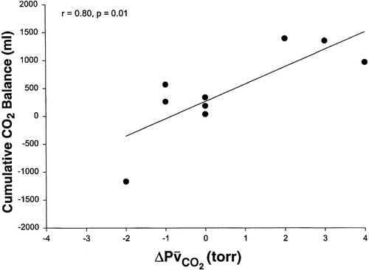
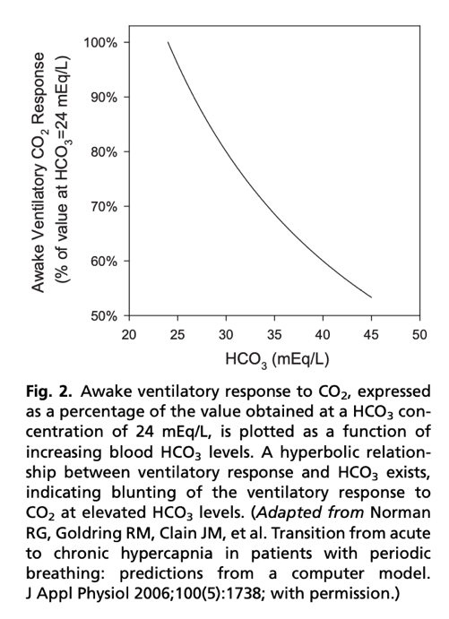
How much CO2 is ‘sequestered’? From https://doi.org/10.1152/jappl.2000.88.1.257
Notes:
Mixed venous CO2
In essence, bicarbonate generation increases the Vd of CO2 (following the creatinine anaology)
Scott’s grand rounds from April (acute breath holds)– all of those kinetics are applicable to the acute change, where there is no bicarbonate buffer.
=➔ free diving, consider bicarbonate supplementation?
From doi:10.1016/j.jsmc.2014.05.014 , summarizing the above study
when CO2 response was abnormally low, a modest rise in awake PCO2 and [HCO3] was seen over multiple days. Similarly, when renal HCO3 excretion rate was lowered to simulate chloride deficiency, the model demonstrated a modest rise in awake PCO2 and [HCO3] over multiple days, even with normal CO2 response. Significantly, the combination of low CO2 response and low renal HCO3 excretion rate produced a synergistic effect on the degree of elevation of PCO2 during wakefulness.

Slide 50
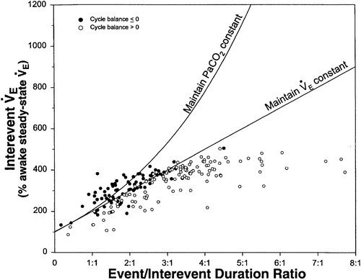
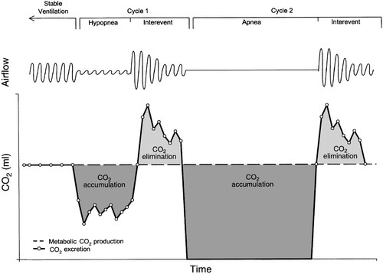
Contribution of Apneas – CO2 loading and unloading
Notes:
(this explains why CPAP works in most OHS) https://doi.org/10.1152/jappl.2000.88.1.257
No relationship was seen between the CO₂ balance for each cycle and its interevent tidal volume or interevent ventilation. Positive CO₂ balance was not associated with a low interevent ventilation and occurred despite increased interevent ventilation to rates as high as 45 l/min.’
Thus, the authors infer the pathophysiology relates to **temporal** V/Q mismatching (as apposed to the usual **spatial** V/Q mismatch), rather than overall inability to compensate.
This is why they used Mixed Venous CO2 as a check – to ensure that temporal V/Q mismatching wasn’t compensated through changes in cardiac output
As the relative duration of the event increased (increasing ratios), there was a progressive increase in the interevent ventilation to a plateau at ratios >3:1. This plateau occurred at an interevent ventilation that was 450% of the awake steady-state value and reflects the maximum ventilation achieved by any patient during the interevent periods.
=➔ this would be different in someone who has pulmonary disease (or deconditioning) – limited in ability to increase
A model has been proposed where daytime hypercapnia can develop if sleep disordered breathing duration is sufficiently long or interapnea periods too short to restore ventilation and eucapnia (Berger et al., 2000). Berger and colleagues have suggested that gradual elevations in CO₂ occur over time since the ventilatory response to hypercapnia is insufficient compared to the rise in CO₂ which occurs during sleep.

Slide 51
CO2 loading and abnormal HCO3 handling
Transient CO2 load during apneic/hypopneic events -> kidneys retain HCO3
HCO3 excretion is slower than PCO2 – will persist into the day
If CO2 Loading/HCO3 retention is severe enough (or retention disordered) that it is not fully normalized, persistent HCO3 retention (met alkalosis) occurs
Excess HCO3 decreases the HCVR (change in PCO2 leads to buffered change in H+ CSF) -> hypoventilation and hypercapnia during the day.
How many patients with a diagnosis of OHS are on loop diuretics? How many were started on loop in the year preceding diagnosis?
Notes:
Might it be better to think about this as the spectrum of disease associated with nocturnal CO2 loading and impaired ventilatory responses, of which obesity (in exclusion, as in OHS) represents 1 end of the spectrum – but heart failure, diuretics, opiates, obstruction, etc. also likely do as well.

Slide 52
Inter-apneic periods insufficient to unload the large amount of CO2 produced and retained during apneic periods (Ayappa I, Berger KI, Norman RG, Oppenheimer BW, Rapoport DM, Goldring RM. Hypercapnia and ventilatory periodicity in obstructive sleep apnea syndrome. Am J Respir Crit Care Med. 2002;166(8):1112-1115.)
-> thus, apneas -> CO2 sequestering. Inter apnea ventilation has to increase (which will be limited by the constraints of the respiratory system and the temporal V/Q mismatching)

Slide 53
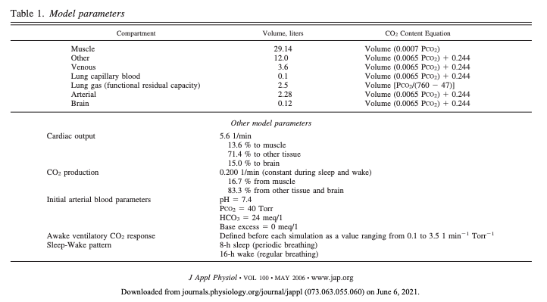
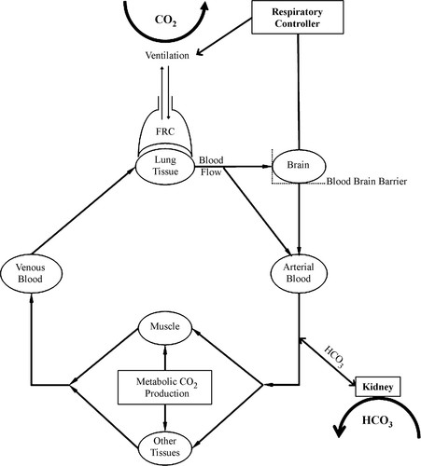
How does acute become chronic?
Notes:
https://journals.physiology.org/doi/full/10.1152/japplphysiol.00502.2005
Schematic of the model used in the simulations. Briefly, CO₂ produced in the tissues is circulated to the lung on the basis of partial pressures and storage capacities of the various compartments. In the lung, CO₂ is removed by ventilation, which is controlled by the respiratory controller responding to the pH of the brain compartment. Arterialized blood leaves the lung and returns to the tissue and the kidney, where bicarbonate (HCO₃⁻) transfer occurs. HCO₃⁻ is transferred on the basis of a target pH and the current Pco₂ according to a specified time course. FRC, functional residual capacity.
‘’
(The CO2 kinetics of the above model was validated at: Rapoport DM, Norman RG, and Goldring RM. CO₂ homeostasis during periodic breathing: predictions from a computer model. J Appl Physiol 75: 2302–2309, 1993
In terms of timing – the model reached steady state within 3 weeks
These simulations suggest that chronic hypercapnia could develop if either:
There is impaired ability to excrete bicarbonate – (diuretics could do this?)
Low hypercapic drive to ventilate (ventilatory CO2 response)
(or both)
In sum: An inciting acute ventilatory event, such as apnea or hypopnea, causes a transient increase in Pa_{co2}. Patients with an adequate and immediate ventilatory response sufficient to maintain the average Pa_{co2} at 40 Torr will show no net change in total tissue CO₂ stores and will therefore remain eucapnic (4). In contrast, patients with inadequate interapnea unloading of CO₂, due either to blunting of the interapnea ventilatory response (3) or to limitation of the interapnea duration relative to duration of apnea (1), will demonstrate a progressive rise in Pa_{co2} over subsequent events with compensatory renal bicarbonate retention
The role of bicarbonate handling in this is supported by the same evidence arguing for including HCO3 27 in the definition: Should bicarb 27 be used? (also can be quantified as base excess over 2 mmol/l - In this prospective observational cohort study, we have demonstrated that obese subjects with a raised BE, but with a normal daytime Pa co 2 , have a ventilatory response between those of normal obese subjects (with-out evidence of awake hypoventilation) and those with hypercapnia and, thus, conventionally defi ned OHS.
https://www.atsjournals.org/doi/full/10.1513/AnnalsATS.201508-563OC also discusses empirical support for the role of both of these physiologic traits.
Reportedly it takes hours for the muscle compartment to equilibrate

Slide 54
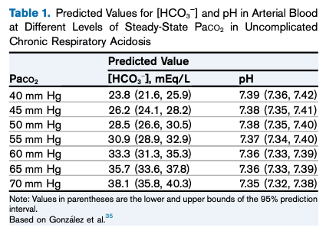
HCO3
3-5 days to reach steady state metabolic compensation in dogs; unknown time in humans
Acute: 0.1 mEq/L per 1 mmHg – modified some by pre-existing degree of HCO3. Not dependent on kidney
Chronic: 1960s – 0.35 to 0.4 mEq/L per 1mmHg Co2 increase; 0.48 - 0.51 mEq/L per 1mmHg more recently; depends on renal function.
Summarized in doi: 10.1053/ j.ajkd.2019.05.029
Notes:
The anticipated effect of an NaHCO3 load of 1 mmol per kilogram of body weight is an increase in plasma [HCO3 − ] of w2 mEq/L if bicarbonate space is 50% of body weigh

Slide 55
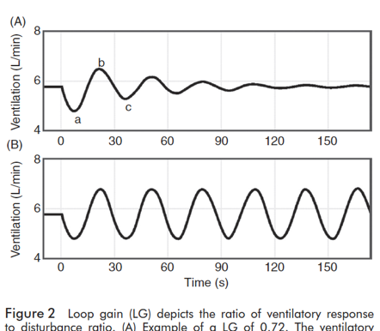
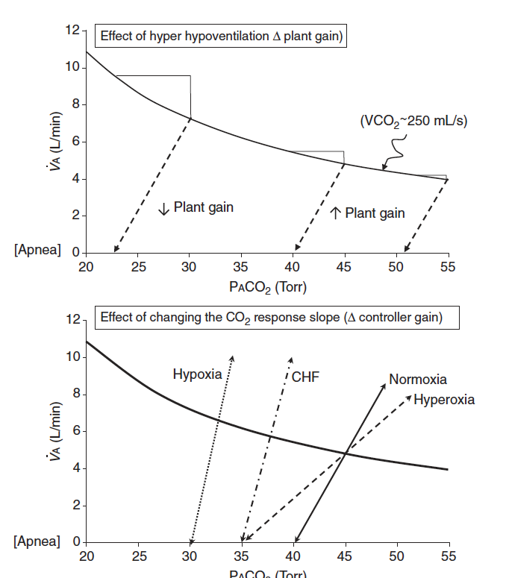
Does the PaCO2 ‘set-point’ change?
For example, in OHS:
Loop gain terminology primarily describes tendency toward stability of ventilation. ‘Gain’ of the feedback loop.
Controller gain: ventilatory response to PO2 and PCO2 )
Plant gain: changes in pulm capillary blood PO2 and PCO2 in response to changes in vent
Mixing gain: effective circulation time – time which cap blood changes are sensed by controller
Many changes are known to influence chemoreflex sensitivity
Ventillatory long-term facilitation is the process that should keep things on track
Ventilatory long-term facilitation is the term for adaptation to chronic stimulus (ie. sustained hypercapnia should increase loop gain to re-establish a baseline, and if this goes wrong you get a ‘wandering baseline’)
Notes:
Although ventilatory LTF has not been reported as such in OSA patients, when compared to age, sex and BMI matched non-OSA participants, untreated OSA patients exhibit a reduced P_{ET}CO₂, reduced CO₂ reserve and increased CO₂ sensitivity below eupnea, which reflects the expression of ventilatory LTF and ventilatory feedback (47, 55). Following CPAP treatment P_{ET}CO₂ and the CO₂ reserve increased in the OSA patients, further supporting the possible presence of ventilatory LTF in untreated OSA patients (47).
https://www.frontiersin.org/articles/10.3389/fneur.2018.00896/full
47 - Salloum A, Rowley JA, Mateika JH, Chowdhuri S, Omran Q, Badr MS. Increased propensity for central apnea in patients with obstructive sleep apnea: effect of nasal continuous positive airway pressure. Am J Respir Crit Care Med. (2010) 181:189–93. doi: 10.1164/rccm.200810-1658OC
55 - Chowdhuri S, Shanidze I, Pierchala L, Belen D, Mateika JH, Badr MS. Effect of episodic hypoxia on the susceptibility to hypocapnic central apnea during NREM sleep. J Appl Physiol. (2010) 108:369–77. doi: 10.1152/japplphysiol.00308.2009
Not clear that it really does ’reset’ so much as never able to compensate (by the modeling done in the next set of slides).
Perhaps this is different with Opiates, oxygen, etc.

Slide 56
1963 - Operation Hideout
21 sailors breathed normal atmosphere for 9 days, then 42 days of 1.5% (FiCO2 0.015; normal is 0.0004)
Alveolar CO2 increased, renal compensation occurred by 24 days. Ventilation changes?
Burgraff et al 2018 (https://pubmed.ncbi.nlm.nih.gov/30211447/) – reduction in cognitive performance throughout the 30 days of hypercapnia (6% FICO2), PaCO2 to 55, higher ventilation – transient increase in chemoreflex, then return to normal
Notes:
For example, due to limitations in CO₂ scrubbing technology, astronauts on the ISS are chronically exposed to 0.005–0.008 (0.5–0.8%), ∼10–20 times higher than earth, with allowable transient (∼1 h) increases in as high as 0.02 (2%; Law et al. 2014).
From Burgraff:
Figure 13. Proposed mechanism(s) accounting for the shift in ventilatory set-point during 30 days of exposure to 6% InCO2 The shift in ventilatory set-point may involve either presynaptic and/or postsynaptic mechanisms. A, the proposed presynaptic mechanism involving both tonic and phasic chemosensitive input into a respiratory motor neuron. Under eucapnic conditions, the primary input onto the respiratory motor neuron is from tonic presynaptic chemosensitive input. During acute hypercapnia, input from the tonic presynaptic input is elevated, alongside increased input from the phasically chemosensitive presynaptic neuron. During chronic hypercapnia, the phasically active chemosensitive input is silenced, whereas elevated input from the tonic chemosensitive presynaptic neuron is maintained. B, the alternative postsynaptic mechanism accounting for a shift in the ventilatory set-point during chronic hypercapnia. In this schematic, there is the presence of both tonically active and phasically active receptors upon the postsynaptic membrane of a respiratory motor neuron. Under eucapnic conditions, activity from the presynaptic chemosensitive neuron activates the tonically active receptors upon the postsynaptic membrane of the respiratory motor neuron. However, during acute hypercapnia, there is both elevated activity of the tonically active receptors, and contribution from the phasically active receptors. During chronic hypercapnia, the phasically active receptors are silenced, whereas activity from the tonically active receptors is maintained at an elevated level.

Slide 57
Submarines and Space Shuttles
Until the advent of nuclear submarines, atmospheric regulation limited duration of submersibles (e.g. Diesel uses O2 combustion).
Now, can keep at 0.5 to 1.5% CO2 with molecular sieves (think Styrofoam that holds the CO2, then can be flushed outside the vessels)
1% atmospheric CO2 increased inspired PCO2 7.5 mmHg and increased Ve 2-3L/min., with lots of variability. – but after a few days the increased ventilation declines and Ve returns to normal – PCO2 increases to reflected the increased inspired CO2. – believed to reflect attenuation of the central chemoreceptor response
Notes:
NOTE: still not clear to me what method of ‘long-term’ control there is to keep the set point from creeping to 40 to 50 to 60 etc.

Slide 58
Chronic hypercapnia by inspired CO2
At 1.5% CO2 inspired, kidneys able to normalize pH. Though paCO2 level increases
At 3.0% and 6%, kidneys are only able to partially compensate, even after 30 days
Bicarbonate excretion in urine was undetectable for 7 days after returning to room air -> suggesting maximal retention was ongoing to coordinate.
Notes:
34. Schaefer KE, Hastings BJ, Carey CR, Nichols G. Respiratory acclimatization to carbon dioxide. J Appl Physiol 18: 1071–1078, 1963. doi:10.1152/jappl.1963.18.6.1071.
35. Burgraff NJ, Neumueller SE, Buchholz K, Langer IIT, Hodges MR, Pan L, Forster HV. Ventilatory and integrated physiological responses to chronic hypercapnia in goats. J Physiol 596: 5343– 5363, 2018. doi:10.1113/JP276666.
36. Crosby A, Talbot NP, Balanos GM, Donoghue S, Fatemian M, Robbins PA. Respiratory effects in humans of a 5-day elevation of end-tidal PCO2 by 8 Torr. J Appl Physiol 95: 1947–1954, 2003. doi:10.1152/japplphysiol.00548.2003.
37. Schaefer KE. Atmung und Saure-Basengleichgewicht bei langdauerndem Aufenthalt in 3% CO2. [Breathing and acid-base equilibrium in the case of long-term stay in 3% CO2]. Pflugers Arch 251: 689–715, 1949. doi:10.1007/BF00361640.

Slide 59
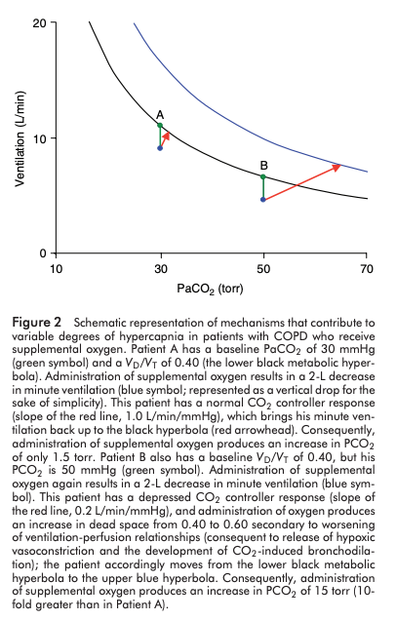
‘CO2 Clearance’
Analagous to creatinine kinetics
Urine volume : VE (exhaled volume)
[U_cr] : FExhaled CO2
Implication: the further down on the ventilation axis or right on the PaCO2 axis you are, the larger the change in CO2 that will occur from a given change in Ve
similar to sCr 5 not being much diff than 6, 70 not much different than 80 as PaCO2 (just faster)
However, due to Dalton’s Law (Alveolar partial pressures), this will STILL have a large impact on hypoxemia – linear relationship described by P_{A}O₂ = FiO₂ (P_{B}-47)—(PaCO₂/R)
Or a smaller change in, say, deadspace leads to a bigger overall change in CO2 excretion
Thus, something that changes the HCVR will have a larger impact on CO2 in someone with a higher baseline CO2
Clinical implication: Susceptibility to ’exacerbations’ with a perturbation in the controller system or the respiratory systems ability to respond
Notes:
RESEARCH QUESTION: how often are acute hypercapneic ABGs at least partially compensated? (or known to be via prior bicarbonates)
'Kinetics' will be the same, but faster. Implication, similar to sCr 5 not being much diff than 6, 70 not much different than 80 as PaCO2
The above mentioned changes in the respiratory control system of OHS patients make them more vulnerable to acute deterioration of their ventilatory systems when faced with new insults, such as chest infection or mild worsening of cardiac function. This makes OHS patients more susceptible to acute ventilatory failure [126,154].
126. BaHamman A: Acute ventilatory failure complicating obesity hypoventilation: update on a ‘critical care syndrome’. Curr Opin Pulm Med 2010, 16:543–551.
154. Rabec C, de Lucas RP, Veale D: Respiratory complications of obesity. Arch Bronchoneumol 2011, 47(5):252–261.

Slide 60
Hypercapnia: indicates frailty of the respiratory system
Distance between ‘MVV’ and Ve required = strength of the control system to resist a stressor.
Might this be a metric of ‘frailty’ of the control system? – less reserve in respiratory system = more prone to this
Returning to the reason why we don’t live at PaCO2 70 and HCO3 44: there is only so much space in an alveoli – and already 79% of inhaled air is N2)
Converse situation of why it is advantageous to develop methods to hyperventilate at altitude: allow more room in the alveoli for oxygen = greater buffer.
Protective effect from hypercapnia? 10.1016/j.jcrc.2017.04.033 – acute respiratory failure (probably not – table 2 fallacy)
Notes:
Javaheri chapter.
based on Dalton’s law, a high PaCO2 imposes a low PaO2. Thus, perhaps the degree of N2 in the air (and thus, the pO2) provides the limit - the lower the CO2 set-point, the more O2 we have available but the higher work of breathing.
(Relatedly, the pH 7.4 in the blood seems to correspond ~6.8 intracellular pH, which is also the pKA of H2O - perhaps maximizes enzyme function?)

Slide 61
Resp System Frailty increased at altitude
CO2 above ~83 mmHg displaces O2 on room air down to ~20 mmHg PaO2 = lower limit of life
PaO2 = FIO2*(Patm-Pb) – (PCO2/R), thus for R 0.8, PaO2 will drop by 1.25 for each CO2 rise.
Thus, any CO2 higher than this must be artificially supported by supplemental oxygen.
Severe hypercapnia REQUIRES O2 to be administered.
Blue line being at elevation
At elevation, hypercapnia ought to be more apparent, because it will show up as hypoxemia faster
How much O2 should it take to fix?
Notes:
[ ] redo this calculation to find details of when exactly it ought to show up
653 mmHg in SLC today
Age / 4 = normal A-a.
653-43 = 610 * 21 = 128.
Normal A-a, say 15.
PaCO2 / 0.8 = 53… 43.
Thus, for a 60 year old, CO2 higher than 43 will lead to decrease in O2 enough for detectable changes in PaO2.
The anticipated effect of an NaHCO3 load of 1 mmol per kilogram of body weight is an increase in plasma [HCO3 − ] of w2 mEq/L if bicarbonate space is 50% of body weigh

Slide 62
“ submissive hypercapnia, an intelligent brain strategy to conserve the work of breathing when restoration of normocapnia becomes difficult or impracticable because of ventilatory or gas exchange limitations.”
https://www.ncbi.nlm.nih.gov/pmc/articles/PMC4568120/
Patients with milder COPD/CHF have ventilatory insufficiency and increased drive to breath that maintains eucapnia – what changes as disease worsens?
Respiratory controller “say’s uncle” when faced with insurmountable ventilatory limitation – tolerate hypercapnia when difficult to restore normocapnia due to ventilatory or gas exchange limitation
Notes:
From: https://www.atsjournals.org/doi/full/10.1513/AnnalsATS.201701-016FR
“Respiratory acidosis occurs either in the setting of suppression of respiratory drive (“won’t breathe”) or with a mechanical impediment to ventilation (“can’t breathe”) (58). Patients who “won’t breathe” have a reduced drive to breathe due to alkalemia or an abnormally low intrinsic respiratory drive, such as in obesity-hypoventilation syndrome or with respiratory depressant medications. In these patients, stimulants have a proper role to play. In contrast, patients who “can’t breathe” have mechanical impairment arising from severe obstructive, neuromuscular, or restrictive disease. They retain CO₂ because they have limited or no capacity to increase ventilation or the cost of doing so is too stressful or inefficient. In fact, “submissive hypercapnia” is not an unreasonable strategy when one cannot increase ventilation or it is too costly in metabolic terms (59). As long as arterial oxygenation can be maintained with supplemental oxygen, this strategy permits the patient to exhale more CO₂ per breath and maintain steady-state CO₂ elimination at lower metabolic expense.”

Slide 63
Clinical implication
Recurrent ‘exacerbations’ likely
How often are these admissions ‘acute on chronic’ by ABG?
How often are A-a gradients ‘normal’?
Quantifying the morbidity associated with respiratory failure at different elevations?

Slide 64
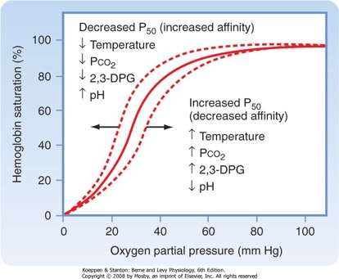
Symptoms of hypercapnia?
CO2 narcosis occur when CO2 rises above 90-120 mmHg
However, because it is not as lipid soluble as other compounds (e.g. N2) – the effects seem to be more closely mediated by intracellular pH, cerebral blood flow, metabolic processes than ‘narcosis’ in the same way.
Causes hypoxemia by a few mechanisms
Dalton’s law and alveolar oxygen displacement
Moves O2-Dissociation curve to the right
Changes V/Q matching (e.g. increased pulm artery pressure)
HA (HA correlated with FiCO2 on international space station https://pubmed.ncbi.nlm.nih.gov/24806559/)
Notes:
To what extent is the ‘normal A-a gradient’ hypoventilation ABG a myth?

Slide 65
Occupational Exposure Limits CO2
Outdoors: 420 ppm (0.042%)
Indoors (typically) 1,000 ppm (0.1%)
Cognitive function ~900 – 1400 pp (Jasen Allen, Pilots)
8-hour OEL 5,000 ppm (0.5%)
20,000 ppm (2%) – headache, dyspnea on exertion
15-minute 30,000 ppm (3%) OEL (leads to increased ventilation, weakly sedating, autonomic signs)

Slide 66
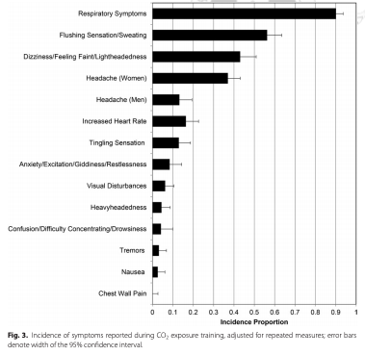
Hypercapnia symptoms in NASA experiments
Healthy astronauts rebreathe up to 8% (60mmHg) CO2 to be familiar with the symptoms

Slide 67
Hypoxemia due to hypoventilation
Thought of analogous to breath holding – degree of hypoxemia with sleep apneas depends on lung volume, blood O2/CO2 level at onset, and ability to ventilatory load compensate between apneas.

Slide 68
OHS pathophysiology – not all mechanical
Patients with OHS can achieve eucapnia during voluntarily hyperventilation, implying that impairments in respiratory system mechanics alone do not explain the hypoventilation [86].
Only 50% of those BMI 50+ manifest abnormalities in PaCO2
Not all mechanical. Also, obesity has only mild affect on lung mechanics (except ERV)
Yet, Chest wall restriction (via VC), BMI, and severity of OSA are all independent predictors. ERS suggests screening with "FVC <50% and venous bicarbonate >27 mmol (A)."
Notes:
The decrease in ventilatory response is attributed to an inadequate increase in tidal volume as a result of a blunt neural response to hypercapnia [73,95]
The hypoxic ventilatory response is also blunted in subjects with OHS. This abnormality is however not familial and improves with treatment as well [132,133]. Alterations in ventilatory
responsiveness are also not as homogenous as initially thought [132] and are related to the daytime vigilance [134]. Individuals with low HCVR exhibit more daytime sleepiness, which is directly related to a higher percentage of REM sleep spent in hypoventilation [134]. A lack of relationship between BMI, HCVR and plasma bicarbonate was reported by Raurich et al., and with PaCO2 by Kessler et al., which might indicate on the other hand that obesity acts as a trigger toward hypoventilation in those patients who already have physiological abnormalities [54,135]. Gas exchange abnormalities will initially be confined to REM sleep, but over time buffering of the raised carbon dioxide produces a secondary depression of respiratory drive that will further reduce ventilation not only during sleep but during wakefulness as well [82].
50% of BMI over 50 have abnormalities. (?in spirometry?)
Jones RL, Nzekwu MM. The effects of body mass index on lung volumes. Chest 2006;130:827–833.
Patients with OHS have lower vital capacity, total lung capacity and expiratory reserve volume compared to eucapnic obese patients
Determinants of hypercapnia in obese patients with obstructive sleep apnea: a systematic review and metaanalysis of cohort studies.
Kaw R, Hernandez AV, Walker E, Aboussouan L, Mokhlesi B
Chest. 2009 Sep; 136(3):787-796.
https://pubmed.ncbi.nlm.nih.gov/19567489/
86: Leech J, Önal E, Aronson R, Lopata M: Voluntary hyperventilation in obesity hypoventilation. Chest 1991, 100:1334–1338.
Patients who are morbidly obese (BMI ≥40 kg/m²) have increased respiratory rates as compared with normal subjects. In four studies, the mean respiratory rate of obese subjects ranged from 15.3 to 21 breaths per minute, while that of normal subjects ranged from 10 to 12 breaths per minute.²⁻⁵

Slide 69
Even spirometry abnormalities are not mech
Lung function impairment was associated with metabolic syndrome (prevalence = 15.0%) independently of age, sex, smoking status, alcohol consumption, educational level, body mass index, leisure-time physical activity, and cardiovascular disease history (odds ratio [OR] [95% confidence interval], 1.28 [1.20-1.37] and OR, 1.41 [1.31-1.51] for FEV(1) and FVC, respectively)
https://pubmed-ncbi-nlm-nih-gov.ezproxy.lib.utah.edu/19136371/
Fine print: appears that abdominal adiposity is -> perhaps this is the ‘mechanism’
Notes:
Overview of problems with BMI- https://pubmed-ncbi-nlm-nih-gov.ezproxy.lib.utah.edu/22485140/ - differential misclassification in women

Slide 70
Pathogenesis:
Increased metabolic burden (VCO2) of obesity, and mechanical loads are pre-requesite (necessary) pathophysiologic changes.
However, diminished ventilatory response to hypercapnia discriminates between very obese patients with and without hypercapnia, thus seems to be a required piece to develop the syndrome
or a result of another causally related process – such as bicarbonate retention.
Supporting evidence: the VE/VCO2 slope is decreased during exercise is morbidly obese men and women and is accompanied by signs of ventilatory limitation during exercise (increased PETCo2 at vent threshold) -> decreased ventilatory response - https://www.atsjournals.org/doi/pdf/10.1513/AnnalsATS.202006-746OC
Notes:
Nevertheless, it is well known that obesity presents a mechanical load to the thorax, and it is certainly possible that the progressive reduction in the V̇ E/V̇ CO2 slope could reflect various degrees of obesityrelated mechanical ventilatory constraints. Indeed, Zavorsky and colleagues (38) previously demonstrated that a blunted ventilatory response to exercise was reversed in individuals with morbid obesity after a period of weight loss over 2.5 months (z21 kg).
We demonstrated that despite an increase in ventilatory drive (via inspired CO2), it was only by alleviating mechanical ventilatory constraints via breathing a lowdensity gas mixture (i.e., heliox) that subjects could increase their ventilatory response to exercise (albeit above the VTH) (40, 41)

Slide 71
Work of breathing in obesity
VO2 declines 16% in obese vs <1% in lean when sedated/paralyzed (=estimate of work of breathing). 5:
FRC decrease (increased WOB due to ventilating on less compliant portion of P-V curve) seen in Kg to CM ratio > 0.7
Tidal expiratory flow-limitation -> air trapping
This occurs to some extent in all obese patients: the normal response is increased HCVR to maintain eucarbia despite the excess load.
Explains why HCVR response might lead to OHS but not lead to hypercapnia in normal weight individuals
Notes:
Summarized at: https://onlinelibrary.wiley.com/doi/full/10.1111/j.1440-1843.2011.02124.x

Slide 72
Drive to breath in OHS
VO2 and VCO2 increase in obesity – similarly, the drive to breath (HVS and HVCPs) increase (by P0.1/Pimax) in eucapnic obese patients (and goes back to normal with weight loss).
In OHS, it appears that this increase in drive to breath does not occur for unknown reasons.
This may occasionally be mediated by the increase bicarbonate (from chloride depletion). An open question: how often are patients who are obese but eucapneic (or more properly, just nocturnal hypercapnia) started on loop diuretics, and then subsequently found to have ‘obesity hypoventilation’?
May have to do with leptin signaling – known to cause satiety and central resp stimulation – thus resistance may relate to obesity and decreased HCVR
Notes:
Why do some patients develop hypoventilation disorders while others do not? Several studies suggest that hypercapnic ventilatory response, i.e., the increase of ventilation to a given level of hypercapnia, can discriminate patients with OHS from those with nonhypercapnic OSA (11). It is unknown whether the reduced hypercapnic ventilatory response is caused by a reduced sensitivity of the chemoreceptors, a blunted brain stem reaction, or an impairment of the executive muscles.
However, the diminished response to hypercapnia suggests that the metabolic burden of obesity and its mechanical load on the upper airways are prerequisites of OHS, but hypercapnic ventilatory response is responsible for differences between patients with obesity with and without OHS.
[x] Javaheri S, Simbartl LA. Respiratory determinants of diurnal hypercapnia in obesity hypoventilation syndrome: what does weight have to do
with it? Ann Am Thorac Soc 2014;11:945–950.“
The possibility that chronic hypoxemia contributes to respiratory muscle dysfunction that leads to diurnal hypercapnia in OHS was recently laid to rest by Hollier et al.^{[35▪]} who demonstrated worsening PaCO₂ in patients treated with oxygen alone.
Hollier CA, Harmer AR, Maxwell LJ. Moderate concentrations of supplemental oxygen worsen hypercapnia in obesity hypoventilation syndrome: a randomized crossover study. Thorax 2014; 69:346–353
Hypercapnic patients were found to have an abnormally high work of breathing both sitting and supine, awake and asleep, compared to eucapnic patients with OSA
Work of breathing in eucapnic and hypercapnic sleep apnea syndrome.
Lee MY, Lin CC, Shen SY, Chiu CH, Liaw SF
Respiration. 2009; 77(2):146-53.
Obesity is normally associated with increased respiratory drive which helps to maintain eucapnia (Steier et al., 2009). Patients with OHS, however, fail to exhibit this augmented drive and ventilatory responsiveness to hypoxia and hypercapnia (Piper and Grunstein, 2011; Sampson and Grassino, 1983; Zwillich et al., 1975).
Leptin resistance theory:
Hyperleptinemia has been associated with a reduction in respiratory drive and hypercapnic response in obese individuals, irrespective of the amount of body fat (Campo et al., 2007).
“Leptin, a pleiotropic peptide hormone mainly secreted by adipocytes, acts on the hypothalamus to regulate energy metabolism, food intake, and satiety (534). In addition, leptin is a potent breathing stimulant, acting mainly on the central nervous system but also at the level of the CB (for a recent review see Ref. 535).” from https://journals-physiology-org.ezproxy.lib.utah.edu/doi/pdf/10.1152/physrev.00039.2019

Slide 73
Hypothesized that lack of increase in respiratory drive increases risk of developing hypercapneic respiratory failure when load increases
Decreased HCVR not inherited (same in 1st degree rels - Jokic R, Zintel T, Sridhar G et al. Ventilatory responses to hypercapnia and hypoxia in relatives of patients with the obesity hypoventilation syndrome. Thorax 2000; 55: 940–5.)
A useful bedside test is to show that the patient voluntarily can easily and rapidly hyperventilate and within a minute normalize oxygenation and produce a PCO2 below 40 mm Hg.28 = Leech J, Onal E, Aronson R, Lopata M. Voluntary hyperventilation in obesity hypoventilation. Chest 1991;100:1334– 1338

Slide 74
Does hypercapnic respiratory failure ever occur before steady state hypercapnia develops?
In a large study of patients with OSAS, Laaban and Chailleux found 11% to be hypercapnic. Risk factors for hypercapnea in this study included higher BMI and reduced FVC
Though 7.2% of hypercapneic OSAS had BMI < 30. COPD was excluded.
BMI, VC, PaO2 only explain <10% PaCO2 variance.
Laaban JP, Chailleux E. Daytime hypercapnia in adult patients with obstructive sleep apnea syndrome in France, before initiating nocturnal nasal continuous positive airway pressure therapy. Chest 2005; 127: 710–15.

Slide 75
ERS defines 4 stages of obesity hypoventilation
0. Pure OSA (no hypoventilation)
1. Obesity sleep related hypoventilation - with morning=evening, with normal bicarbonate (<27) during the day
2. Obesity sleep related hypoventilation - with morning worse than evening, with abnormal bicarbonate (27+) during the day – CO2 not fully breathed off during inter-event period
2b. Awake base excess – HCO3 retention that occurs through the night not fully reversed
3 and 4. Awake hypoventilation / elevated PaCO2 – with our without comorbidity
Increased HCO3 lowers HCVR and causes frank hypoventilation.
Note: one unknown is whether Loop diuretics push patients from stage 2 to 3 to 4. Study idea: how many at each phase are on diuretics?
➔ research question: how many patients who have elevated bicarbonate do, actually, have transient nocturnal hypoventilation? This would be easily answerable with a cohort of newly diagnosed patients with HCO3 over 27 who prospectively add on TcCO2 and see how many have 10 mmHg increases in CO2.
Notes:
From: https://www.ncbi.nlm.nih.gov/pmc/articles/PMC3871022/
“However, should the CO2 level rise further, elevated bicarbonate level will blunt the ventilatory response to CO2 by reducing the change in pH associated with the change in CO2, and the chemosensory stimulus will be less for any given change in the level of CO2 [170]. This would ultimately result in a higher wake CO2 level [113,168]. In a recent study it was confirmed that patients with higher bicarbonate concentration had a more blunted CO2 response [135]. The development of decreased central respiratory drive and/or the greater ventilatory limitations imposed by more extreme central obesity may initiate the acute failure to compensate for OSA, but only if the renal compensatory mechanism is impaired [100,171]. In other words, whether or not daytime chronic hypercapnia develops depends on the individual’s ability to unload both CO2 and bicarbonate during the waking period [168].
From: doi: 10.1097/MCP.0000000000000210
Over the last 30 years, the group at New York University has published a compelling series of studies making the case that nocturnal hypercapnia and compensatory increases in bicarbonate, developing as a result of reduced nocturnal CO₂ clearance, play a major role in the pathogenesis of OHS ^{[26–32]}. These investigations included the seminal finding that effective treatment of OSA associated with OHS can ameliorate diurnal hypercapnia ^{[26]}. Computer modeling subsequently demonstrated a temporal mismatch between CO₂ presentation at the alveolar/capillary interface because of periodic breathing that results in reduced CO₂ elimination ^{[27]}, and human studies confirmed that inter-event hyperventilation may not, in some patients, be of sufficient magnitude to maintain CO₂ homeostasis, thus leading to rising levels of PaCO₂ during the course of a night ^{[28–30]}. The combination of episodic (apnea/hypopnea related) and/or prolonged (hypoventilation related) nocturnal hypercapnia ^{[31]} stimulates renal reabsorption and generation of bicarbonate each night, which cannot be entirely eliminated during the course of each successive day ^{[32]}. Presumably, this process is made even worse by the increased CO₂ production in these patients already mentioned ^{[4▪▪]}. A sustained elevation of serum bicarbonate ensues, increasing CO₂ buffering capacity, attenuating the fall in cerebrospinal fluid pH that would normally result from hypercapnia and blunting the hypercapnic ventilatory response leading to diurnal hypercapnia
26. Rapoport DM, Garay SM, Epstein H, Goldring RM. Hypercapnia in the obstructive sleep apnea syndrome: a reevaluation of the ‘Pickwickian syndrome’. Chest 1986; 89:627–635.
27. Rapoport DM, Norman RG, Goldring RM. CO₂ homeostasis during periodic breathing: predictions from a computer model. J Appl Physiol 1993; 75:2302–2309.
28. Berger KI, Ayappa I, Sorkin IB, et al. CO2 homeostasis during periodic breathing in obstructive sleep apnea. J Appl Physiol 2000; 88:257–264.
29. Berger KI, Ayappa I, Sorkin IB, et al. Postevent ventilation as a function of CO₂ load during respiratory events in obstructive sleep apnea. J Appl Physiol 2002; 93:917–924.
30. Ayappa I, Berger KI, Norman RG, et al. Hypercapnia and ventilatory periodicity in obstructive sleep apnea syndrome. Am J Respir Crit Care Med 2002; 166:1112–1115.
31. Berger KI, Ayappa I, Chatr-Amontri B, et al. Obesity hypoventilation syndrome as a spectrum of respiratory disturbances during sleep. Chest 2001; 120:1231–1238.
32. Norman RG, Goldring RM, Clain JM, et al. Transition from acute to chronic hypercapnia in patients with periodic breathing: predictions from a computer model. J Appl Physiol 2006; 100:1733–1741.
There are data showing that metabolic alkalosis with alkalemia (pH, 7.45–7.55) can lead to a 10 to 20% depression of ventilation (74–78).
Pokorski M, Lahiri S. Relative peripheral and central chemosensory responses to metabolic alkalosis. Am J Physiol 1983;245:R873–R880.
…
Javaheri S, Shore NS, Rose B, Kazemi H. Compensatory hypoventilation in metabolic alkalosis. Chest 1982;81:296–301.
Pooled sensitivity of HCO3 27 or higher: 0.86, pooled specificity 0.77 among patients with high pre-test probability for OHS (e.g. sleep disordered breathing assessment).

Slide 76
Is HCO3 elevation without hypovent part of the spectrum?
CHEST - https://journal.chestnet.org/article/S0012-3692(15)30169-0/fulltext
These data suggest that obese individuals with a raised BE, despite normocapnia while awake, should probably be regarded as having early obesity-related hypoventilation

Slide 77
Diagnosing OHS using that classification
Data from India: They (Sivam, JCSM) found 19% of ORSH (class I and II) and 17% of OHS (class III and IV), which was similar to 21.6% and 10.8% seen in our study (Goyal, Sleep Med) in obese people (BMI >30 kg/m2), respectively.
Notes:
https://doi.org/10.5664/jcsm.7318 - Sivam
https://pubmed.ncbi.nlm.nih.gov/31837626/ - Goyal

Slide 78
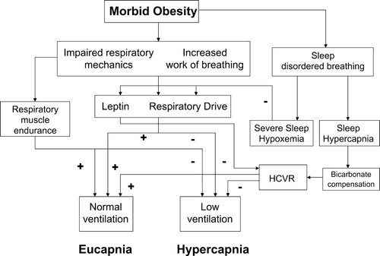
OHS Mechanisms – proposed
CO2 production and alveolar dead space can’t be the whole story, because it doesn’t explain why only a minority of obese patients retain CO2
Either due to predisposition (e.g. blunted HCVR, though hasn’t been found)
OR long term adaptation as occurs in submariners rebreathing CO2
Proof would be in intervening on one of these steps
Notes:
https://journals.physiology.org/doi/full/10.1152/japplphysiol.00713.2009
Schema outlining some of the potential interactions involved in the development of hypoventilation in a subgroup of individuals with morbid obesity. The plus sign (+) denotes this factor, if normal or increased, has a positive influence on maintaining ventilation. The minus sign (−) denotes factors that, if reduced or blunted, would contribute to lowered ventilation and eventual hypercapnia. HCVR, hypercapnic ventilatory response.
However:
“In a previous study we showed that hypercapnia in OHS was correlated to ventilatory restriction but there was no relationship between PaCO2 and all parameters of fat distribution, including BMI”
Resta O, Foschino Barbaro MP, Bonfitto P, et al. Prevalence and mechanisms of diurnal hypercapnia in a sample of morbidly obese subjects with obstructive sleep apnoea. Respir Med 2000;94:240–246
Randerath W. More than obstruction: rethinking obesity hypoventilation? Ann Am Thorac Soc 2020;17:282–283.
Surprisingly, huge databases have shown that obesity only mildly affects parameters of lung mechanics (6). With the exception of expiratory reserve volume, all other parameters exceed the limits of normal only in extreme cases (6). High body weight is a prerequisite of OHS, but its mechanical influence on ventilation is almost negligible

Slide 79
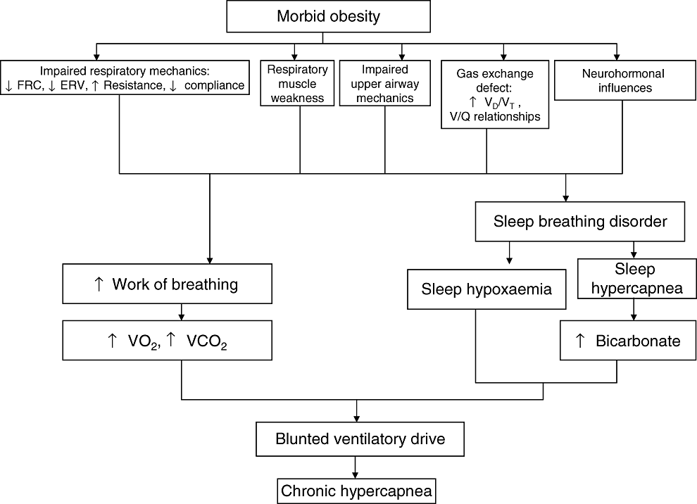
OHS Mechanisms
Notes:
https://doi.org/10.1111/j.1440-1843.2011.02124.x

Slide 80
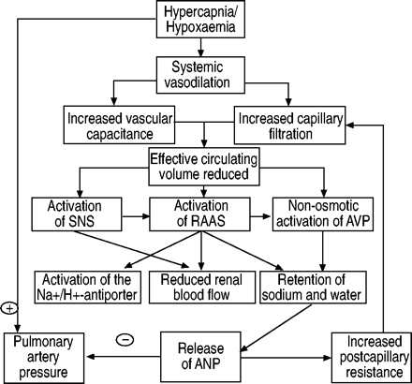
Why are obese patients fluid overloaded?
Frequently have HFpEF, ?Cor Pulmonale
Are obese patients always fluid overloaded due to an increase in pleural pressure -> CVP has to be higher for a given preload?
Additionally, a high bicarbonate level indicates a metabolic alkalosis but does not differentiate a primary from a compensatory one. Because obese patients are frequently hyperaldosteronemic and are often on diuretics, corticosteroids, or both, they are prone to develop primary metabolic alkalosis that triggers mild compensatory hypercapnia.⁷ ,⁸
Notes:
Could we look at people who meet diagnostic criteria for OHS – then look how many might be on diuretics -> make the bicarbonate (and/or acid-base status) misleading?
8 Schrier RW, Masoumi A, Elhassan E. Aldosterone: role in edematous disorders, hypertension, chronic renal failure, and metabolic syndrome. Clin J Am Soc Nephrol 2010;5:1132–40. (this wasn’t doesn’t actually have all that much useful information)
47. De Leeuw PW, Dees A: Fluid homeostasis in chronic obstructive lung disease. Eur Respir J 2003, 22(Suppl 46):33s–40s.
Additional pathophysiology citations
5. Piper AJ, Yee BJ. Hypoventilation syndromes. Compr Physiol 2014; 4:1639–1676.
19. Lin CK, Lin CC. Work of breathing and respiratory drive in obesity. Respirology 2012; 17:402–411.
Counterpoint: hypoxia causes diuresis and it appears to be mediated by peripheral chemoreceptors - https://journals.physiology.org/doi/abs/10.1152/jappl.1995.78.2.377

Slide 81
Part 3 – other causes of hypercapneic respiratory failure - physiology
COPD
COPD, OSA overlap
CHF
Neuromuscular disease
Opiates? (To what extent does this cause chronic hypercapnia in isoluation?)
**Restrictive Thoracic Disease
CF? (ILD)

Slide 82
Ventilatory Failure in COPD – not due to the obstruction itself
Increase in resistance on 5-10 cmH2O/L/S in severe COPD – easily surmountable. 37
Modeling suggests virtually no stress on respiratory control system despite reductions in FEV1 to 50% of predicted. FEV1 to 50% of predicted (306). Even when FEV1 is reduced to 20% of predicted, the increase in respiratory motor output needed to maintain normocapnia is fairly small.
=> instead, it is the mechanical loading (elastic load from hyperinflation), threshold load from AutoPEEP, and functional weakness of the inspiratory muscles.
The work of breathing in severe COPD is 10 to 12 times greater than normal - Loring SH, Garcia-Jacques M, Malhotra A. Pulmonary characteristics in COPD and mechanisms of increased work of breathing. J Appl Physiol (1985) 2009:107:309–314. 15% of total oxygen consumption at rest, higher with exertion.
Notes:
In summary, the pathophysiology of COPD presents a curious paradox in that the name of the disease focuses on airway obstruction and the diagnosis is based on decreased airflow during expiration, yet the mechanical consequences occur during inspiration and consist of an elastic load (as a result of hyperinflation), a threshold load (as a result of autoPEEP), and functional weakness of the inspiratory muscles (as a result of hyperinflation) with only a small increase in inspiratory airway obstruction.
37. Burrows B, Saksena FB, Diener CF. Carbon dioxide tension and ventilatory mechanics in chronic obstructie lung disease. Ann Intern Med 65: 685-700, 1966
306 YounesM.Mechanisms of ventilatory failure. Current Pulmonology 14: 243-292, 1993a
However, CO2 retention is unlikely to occur when FEV1 is above 1 L (269 - Montes de Oca M, Celli B. Mouth occlusion pressure, CO2 response and hypercapnia in severe chronic obstructive pulmonary disease. Eur Respir J 12: 666-671, 1998) unless other factors such as severe obesity or sleep-disordered breathing come into play

Slide 83
Proportion developing Hypercapnia?
https://www.dovepress.com/getfile.php?fileID=53396

Slide 84
Spirometry is misleading for this
FVC depend on expiratory muscles, whereas work of breathing is achieved by the action of inspiratory muscles (FEV1 should be better, no?). Thus, doesn’t correlate well at all with development of hypercapnia

Slide 85
Due to airtrapping and mechanical loads
Instead, expiratory flow limitation: delays lung emptying with the result of inspiration starting before emptying has finished
Net: dynamic hyperinflation.
This worsens when demands are increased
And in sleep – NREM (increased upper airway resistance and blunted chemosensitivity) and REM (upper airway collapse and skeletal muscle atonia)
Dynamic Hyperinflation: operates on less compliant part of pressure/volume curve (more work of breathing), this increased VCO2, Vd?vt increases, mechanical disadvantage of the diaphragm
Load compensation takes place until late in the disease (309) during the DAY, but this falls apart at night (114,296)
Notes:
309 Younes M. Mechanisms of respiratory load compensation. In: Demsey JA, Pack AL, editors. Regulation of Breathing. New York: Marcel Dekker, Inc., 1995b, pp. 867-922.
296 Wilson PA, Skatrud JB, Dempsey JA. Effects of slow wave sleep on ventilatory compensation to inspiratory elastic loading. Respir Physiol 55: 103-120, 1984.
114 Iber C, Berssenbrugge A, Skatrud JB, Dempsey JA. Ventilatory adaptations to resistive loading during wakefulness and non-REM sleep. J Appl Physiol 52: 607-614, 1982

Slide 86
Drive to breath in COPD
Increased compared to patients without COPD - both by P0.1 and diaphragm activity.
Interestingly, differences in drive to breathe do not separate hypercapneic patients with COPD from normocapnic.
Persists essentially until respiratory system can’t eliminate further CO2, then bicarbonate compensation comes in to play

Slide 87
Sleep in COPD without OSA
https://www.dovepress.com/getfile.php?fileID=19163 Holmedal

Slide 88
Non-apnea related hypoventilation in COPD
Sleep disordered breathing in COPD has many non-apnea components – for examples ~30% decreased in Ve during REM sleep may be enough to significantly increase PaCO2, even after have left REM
Because patients with COPD have increased physiological dead space, the rapid shallow breathing that normally accompanies bursts of eye movements in REM sleep produces an even greater decrease in alveolar ventilation than in healthy subject. This can account for virtually all the hypoxaemia observed in REM sleep in patients with COPD.54
Significant hypoventilation during sleep is common in advanced COPD and was reported in 43% of 54 subjects with advanced COPD by O'Donoghue et al. 56
Compensatory renal retention of bicarbonate may then lead to impairment of ventilatory control and maintenance of daytime hypercapnia 55.
COPD - non-OSA sleep disordered breathing prevalence? (e.g. CSA, hypoventilation, sleep fragmentation). Overlap syndrome is actually a mix of separate pathophysiology: OSA, CSA, worsening airflow obstruction, hypoventilation, oxygen desaturation, and sleep fragmentation.
Notes:
54 - Catterall JR, Calverley PM, MacNee W, Warren PM, Shapiro CM, Douglas NJ, Flenley DC. Mechanism of transient nocturnal hypoxemia in hypoxic chronic bronchitis and emphysema. J. Appl. Physiol. (1985) 1985; 59: 1698–1703
55. .55 Douglas NJ, Calverley PM, Leggett RJ, Brash HM, Flenley DC, Brezinova V. Transient hypoxaemia during sleep in chronic bronchitis and emphysema. Lancet 1979; 1: 1–4.
56 56 O'Donoghue FJ, Catcheside PG, Ellis EE, Grunstein RR, Pierce RJ, Rowland LS, Collins ER, Rochford SE, McEvoy RD, Australian trial of Noninvasive Ventilation in Chronic Airflow Limitation investigators. Sleep hypoventilation in hypercapnic chronic obstructive pulmonary disease: prevalence and associated factors. Eur. Respir. J. 2003; 21: 977–984.
“During REM sleep there is generalised postural muscle atonia and the persistence of ventilation is primarily dependent on diaphragm activity and central drive”

Slide 89
Thus: nocturnal hypoxemia (due to unmeasured hypercapnia) is common in patients with advanced COPD even without OSA
One of the major puzzles in COPD is why do some patients develop hypercapnia and others do not (269).
Indeed, even when patients develop acute increases in PaCO2 as a result of severe progressive respiratory failure they develop increases in respiratory drive (173, 227, 277).
Notes:
269 - Tobin MJ, Gardner WN. Monitoring of the control of ventilation. In: TobinMJ, editor. Principles and Practice of Intensive Care Monitoring. New York: McGraw-Hill, Inc., 1998, pp. 415-464.
173 Montgomery AB, Holle RH, Neagley SR, Pierson DJ, Schoene RB. Prediction of successful ventilatorweaning using airway occlusion pressure and hypercapnic challenge. Chest 91: 496-499, 1987.
227 Sassoon CS, Te TT, Mahutte CK, Light RW. Airway occlusion pressure. An important indicator for successful weaning in patients with chronic obstructive pulmonary disease. Am Rev Respir Dis 135: 107-113, 1987.
277 Tobin MJ, Perez W, Guenther SM, Semmes BJ, Mador MJ, Allen SJ, Lodato RF, Dantzker DR. The pattern of breathing during successful and unsuccessful trials of weaning from mechanical ventilation. Am Rev
Respir Dis 134: 1111-1118, 1986.

Slide 90
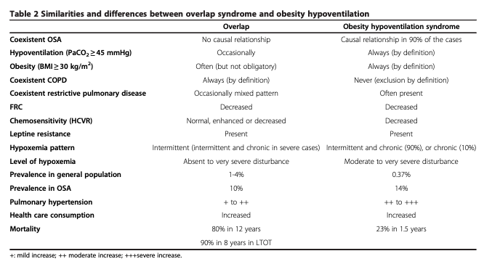
COPD – OSA overlap (OVS) - pathogenesis
Similar to OHS, obstructive events cause CO2 loading, which the disadvantaged pulmonary system cannot compensate for.
Notes:
Chart from https://respiratory-research.biomedcentral.com/track/pdf/10.1186/1465-9921-14-132.pdf
However, CO2 retention is unlikely to occur when FEV1 is above 1 L (269) unless other factors such as severe obesity or sleep-disordered breathing come into play –from https://doi.org/10.1002/cphy.c140008

Slide 91
Chapman et al. demonstrated that in eucapnic morbid obesity without OSAS, the hypercapnic and isocapnic hypoxic ventilatory response fell after weight reduction surgery (gastroplasty) such that for a given oxygen saturation, the mean ventilation was significantly lower in the less obese state (Chapman KR, Himal HS, Rebuck AS. Ventilatory responses to hypercapnia and hypoxia in patients with eucapnic morbid obesity before and after weight loss. Clin. Sci. (Lond.) 1990; 78: 541–5.)
“disturbances in lung function and ventilatory control in obese eucapnic sleep apnoea patients are intermediate along a continuum from simple obesity to OHS” Gold AR, Schwartz AR, Wise RA et al. Pulmonary function and respiratory chemosensitivity in moderately obese patients with sleep apnea. Chest 1993; 103: 1325–9.

Slide 92
Chest 2021 Review O2 in SDB
Notes:
O2 for COPD: Overlap – NOTT trial

Slide 93
Other Hypercapnic OSAS?
Thus, in order for hypercapnic OSAS to develop, other factors (e.g. chronic obstructive pulmonary disease, hypoxia, heart failure, kyphoscoliosis, infection, sedatives or diuretic therapy) need to be present to impair the acute ventilatory compensation for transient sleep hypercapnea.
What portion of patients who are hypercapnic with OSA meet OHS definition?
Spectrum from OHS -> pure OSA.. With OVS or other overlaps in the middle

Slide 94
CHF as a cause of hypercapnia
An increased respiratory load resulting from interstitial edema secondary to acute left-ventricular failure together with decreased blood flow to the respiratory muscles may markedly impair respiratory muscle performance and reduce the time to task failure (14).
Classically, Hypocapnia is anticipated:
1. Peripheral chemoreceptors are unregulated (thought related to 'stagnant hypoxia' at the carotid bodies - low shear stress, blood flow, and CO) and thus they are hypersensitive (both increased loop gain - CSR and periodic breathing in exercise - and baseline hyperventilate). 2. Transient Pulm HTN in exercise can also stimulate C fibers.
Notes:
14 Aubier M, Trippenbach T, RoussosC.Respiratory muscle fatigue during cardiogenic shock. J Appl Physiol 51: 499-508, 1981
pulmonary (alveolar, or interstitial) edema = stiffer lungs = lower FRC = rapid shallow breathing with relative increase in deadspace fraction.

Slide 95
CHF
Stage 1: interstitial fluid (can be up to 500mL with minimal extra pressure)
Stage 2 Crescentic filling of the alveoli
Stage 3 Alveolar Flooding
Stage 4 Froth in air passages
Historically taught that hypoxemia and stimulation to vagal nociceptors results in hyperventilation – which may be true, until load is too great

Slide 96
CHF Physiology
Normally, enhanced peripheral chemoreflex responsiveness (both to hypoxia and to hypercapnia) -> upreg SNS and downreg PNS, sympathetic-respiratory coupling, irregular breathing.
VD/VT as well as increased chemoreflex sensitivity increase contributes to the pathologic increase in Ve/VCO2
Thus, it’s likely that hypercapnia must result from either an imposed load (edema) or some change in this upregulation (opiates?)
Would neurohormonal blockade block this (e.g. Losartan) upregulation and predispose to hypercapnic respiratory failure?
Notes:
Interestingly, patients with untreated hypertension also have increased peripheral chemoreflex sensitivity
---
https://erj.ersjournals.com/content/erj/51/2/1700860.full.pdf
In patients with CHF, there is heightened sympathetic activity and potentiated ventilatory responses when exposed to both hypercapnia [27, 29] and hypoxia [26, 30], indicating higher chemosensitivity [31]. Most studies have demonstrated that CHF patients have normal blood gases at rest and that PaCO2 either stays the same or declines from rest to peak exercise, similar to normal controls [8, 32–34]. Furthermore, PaCO2 at peak exercise is similar between patients with milder and more severe exercise impairment in CHF, while V′E/V′CO2 increases in proportion to the severity of disease [34].
==> likely also ergoreceptor mediated by tissue acidosis -> increase in ventilation indep. Of changes in PaCO2
CHF patients rarely desaturate during exercise, and are limited by impaired maximal cardiac output and O2 extraction, rather than ventilation [34] (table 1). Vasodilators such as sodium nitroprusside increase cardiac output and exercise capacity by improving overall O2 transport, despite increasing perfusion to low V′A/Q′ regions, which may worsen PaO2 [101]. As maximal ventilatory capacity is maintained in CHF, they can compensate for the high VD/VT, bringing the PaCO2 down to normal levels at peak exercise and maintaining a normal alveolar O2 tension. β-Blockers improve survival in CHF with reduced systolic function [102–104], but carvedilol (which has β- and α-blocker activity) also improves ventilatory efficiency by attenuating the influence of overactive chemoreceptor and ergoreceptor reflexes [105–110]. Diuretics reduce left ventricular filling pressure, improving the cardiac output, and also reduce VD/VT related to interstitial oedema

Slide 97
Opiate Induced Resp Depression
Mu receptor mediates pain relief and depression of respiration (normal RR drops first, then tidal volume reduced – HCVR and HVR reduced)
Partial agonists have a reduced effect on breathing
Equianalgesic doses of various opiates have same effect – though rapidity of onset determines whether apnea is caused, or just hypoventilation.
Degree of response is state dependent (co-ingestions, sex, physiologic state)

Slide 98
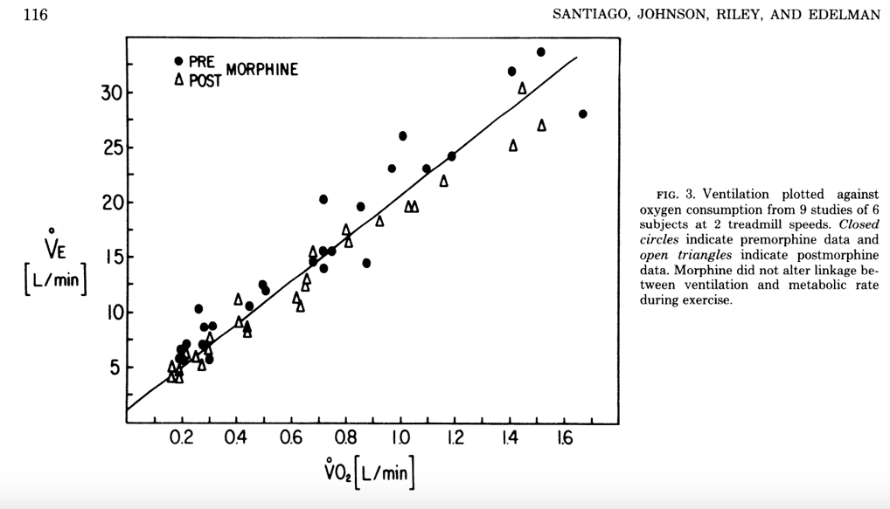
Morphine in exercise
In health -> morphine decreased Ve by decreasing Vt primarily
While morphine decreased HCVR and HVR, it did not change the VeCO2 or O2 cost of exercise
Notes:
https://journals.physiology.org/doi/abs/10.1152/jappl.1979.47.1.112
Maybe also blunts ergoreceptor response?

Slide 99
Opiates during delivery
https://www.ingentaconnect.com/content/wk/ane/2017/00000124/00000003/art00029

Slide 100
Neuromuscular disease
The topic of respiratory muscle fatigue is complex and the interested reader is referred to a detailed review of the topic (143).
Respiratory muscle fatigue can develop whenever ventilation must be maintained at greater than 50% of maximal voluntary ventilation
Mador MJ, Magalang UJ, Rodis A, Kufel TJ. Diaphragmatic fatigue after exercise in healthy human subjects. Am Rev Respir Dis 1993;148:1571–1575.
Freedman S. Sustained maximum voluntary ventilation. Respir Physiol 1970;8:230–244.
Notes:
143 - Laghi F, Tobin MJ. Disorders of the respiratory muscles. Am J Respir Crit Care Med 168: 10-48, 2003.
REM hypoventilation?

Slide 101
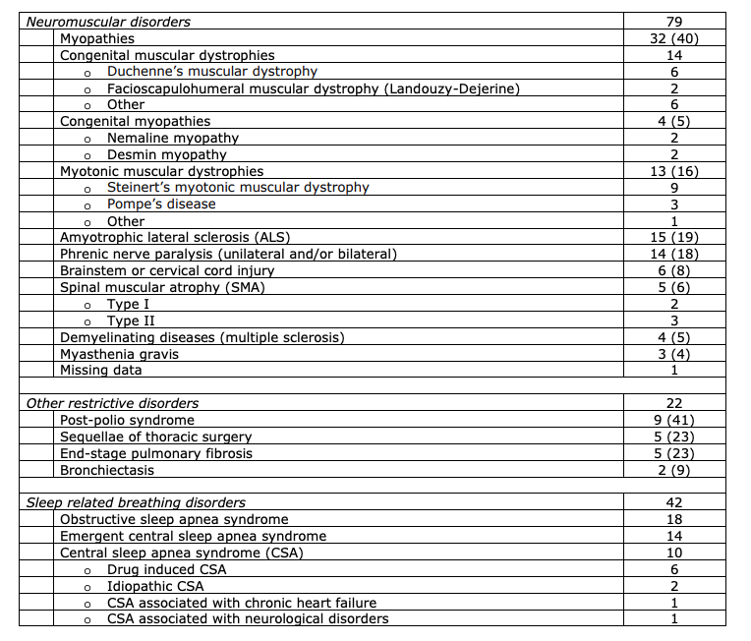
Neuromuscular disease
Corticospinal tracts connect resp centers to spinal motor neurons – ventilatory drive problems when abnormal.
MS – ventilation control problems and bulbar sx -> aspiration
SCI - https://breathe.ersjournals.com/content/12/4/328.short
ALS – NPPV suggested when FVC <50% pred, MIP < -60, SNIP less than 40, or sleep disordered breathing identified.
Dipharagmatic dsfxn – neuropathic, myopathic, or metabolic.
Duchenne/Becker/Myotonic Dystrophy – muscle weakness.
Graphic from: Geneva area NIV initation prev. CHEST
Notes:
https://journal.chestnet.org/cms/10.1016/j.chest.2020.02.064/attachment/b6c3b1f8-b826-4e55-8d6e-2255f6180fcb/mmc1.pdf

Slide 102
Neuromuscular hypoventilation
First occurs during REM sleep (lowest drive and muscle paralysis)- Base excess of 4 mEq correlates. - can be tested at home with ET CO2. For progressive conditions, often predates awake failure by years.
Can lead to blunted ventilatory responses in the day (perhaps predisposing to exacerbations, even beyond steady state failure)
NPPV likely improves survival in ALS
https://www.atsjournals.org/doi/10.1164/rccm.201210-1804CI

Slide 103
ILD? CF
https://www.karger.com/Article/Pdf/369862 In Germany NIPPV offered to patients with ILD and hypercapnia (30 w hypercap, 374 w/o)
Treated with NIPPV, in addition to pulmonary rehab. Improved 6 MW outcome (compared to at enrollment – not a comparative study)

Slide 104
Part 4 - Epidemiology
Questions:
How often is the diagnosis of hypercapnic respiratory failure (or perhaps, a specific subtype) made during an acute exacerbation?
Of all blood gasses obtained within ED, 24h or admission to hospital or admission to ICU with respiratory acidosis and metabolic alkalosis (inferring, this is often compensation)– how many are acutely decompensated vs acute on chronic? How many have been labeled as having a cause of hypercapnia on discharge?
(what proportion of patients have some degree of blood gas compensation?
Review all labels of.. Say.. OHS and see how it was diagnosed (labor intensive)
Notes:
Classically, hypercapnic respiratory (more properly, ventilatory) failure has been thought of as mostly caused by COPD, neuromuscular disease or obesity hypoventilation syndrome. Yet, personal observation suggests that the cause is often multifactorial, and that many of these patients receive incorrect or overly broad syndromic diagnosis (think “COPD” in the absence of pulmonary function testing) that do not imply a correct line of treatment or the proper diagnostics. Many subpopulations (undiagnosed obesity hypoventilation, COPD and OSA overlap, or patients with unrecognized vascular congestion) have plausible mechanisms by which their management could be improved, and readmissions prevented, yet very little data exists to guide their treatment.

Slide 105
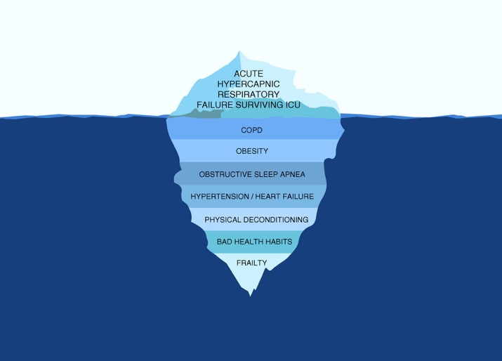
https://www.atsjournals.org/doi/pdf/10.1164/rccm.201608-1666OC
N=78 patients, consecutive; Geneva. Recruited at ICU discharge after surviving PaCO2 over 6.3 kpa and requiring invasive or NIV. Exclude NM dz, iatrogenic, or with persisting confusion
21% had been hospitalized in the last yr for resp failure. 67% had COPD. 81 percent of patients without COPD were obese. 29% had OSA known (mostly untreated); 66% of those tested had mod-severe OSA. 51% had COPD&OSA. 44% had HFpEF, ~16%ish had pHTN
Patients who were not treated for OSA had higher readmissions (similar with others)

Slide 106
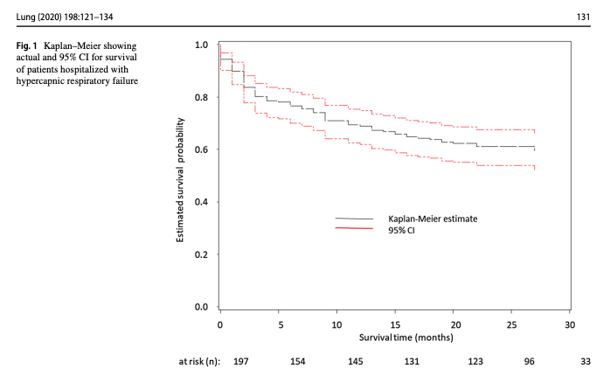
Readmission after Hypercapneic Resp Failure
https://link.springer.com/content/pdf/10.1007/s00408-019-00300-w.pdf UVM
202 patients admitted with acute hypercapneic resp failure
Identified by ICD code. (Study question: comparison of ICD code to ABG?)
Comorbs: 29% CHF, 24% OSA, 6% OHS, 46% COPD, 10% Asthma
Admission reason: 50% resp failure, 11% pneumonia, 23% AECOPD, 5% overdose, 12% sepsis, 29% cardiac disease
23% readmission within 30 days; higher with peripheral vascular disease, active smoking, ILD and Bronchiectasis; increased with compensation (bicarb 40-49 vs 20-29)
Notes:
ICD 10 diagnostic codes [J96.02 (acute HRF), J96.22 (acute and chronic respiratory failure with hypercapnia), J96.92 (respiratory failure unspecifed with hypercapnia), J96.12 (chronic respiratory failure with hypercapnia), E66.2 (morbid obesity with hypoventilation)]

Slide 107
Rationale for better clarifying chronicity:
Bayesian pretest probability during workup of an undifferentiated patient.
Data suggesting that morbidity is high regardless of etiology – clarifying where efforts might be best targeted.
Begin differentiating the hypercapnia itself from being causally harmful from it being an indication of respiratory system failure.
Though: note that 1 abg cannot tell you chronicity. - https://emcrit.org/ibcc/hypercapnia/
Notes:
Study 1: review of admission with compensated hypercapnia - random sample chart review
Inpatient and ICU admissions with a blood gas suggesting a.) acute on chronic hypercapnia and b.) chronic compensated hypercapnia
If looking at chronic / compensated hypercapnia, could look at whether there was a prior presentation during which the pathology was/should have been identified.
--Random sample of those patients: n=300?, need a second reviewer probably to help and double-check
--could do at U of U, or VA system?
-determine discharge diagnoses
-determine medication changes and referrals placed on discharge (particularly, sleep)
-stratify by admission RR? Initiation of BiPAP while inpatient (billing restriction suggests almost no-one is going home with it)

Slide 108
How often is there ‘pure’ hypoventilation
Study 0: Normal A-a gradient and hypoxemia? How often ‘pure’ hypoventilation?
Obesity physiology - https://onlinelibrary.wiley.com/doi/full/10.1111/j.1440-1843.2011.02096.x
In the two previously mentioned studies, the subjects with BMIs of 49–50 were free of pulmonary disease and had A-aO₂ gradients of 22.6 ± 2.8³⁸ and 19 ± 9 mm Hg,⁴⁰ respectively. Therefore, although obesity can cause a mild widening of the A-aO₂ gradient, this is not sufficient to cause frank hypoxaemia.
38. https://pubmed.ncbi.nlm.nih.gov/7212333/ ABG+PFTs before and after weight loss showed that ERV improved and the A-a gradient decreased with weight loss
40. https://pubmed.ncbi.nlm.nih.gov/17296634/ - prop bari surg - Twenty-five morbidly obese individuals (mean [SD] age, 3910 years; mean BMI,497 kg/m2; mean body fat, 506%; mean waist circumference, 13515 cm; mean W/H ratio,0.970.11). the alveolar-arterialoxygen pressure difference (P[A-a]O2) was 199 mm Hg (range, 1 to 37 mm Hg); inear regression showed that 32% and 36%,respectively, of the variance in the P(A-a)O2and PaO2
VA population: how often are pure hypoventilation disorders misdiagnosed and mismanaged? (how often does an O2 consultation follow?)
Notes:
“The alveolar-arterial (A-a) gradient is usually normal and can differentiate pulmonary parenchymal disease as the cause of hypoventilation; however, owing to ventilation and perfusion mismatch in the lung bases of obese patients, it is not uncommon to have a modest elevation in A-a gradient.65 Serum bicarbonate can be used as a screening test, with levels less than 27 mEq/L having a 97% negative predictive value.1 A serum bicarbonate level of 27 mmol/L and higher gives sensitivity of 76.6% and specificity of 74.6%. A nadir oxygen saturation level (SpO2) less than 80% is also an independent predictor of the diagnosis of OHS with a sensitivity of 82.8% and specificity of 5.5%.66
“
[ ] 1 - . Mokhlesi B, Tulaimat A, Faibussowitsch I, et al. Obesity hypoventilation syndrome: prevalence and predictors in patients with obstructive sleep apnea. Sleep Breath 2007;11:117–24.
---this one may be important to feasibility of the A-a gradient proposal
[ ] With these se:sp data, does the diagnostic algorithm make sense? LR+ 3, LR- 0.3 for Bicarb

Slide 109
Hypercapnic Resp Failure Diagnosis/Epi
Study 5:
How frequently are patients with hypercapneic respiratory failure admitted? Either with the label applied, or a determination by blood gas (in a way, the relation between those two groups would be strengthened by the result of study 1).
-Clinical outcomes: readmission, cost, mortality (done in UMich paper)
- identify those at high risk of re-admission (by CPAP use or referral?
How often is an acute exacerbation caused by something known to decrease controller gain / chemoreflex? (Opiates, oxygen) -> vs what portion are due to some inability in the respiratory system to cope (worsening underlying physiology, reduced plant gain)
What happens after the exacerbation? Particularly in patients where the problem was in the controller gain / sensing portion (won’t breathe) – do they immediately go back to the ‘normal’ set point. If not, why not?

Slide 110
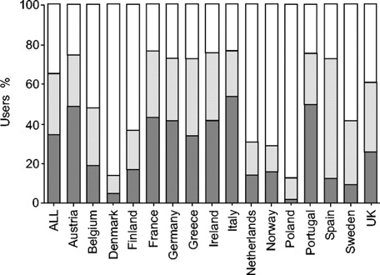
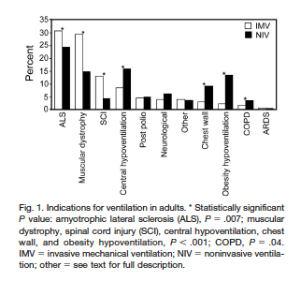
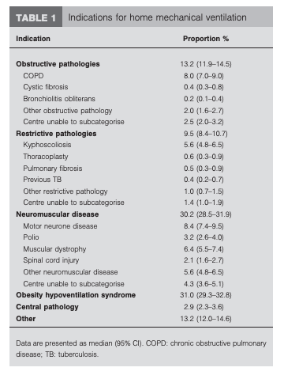
Reasons for Home NIV
Percentage of users in each disease category by country (see Methods section for an explanation of disease categories). ▪: lung/airways; : thoracic cage; □: neuromuscular.
Euvoven: 6.6 per 100k DOI: 10.1183/09031936.05.00066704
Canada (Canuvent): DOI: https://doi.org/10.4187/respcare.03609
AUS/NZ: DOI: 10.1183/09031936.00206311
S. J. Lloyd-Owen et al. Eur Respir J 2005;25:1025-1031

Slide 111
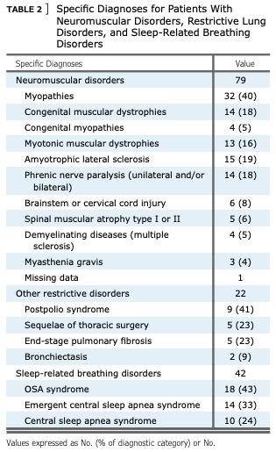
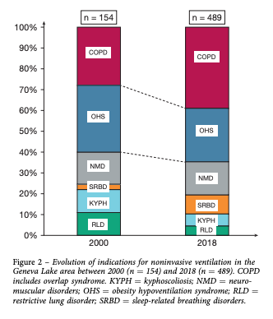
Trends- DOI: https://doi.org/10.1016/j.chest.2020.02.064
“The population of patients under chronic NIV has also changed, from the initial predominantly restrictive indications (sequelae of TB, postpolio syndrome, chest wall disorders, and neuromuscular disorders) to a progressive increase of patients with chronic respiratory failure (CRF) because of obesity hypoventilation syndrome (OHS), COPD, and overlap syndromes which started in the late 1990s”
Obesity was highly prevalent: BMI was $ 30 kg/m2 in 270 patients (55%), $ 35 kg/m2 in 180 patients (37%), and $ 40 kg/m2 in 106 patients (22%).
NIV was initiated electively in 247 subjects (50%) vs in an emergency setting for 220 (45% of all patients; not specified for 22 patients; 5%). Most patients were started on NIV as inpatients (n ¼ 400; 82%) vs 73 (15%) as outpatients (not specified for 16 patients; 3%)

Slide 112
OHS - Epidemiology
ERS summary: https://err.ersjournals.com/content/28/151/180097
Either diagnosed at:
1. 30-70% diagnosed during respiratory decompensation, often not at the first one. (Reportedly, affects 50% of hospitalized patients with BMI over 50) 9, 26, 29, 60, 69
2. Or at the time of escalation outpatient care to a pulmonologist or sleep medicine physician. (Presentation resembles OSAS)
The cohorts (depending how they are identified) seem to have significant differences
Notes:
9. Nowbar S, Burkart KM, Gonzales R, et al. Obesity-associated
hypoventilation in hospitalized patients: prevalence, effects, and
outcome. Am J Med. 2004;116(1):1-7.
26. Marik PE, Desai H. Characteristics of patients with the “malignant
obesity hypoventilation syndrome” admitted to an ICU. J Intensive
Care Med. 2013;28(2):124-130.
29. Castro-Añón O, Pérez de Llano LA, De la Fuente Sánchez S, et al.
Obesity-hypoventilation syndrome: increased risk of death over
sleep apnea syndrome. PLoS One. 2015;10(2):e0117808.
60. Priou P, Hamel J-F, Person C, et al. Long-term outcome of
noninvasive positive pressure ventilation for obesity hypoventilation
syndrome. Chest. 2010;138(1):84-90.
69. Pérez de Llano LA, Golpe R, Ortiz Piquer M, et al. Short-term and
long-term effects of nasal intermittent positive pressure ventilation
in patients with obesity-hypoventilation syndrome. Chest. 2005;
128(2):587-594.
“Thus significant COPD, untreated hypothyroidism, use of opiates (including methadone), and use of sedating or psychoactive medications are, in our experience, often found in patients with hypercapnia and OSAHS. Unfortunately, as the drugs frequently are hard to discontinue it is difficult to prove their role in the hypercapnia other than conceptually.”
“These patients frequently come to the attention of the clinician after an episode of severe acute respiratory decompensation or an intercurrent unrelated hospitalization leading to iatrogenic suppression of ventilation with oxygen, sedatives, or overdiuresis”
Berger, K., Goldring, R., & Rapoport, D. (2009). Obesity Hypoventilation Syndrome. Seminars in Respiratory and Critical Care Medicine, 30(03), 253–261. doi:10.1055/s-0029-1222439

Slide 113
OHS likely to track obesity
Updated obesity updates and forcasts - https://www.ajpmonline.org/article/S0749-3797(12)00146-8/fulltext

Slide 114
OHS prevalence – Enriched populations
Bariatric surgery screening - 67.8% - https://www.atsjournals.org/doi/10.1513/AnnalsATS.202002-135OC
Admitted to ICU due to hypercapneic respiratory failure – very high rate of missed diagnosis (previously diagnosed with COPD or CHF, for example)
BMI over 50 and hospitalized or undergoing surgery (Kaw et al)
Between 10% to 20% of patients referred to sleep laboratories have OHS (76, 242, 267), with the incidence increasing as the BMI range increases (265,283) - https://doi.org/10.1002/cphy.c140008
Simulation based on those prevalences: “Although not well known, the prevalence of OHS increases as the prevalence of obesity increases (7, 8), with an estimated prevalence of 0.3–0.4% in the general population, 10–20% in patients with sleep-related breathing disorders, and nearly 50% among hospitalized patients with BMI greater than 50 kg/m².” - Mokhlesi B. Obesity hypoventilation syndrome: a state-of-the-art review. Respir Care 2010; 55:1347–1362.
Notes:
Bariatric surgery screening for OHS:
Tran, Wang, Gharaibeh, et al.: Bariatric Surgery Risk in Obesity Hypoventilation - A total of 1,718 patients undergoing polysomnography with end-tidal CO2 monitoring prior to bariatric surgery at Cleveland Clinic from September 2011 to September 2018 were included.”
Key Findings: “OHS prevalence was 68.4%. Unadjusted analyses revealed a 1.5% increased odds of OHS (1.01; 1.00-1.03) per 1-unit BMI increase, 1.7% (1.02; 1.01-1.02) per 1% increase in sleep time Sa_{O2} < 90%, 12% increase (1.12; 1.03-1.22) per 1-U increase in hemoglobin A1c, and 3.4% increased odds (1.03; 1.02-1.05) per 5-U increase in apnea-hypopnea index. The association of apnea-hypopnea index with OHS persisted after adjustment for age, sex, race, and BMI and its comorbidities (1.02; 1.01-1.04)”
“In a single-center retrospective study of morbidly obese patients admitted to the intensive care unit because of hypercapnic respiratory failure due to obesity hypoventilation, 75% had been erroneously diagnosed and treated for COPD, and 86% were being treated for congestive heart failure (36).”
“Marik and Desai reported that 8% of all admissions to a general ICU with acute-on-chronic hypercapnic respiratory failure met diagnostic criteria for OHS (22). “
Marik PE, Desai H. Characteristics of patients with the “malignant obesity hypoventilation syndrome” admitted to an ICU. J Intensive Care Med 2013;28:124–130.
BMI over 50+ - high rates
Kaw R, Bhateja P, Paz y Mar H, et al. Postoperative complication in patients with unrecognized obesity hypoventilation syndrome undergoing elective noncardiac surgery. Chest 2015; doi: 10.1378/chest.14-3216. [Epub ahead of print].
The CDC estimated that 7.6% of the adult U.S. population has a BMI ≥40 kg/m² (https://pubmed.ncbi.nlm.nih.gov/29922829/).

Slide 116
OHS Diagnosis
Review OHS diagnoses – how many of them meet objective criteria for obesity hypoventilation syndrome? Look at the converse: people with BMI 35 and compensated CO2 over 52 and see how many have the diagnoses vs other explenations vs no further workup. (this would represent a subset of all patients – as it would primarily include those who have had blood gas assessments, which would bias towards those that came in during exacerbations).
All ABG based work is going to have some hyperventilation. Has there been research into this?
Notes:
From https://www.atsjournals.org/doi/full/10.1513/AnnalsATS.201711-888WS
“To be diagnosed with OHS, the patient should have a body mass index of 30 kg/m2 or greater an arterial partial pressure of carbon dioxide of 45 mm Hg or greater during wakefulness, and exclusion of other causes of hypercapnia (44). Approximately 90% of patients with OHS have concomitant OSA (45). OHS is estimated to occur in 1/160 adults (46). OHS should be suspected in very obese patients (46), obese patients with an increased serum bicarbonate (≥27 mEq/L) (47), room air hypoxemia while resting, persistent hypoxemia during PSG, or when a restrictive ventilatory defect is present. An elevated serum bicarbonate or base excess may be a better marker of prolonged hypoventilation as opposed to daytime arterial blood gases (patients may hyperventilate during the sampling) (48). The use of serum bicarbonate in addition to the STOP-Bang questionnaire may identify potential patients with OHS (49).”
→The diagnosis of OHS (‘exclusion of other causes’) is interesting, as it implies overlap syndromes cannot exist – yet presumably whatever physiology drives OHS can also be present in someone with coexisting factors

Slide 117
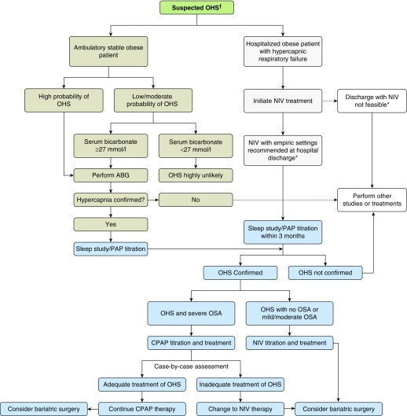
OHS diagnosis
(interestingly, it seems like loop diuretic use likely can predispose to nocturnal -> daytime hypercapnia re: diagnosis of OHS. This seems like an area where renal physiology might get in the way… perhaps look in to this?)
What proportion of ‘OHS’ patients have loop diuretics on board?
“ OHS being more likely in the presence of morbid obesity, greater severity of pulmonary hypertension (dependent oedema more common) and more severe nocturnal oxygen desaturation”
- Banerjee D, Yee BJ, Piper AJ, Zwillich CW, Grunstein RR. Obesity hypoventilation syndrome: hypoxemia during continuous positive airway pressure. Chest 2007; 131: 1678–1684.
[ ] research question: how often is it that these patients are on a loop diuretic?
Notes:
Study 4: simultaneous transcutaneous capnography vs blood gas in ICU? Does the delta between them vary by whether there is sedation on board?
Multiple authors have argued for expanding OHS diagnostic criteria to include calculated serum bicarbonate values of greater than 27 mEq/l from arterial blood gas readings and/or calculated base excess of greater than 2 mmol/l ^{[20▪▪,21–23]}. Not only are bicarbonate and base excess longer term measures of exposure to elevated levels of PaCO₂, these metrics are also less sensitive to the transient changes in PaCO₂ and PaO₂ often engendered by the anxiety and pain that accompany arterial puncture. Not surprisingly, opinions are mixed and many have legitimate concerns about using calculated bicarbonate values derived from arterial blood draws. Using cutoff values of greater than 27 mEq/l, calculated bicarbonate from arterial blood gases has 90% sensitivity but perhaps only 50% specificity for making a diagnosis of OHS ^{[24]},
Patients with OHS have higher healthcare utilization than comparable eucapnic obese patients - The use of health-care resources in obesity-hypoventilation syndrome.Berg G, Delaive K, Manfreda J, Walld R, Kryger MH Chest. 2001 Aug; 120(2):377-83.

Slide 118
However, even among the morbidly obese (BMI >40 kg/m²) with OSA, less than one quarter develop OHS. (Laaban JP, Chailleux E. Daytime hypercapnia in adult patients with obstructive sleep apnea syndrome in France, before initiating nocturnal nasal continuous positive airway pressure therapy. Chest 2005; 127: 710–715.)

Slide 119
HCO3 utility in diagnosis:
a prevalence of 5% is typically seen in patients with SDB with BMI of 30 to 34.9 kg/m², 10% is typically seen in patients with BMI of 35 to 40 kg/m², and 20% is seen in patients with BMI >40 kg/m²
Balachandran JS, Masa JF, Mokhlesi B. Obesity hypoventilation syndrome epidemiology and diagnosis. Sleep Med Clin. 2014;9:341–347.
Pooled sensitivity of HCO3 27 or higher: 0.86, pooled specificity 0.77 among patients with high pre-test probability for OHS (e.g. sleep disordered breathing assessment).
+LR 3.7, -LR 0.18
https://www.ncbi.nlm.nih.gov/pmc/articles/PMC6680300
Notes:
Of note, not known if SpO2 can be used to augment this

Slide 120
Frequency of missed diagnoses
“It is a condition underappreciated by clinicians; with one study showing among patients admitted to internal medicine services with OHS, only 23% were diagnosed and only 13% commenced on appropriate therapy”
- Nowbar S, Burkart KM, Gonzales R, Fedorowicz A, Gozansky WS, Gaudio JC, Taylor MR, Zwillich CW. Obesity-associated hypoventilation in hospitalized patients: prevalence, effects, and outcome. Am J Med 2004;116:1–7.
Characteristics of patients with the "malignant obesity hypoventilation syndrome" admitted to an ICU.
Marik PE, Desai H J Intensive Care Med. 2013 Mar-Apr; 28(2):124-30.
Marik and Desai found that 8% of all admissions to a general ICU met criteria for OHS. All OHS patients had been admitted with acute on chronic hypercarbic respiratory failure, and of these patients, nearly 75% were misdiagnosed and treated for obstructive lung disease despite having no evidence of obstruction on pulmonary function testing.
Notes:
30 Nowbar S, Burkart KM, Gonzales R et al. Obesity-associated hypoventilation in hospitalized patients: prevalence, effects, and outcome. Am J Med 2004;116:1-7
Nowbar: Of 277 patients with a BMI ≥35 kg/m² admitted to an inpatient medical service, Nowbar and colleagues⁴ found that 31% met criteria for OHS. when a subgroup of patients with BMI greater than 50 kg/m² was examined, OHS was found in 48%. Of particular concern, (though likely representative of many hospitals), effective therapy for hypoventilation was only instituted in 13% of these patients.

Slide 121
Obesity – Airway disease missed dx
Veterans (5000) in PNW - DOI: 10.1378/chest.13-2759
BMI category increase = reduced likelihood of airflow limitation
In each higher category, likelihood of an inappropriate diagnostic label increased as did likelihood of being started (and remaining a year later) on inhalers, inappropriately.
Gershon and colleagues studied the healthcare burden of COPD overdiagnosis and demonstrated that individuals with overdiagnosed COPD had 89% higher rates of hospitalizations, 42% higher rates of emergency department visits, and 52% higher rates of ambulatory care visits compared with people without COPD after adjustment for age and sex (10).
Notes:
10 - Martinez CH, Mannino DM, Jaimes FA, Curtis JL, Han MK, Hansel NN, et al. Undiagnosed obstructive lung disease in the United States: associated factors and long-term mortality. Ann Am Thorac Soc 2015;12:1788–1795.
Narrative review - https://www.atsjournals.org/doi/10.1164/rccm.201804-0621CI
Scoping review of missed diagnosed of COPD appendix summarizing - https://www.resmedjournal.com/action/showFullTableHTML?isHtml=true&tableId=undtbl1&pii=S0954-6111%2817%2930157-9

Slide 122
OHS EMR phenotype
Study 3: Develop an EMR phenotype for OHS
(Challenge: identify patients from EMR) https://www.ncbi.nlm.nih.gov/pmc/articles/PMC6318047/
—use structured data (dx codes, labs, etc.) vs unstructured (would need NLP - my thought is to avoid this for now)
—Likely would need to initially establish PPV and NPV of the algorithm, ideally (maybe with random sampling / review of negatives): this seems likely to be it’s own small publication
“Alternatively, sensitivity (true positive rate) and specificity (true negative rate) can be calculated by applying the algorithm to already curated or gold-standard data. “
Notes:
Develop methods to identify these patients in clinical data: develop EMR phenotypes (= algorithms to identify patients) who have conditions that cause hypercapneic respiratory failure, starting with obesity hypoventilation (due to high likelihood of inaccurate and missed diagnoses by virtue of the need for follow-up testing), followed-by COPD/OSA overlap. This would involve developing an algorithm (likely rule based, though natural language processing could be considered) to identify cases and performing a limited manual chart review to establish its accuracy.
[ ] look in to informatics literature - different EMR computable phenotypes (“These can also be referred to as EHR condition definitions, EHR-based phenotype definitions, or simply phenotypes.”) to identify patients:
https://rethinkingclinicaltrials.org/chapters/conduct/electronic-health-records-based-phenotyping/definitions/
Marik and Chen 2012 used:
“adult patients meeting the following criteria: (i) age > 18 and <90 years; (ii) a BMI ≥ 40 kg m−2; (iii) a daytime PaCO2 > 45 mmHg and (iv) an admission HCO3 > 28 mEq L−1. Patients were excluded if they had (i) intrinsic lung disease, (ii) thoracic musculoskeletal/neuromuscular disease, (iii) a greater than 20‐pack year smoking history or (iv) evidence of obstructive lung disease on pulmonary function testing.”
“Patients with severe OHS met all of the following criteria at the time of diagnosis: (1) obesity with a BMI of > 30 kg/m²; (2) hypercapnic respiratory failure (PaCO₂ ≥ 6.7 and PaO₂ < 8.0 kPa); (3) FEV1/FVC ratio of ≥ 70%; (4) the absence of any respiratory disorder that could account for gas-exchange disturbances (eg, kyphoscoliosis or diaphragmatic paralysis). We decided to exclude patients with mild hypercapnia to be sure that we were dealing with “real pickwickian patients”. We and other authors believe that there is a wide range of severity among patients with OHS, so prognosis and response to therapy may vary between individuals“ - https://journals.plos.org/plosone/article?id=10.1371/journal.pone.0117808
Alternative causes: such as under-lying obstructive respiratory disease, mechanical respiratory limitations (eg, kyphoscoliosis), neuro-pathic and myopathic conditions, and central causes (eg, cerebrovascular disease, severe hypothyroidism)
-Opiates?
venous serum bicarbonate threshold of 27 mEq/L, suggestive of chronic respiratory acidemia from hypoventilation, could be used for OHS diagnosis. Their data demonstrated that among obese patients with OSA, a serum bicarbonate level less than 27 mEq/L had a 97% negative predictive value for excluding a diagnosis of OHS.
In fact, even among patients with an apnea-hypopnea index ≥100/h and serum bicarbonate ≥27 mEq/L, 24% do ≥ not meet criteria for OHS,
Obesity hypoventilation syndrome: prevalence and predictors in patients with obstructive sleep apnea.
Mokhlesi B, Tulaimat A, Faibussowitsch I, Wang Y, Evans AT
Sleep Breath. 2007 Jun; 11(2):117-24

Slide 123
Issues around case definition
awake hypoventilation (Pa_{CO2} > 45 mm Hg at sea level; 42 mmHg at elevation)
➔ how should we adjust this for our elevation? Yes, possible instrumental variable
Is this known? We do lessen the ‘hypoxemic’ buffer
Should we include VBGs suggesting compensation (e.g. using the Farkas transformation)?
‘We propose that the definition of OHS should be based on obesity, plus a PaCO 2 ≥45 mm Hg (6 kPa) OR an arterial base excess >3 mmol/L OR a standard HCO 3− >27 mmol/L (in the absence of another cause for a metabolic alkalosis)’
--https://thorax.bmj.com/content/thoraxjnl/69/1/83.full.pdf
Should bicarb 27 be used? (also can be quantified as base excess over 2 mmol/l - In this prospective observational cohort study, we have demonstrated that obese subjects with a raised BE, but with a normal daytime Pa co 2 , have a ventilatory response between those of normal obese subjects (with-out evidence of awake hypoventilation) and those with hypercapnia and, thus, conventionally defi ned OHS.
Effect of ABG on hyperventilation - https://www.heartandlung.org/article/S0147-9563(16)30304-1/fulltext - Respiratory rate increased slightly during arterial puncture without any change in P_{ET}CO₂. Hence, acid–base status must be interpreted without the assumption of procedure induced hyperventilation.
Notes:
OHS Diagnostic Criteria:
Box 1 Diagnostic features of OHS
Obesity
BMI ≥30 kg/m²
Chronic hypoventilation
Awake daytime hypercapnia (sea-level arterial P_{CO2} ≥45 mm Hg, P_{O2}<70 mm Hg)
Possible role of serum venous bicarbonate or calculated capillary blood gas bicarbonate greater than 27 mEq/L*
Sleep-disordered breathing†
Obstructive sleep apnea (apnea-hypopnea index [AHI] ≥5 event/h)
Nonobstructive sleep hypoventilation (AHI <5 events/h, P_{CO2} increases by ≥7 mm Hg during sleep or oxygen saturation ≤88% for at least 5 min without obstructive respiratory events)
Exclusion of other causes of hypoventilation
Severe obstructive respiratory disease
Severe interstitial lung disease
Severe chest-wall disorders (eg, kyphoscoliosis)
Severe hypothyroidism
Neuromuscular disease
Congenital hypoventilation syndromes
* Serum bicarbonate level assessment is not part of the definition but advocates suggest using this for screening.
† OSA is present in 90% of cases, with the remaining cases featuring nonobstructive sleep hypoventilation.

Slide 124
OHS treatment
BiPAP (quicker blood gas normalization)
CPAP also usually works, and probably no long term difference
Bariatric Surgery: unknown,
Study idea: use our bariatric cohort (not known precisely how many have OHS) to see if bicarbonate improved significantly after.
Study 6: how many are inappropriately prescribed oxygen (hypercapnia with normal A-a gradient)? ERS: Monotherapy with oxygen reduces ventilation and increases hypercapnia. Oxygen should only be applied as an adjunct to NIV
ATS 2019 guideline: “ Should screening for comorbidities associated with OHS (i.e., metabolic syndrome, pulmonary hypertension, coronary artery disease) vs. no such screening be used in patients with OHS at the time of diagnosis?”
“ Should a bariatric procedure vs. no bariatric procedure be used as first-line therapy for OHS?”

Slide 125
OHS Readmissions
ATS 2019: Short-term rates of hospitalization were reduced by PAP, but the event rate was low and data were reported in only one RCT (19). Longer-term data suggest high rates of hospitalization in patients with OHS on PAP but without a comparison group (data from five observational studies: 10% at 3 mo to 49% at 5 yr) (20, 22, 65, 70, 74).
Notes:
19 – Masa, thorax: https://www.ncbi.nlm.nih.gov/pubmed/27406165/
20 – Masa, lancet https://www.ncbi.nlm.nih.gov/pubmed/30935737/
22 - https://www.ncbi.nlm.nih.gov/pubmed/27852952/
65 https://www.ncbi.nlm.nih.gov/pubmed/16100142/
70 https://www.ncbi.nlm.nih.gov/pubmed/26648713/
74
https://scholar.google.com/scholar_lookup?journal=Eur+Respir+J&title=Results+of+non-invasive+ventilation+in+patients+with+acute+hypercapnic+ventilatory+failure+and+obesity+hypoventilation+syndrome+(OHS)&author=JF+Sanchez+Gomez&author=A+Pacheco&author=G+Zamora&author=JM+Benitez+Moya&author=A+Valido+Morales&volume=40&publication_year=2012&pages=2042&

Slide 126
If OHS diagnosed at exacerbation:
1162 hospitalized patients, 119 (10%) were discharged on NIV, 90% discharged without PAP.
90d mortality: “After adjusting for age, sex, and baseline Pa_{CO2}, the odds ratios (ORs) for mortality were significantly lower in the group discharged on PAP (adjusted OR, 0.16; 95% CI, 0.08–0.33; P < 0.0001; estimated risk difference: 136 fewer deaths per 1,000 patients, with 95% CI from 105 fewer to 152 fewer deaths). ”
In the subgroup with baseline/hospitalization ABGs: “After adjusting for age and sex, the OR for mortality was lower in the group discharged on PAP (adjusted OR, 0.48; 95% CI, 0.19–1.24; estimated risk difference, 44 fewer deaths per 1,000 patients, with 95% CI from 72 fewer to 19 more).”
https://www.ncbi.nlm.nih.gov/pmc/articles/PMC6680300/ (ATS guideline)

Slide 127
OHS Treatment
OHS: supplemental oxygen will increase CO2 and decrease pH
58-59
Hollier 2013: RCT of 0.28 vs 0.5 fio2 for 20m – n=14 w untreated OHS. Fio2 50 increased acidemia, vd/vt, and decreased Ve
Wijesinghe RCT of 100% fio2 vs room air for 20 mins – ptco2 increased 5, decreased Ve 1.4 l/min, increased Vd/Vt 0.067
Would ABGs with supraphysiologic high PaO2 make a reasonable surrogate for quality of care? (presumably only some period after presentation to the ED – where O2 levels ought to be titrated).
How accurate is inpatient HSAT? https://pubmed.ncbi.nlm.nih.gov/27992566/ , https://www.ncbi.nlm.nih.gov/pmc/articles/PMC6045781/
Notes:
Hollier CA, Harmer AR, Maxwell LJ, et al. Moderate concentrations of supplemental oxygen worsen hypercapnia in obesity hypoventilation syndrome: a randomised crossover study. Thorax 2014; 69: 346–353.
https://thorax.bmj.com/content/69/4/346
https://www.sciencedirect.com/science/article/abs/pii/S0012369211602250
Inclusions for HSAT
In CHF: ’medically stabilized, euvolemic, weaned off supplemental oxygen, and receiving a stable diuretic regimen on which they would be discharged. Exclusion criteria were as follows: current treatment for sleep apnea; oxygen use; right-sided heart failure without left-sided failure; systolic blood pressure less than 80 mm Hg; COPD exacerbation; status post–heart transplant or implantation of a left ventricular assist device; chronic hemodialysis; or uncorrected valvular heart disease. Patients could not be receiving standing sedative-hypnotic medication while in the hospital, and, specifically, patients could not take any sedative-hypnotic medication on the night of the sleep recordings.’

Slide 128
OHS weight loss bariatric surgery
https://www.ncbi.nlm.nih.gov/pubmed/25702144/. n=63, BMI 35+ and OSA or OHS; lap gastric band vs nutritional care. 25 with OHS/Mixed synd. 35% in surgery group (vs 13%) able to discontinue PAP; reduction in AHI 13 greater at 3 years.
https://www.ncbi.nlm.nih.gov/pubmed/28971973/ BMI 30+ and CO2 45. 37 patients, all NIV, but +/- intensive lifestyle or usual care (NO bariatric surgery). Similar reductions in PaCO2 at 3 months.
Observational data: Improvements in PaO2 and PaCO2 sustained up to 5 years. RVSP decreased 13 mmHg.
Notes:
Observational studies;
https://pubmed.ncbi.nlm.nih.gov/17953247/ N=105 patients – bypass
At 1 year after RYGBP, patients presented significant weight loss and improvement of hypoxemia (from 73.3 +/- 10.6 to 90.5 +/- 11.5, P = 0.000), hypercarbia (from 44.5 +/- 5.7 to 40.6 +/- 4.9, P = 0.005), and in spirometric (P = 0.004) and polysomnographic results (P = 0.001). CPAP-BiPAP treatment after weight loss was necessary in only 14% of patients (P = 0.001).
https://pubmed.ncbi.nlm.nih.gov/15603656/ N= 30 patients band gastroplasty
Evidence of pulmonary disease was absent in all patients 1 year after surgery. Forced vital capacity, inspiratory and expiratory forces, tidal volume, SaO(2), and PaCO(2) significantly improved after weight reduction.
https://pubmed.ncbi.nlm.nih.gov/2503905/ n = 29
After weight loss had been induced the smokers showed mild hyperinflation and air trapping. Resting arterial blood gas tensions improved, with a rise in arterial oxygen tension from 10.63 to 13.02 kPa and a fall in arterial carbon dioxide tension from 5.20 to 4.64 kPa. There was no correlation between weight loss and the changes in blood gas tensions or lung volumes.

Slide 129
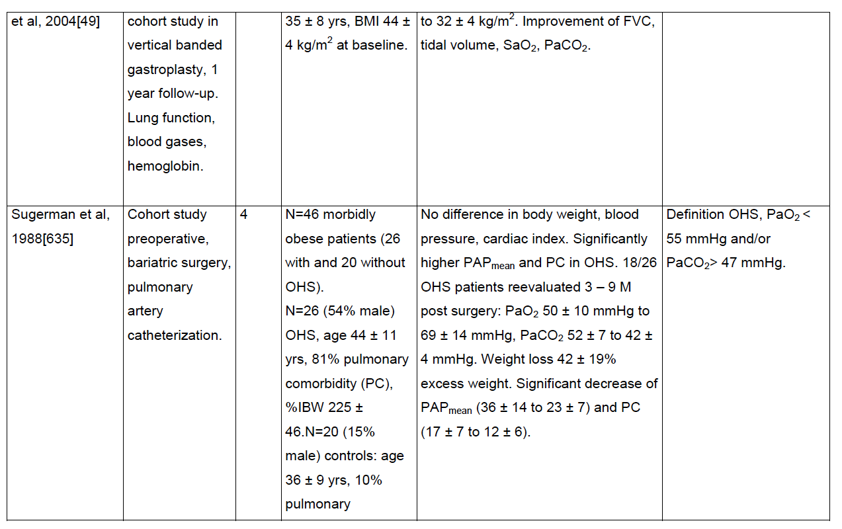
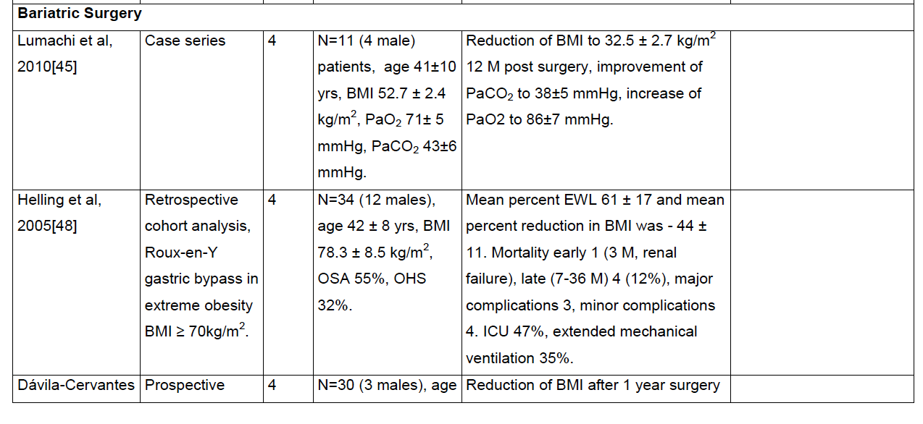
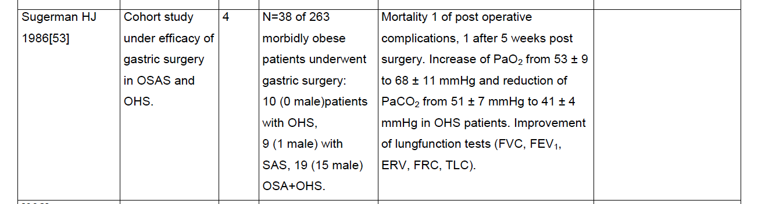
OHS study summaries from ERS supplement

Slide 130
Overlap syndrome epidemiology
Key source: CHEST 2017; 152(6):1318-1326
Frequency: Thus based on established prevalence figures, both disorders should coexist in about 1% of the adult general population, with even higher figures likely depending on the definitions used for diagnosis. Phenotypically, emphysema seems protective while chronic bronchitis predisposing. Overall, the relationship has been unclear whether COPD predisposes to OSA or vice versa.
[ ] is the risk of having overlap syndrome, given an admission for hypercapneic respiratory failure and COPD, known?

Slide 131
Chest 2021 Noct o2 rev - DOI: https://doi.org/10.1016/j.chest.2021.02.017
29-66 % of patients with COPD have OSA 37-41
Conflicting results about O2 effect OSA generally – no direct evidence to overlap
O2 therapy doesn’t seem to increase risk of hypercapnia - NSO therapy at 2 L/min reduced the episodes of desaturation per hour and the time spent in desaturation, but there were no differences between air and oxygen in episodes of SDB per hour, the duration of episodes of SDB, baseline sleeping PaCO2 , or PaCO2 during episodes of desaturation or SDB (https://www.sciencedirect.com/science/article/abs/pii/S0012369216310984) , 44. (Goldstein RS, Ramcharan V, Bowes G, McNicholas WT, Bradley D, Phillipson EA. Effect of supplemental nocturnal oxygen on gas exchange in patients with severe obstructive lung disease. N Engl J Med. 1984;310(7):425-429.)
In one study, elevated venous bicarbonate, a surrogate of hypercapnia, was noted in patients with OSA (not just overlap) receiving NSO - https://www.atsjournals.org/doi/10.1164/rccm.201802-0240OC
Notes:
Furthermore, hypercapnia alone can induce sympathetic activation and BP elevations.46,47
46. https://www.tandfonline.com/doi/abs/10.3109/10641968809075998 – general physiology
47. https://erj.ersjournals.com/content/35/1/132 – specifically in OSA-COPD overlap
37-41
37 37. Lopez-Acevedo MN, Torres-Palacios A, Elena Ocasio-Tascon M, Campos-Santiago Z, Rodriguez-Cintron W. Overlap syndrome: anindication for sleep studies?: a pilot study. Sleep Breath. 2009;13(4): 409-413. chestjournal.
38 38. Soler X, Gaio E, Powell FL, et al. High prevalence of obstructive sleep apnea in patients with moderate to severe chronic obstructive pulmonary disease. Ann Am Thorac Soc. 2015;12(8):1219-1225.
39. 39. Sanders MH, Newman AB, Haggerty CL, et al. Sleep and sleepdisordered breathing in adults with predominantly mild obstructive airway disease. Am J Respir Crit Care Med. 2003;167(1):7-14.
40 40. Owens RL, Malhotra A. Sleep-disordered breathing and COPD: the overlap syndrome. Respir Care. 2010;55(10):1333-1344; discussion 1344-1336.
41. 41. Marin JM, Soriano JB, Carrizo SJ, Boldova A, Celli BR. Outcomes in patients with chronic obstructive pulmonary disease and
obstructive sleep apnea: the overlap syndrome. Am J Respir Crit Care Med. 2010;182(3):325-331.

Slide 132
Overlap syndrome diagnosis
What is the sensitivity and specificity of STOP bang different in this population? Or other ways to identify high risk patients (either to identify undiagnosed OSA or OHS)
—could you identify patients who have overlap syndrome based on the pattern of desaturation on PSG / HSAT + smoking? (PPV for also having COPD seems like it’d be pretty good)
do patients with overlap syndrome develop daytime hypercapnia at less obstructive levels than matched people without OSA? Yes, see Resta et al below
Meta-analysis on factors on predicting OSA in COPD
➔ https://doi.org/10.1016/j.smrv.2016.10.004
Although data are lacking, Resta and colleagues (71 - Resta O, Foschino Barbaro MP, Brindicci C, Nocerino MC, Caratozzolo G, Carbonara M. Hypercapnia in overlap syndrome: possible determinant factors. Sleep Breath 2002;6:11–18.) have demonstrated hypercapnia with relatively preserved lung function in patients with OSA–COPD compared with patients with COPD alone, a finding that may help clinicians recognize those patients. (From ATS guideline https://www.atsjournals.org/doi/10.1164/rccm.202006-2382ST)
Notes:
Is the comorbidity profile of patients diagnosed with OHS known? Does it differ from OSA/COPD overlap?
[ ] could do this relatively simply with TrinetX database if it hasn’t been done (though OSA/COPD overlap might be difficult, as diagnostic codes might not be as reliable
Resta O, Foschino Barbaro MP, Brindicci C, Nocerino MC, Caratozzolo G, Carbonara M. Hypercapnia in overlap syndrome: possible determinant factors. Sleep Breath 2002;6:11–18.
“In the comparison between overlap and OSA patients, the overlap group had a significantly higher PaCO2 (44.59 vs. 39.22 mm Hg; p < 0.01), in the presence of a similar AHI (40.46 vs. 41.59/h). Comparing overlap to COPD patients, overlap showed a significantly higher PaCO2 value (44.59 vs. 39.63 mm Hg; p < 0.005) and had significantly less severe obstructive impairment (FEV 162.93 vs. 47.31%; FEV1 /FVC ratio 66.71 vs. 59.25%; p < 0.005).“” “In conclusion, the occurrence of hypercapnia in overlap patients is only partially explained by the combination of overweight and reduced respiratory function, supporting the hypothesis of a multifactorial genesis.”"

Slide 133
Overlap syndrome diagnosis
https://www.ncbi.nlm.nih.gov/pmc/articles/PMC7347183/pdf/pone.0235331.pdf
OVS: less snoring, morning headaches, and EDS including sleepiness while driving.
More common nocturia.
OVS has more comorbidities (HLD, HTN, Stroke, CAD/MI, PVD, CHF) – largely mediated by increased smoking.
Leads to more profound hypoxemia, higher Risk of pHTN and right heart failure.

Slide 134
Overlap syndrome(?) missed diagnosis
https://www.atsjournals.org/doi/full/10.1513/AnnalsATS.202005-425RL
In patients admitted to ICU with hypercapneic respiratory failure - severe sleep apnea was ultimately diagnosed in a majority - may be an opportunity to decrease re-admissions
“Consistent differences in key OSA traits were not observed between OVS and OSA alone.” - https://physoc.onlinelibrary.wiley.com/doi/full/10.14814/phy2.14371

Slide 135
Overlap syndrome - outcomes
Key source: CHEST 2017; 152(6):1318-1326
When OSA present, associated with deeper desaturations than non COPD matched controls – associated with increased risk of cor pulmonale. The oxygen desaturation index provides ameasure of intermittent hypoxemia, which is particularlyimportant in the generation of systemic inflammation,52and appears to be superior to the AHI in predictingcardiovascular comorbidity
Patients with both COPD and OSA are more likely to develop hypercapnia, pulmonary hypertension and right-sided heart failure than patients with COPD alone. Bradley TD, Rutherford R, Grossman RF, Lue F, Zamel N, Moldofsky H, Phillipson EA. Role of daytime hypoxemia in the pathogenesis of right heart failure in the obstructive sleep apnea syndrome. Am. Rev. Respir. Dis. 1985; 131: 835–839.
Notes:
COPD with hypoxemia but no OSA – no evidence for (or really against) nocturnal oxygen https://www.nejm.org/doi/full/10.1056/NEJMoa2013219

Slide 136

Differentiating OVS and OHS
doi:10.1186/1465-9921-14-132 Cite this article as: Verbraecken and McNicholas: Respiratory mechanics and ventilatory control in overlap syndrome and obesity hypoventilation. Respiratory Research 2013 14:132.
https://link.springer.com/content/pdf/10.1186/1465-9921-14-132.pdf
Notes:
From above citation:
“Chronic daytime hypercapnia would emerge if both the acute ventilatory compensation for transient nocturnal hypercapnia is compromised, as well as the bicarbonate excretion, as might be seen under condition of hypoxia (f.i. chest infection), diuretic therapy, or heart failure [170,178]. This makes both patient categories more susceptible to acute ventilatory failure [126]. Despite this, the diagnosis of overlap syndrome and of OHS appears to be often overlooked, especially in a clinical setting when dealing with the other illnesses of these patients [189].
“
In subjects with chronic hypercapnia, there is an increased blood bicarbonate concentration, which may inhibit the ventilatory response to CO2 and decreases mouth occlusion pressure response during wakefulness and sleep [50]. When normocapnic, overlap patients can however have a normal or even enhanced ventilatory response to CO2 [51]. This is in contrast to the data on decreased hypercapnic (HCVR) and hypoxic (HVR) ventilatory response in OHS, as compared to obese, non-hypercapnic subjects [52].
Hypoxemia and hypercapnia are however less severe in patients with overlap than in patients with OHS [54].
Effectively, daytime hypercapnia is more common in overlap syndrome as compared to simple OSA [23]. However, a correlation between hypercapnia and the frequency and duration of respiratory events during the night could not be observed [72,73].
23 Bradley TD, Rutherford A, Lue F, Moldofsky H, Grossmann RF, Zamel N, Phillipson EA: Role of diffuse airway obstruction in the hypercapnia of obstructive apnea. Am Rev Respir Dis 1986, 134:920–924.
50 Radwan L, Maszczyk Z, Koziorowski A, Koziej M, Cieslicki J, Sliwinski P, Zielinski J: Control of breathing in obstructive sleep apnoea and in patients with the overlap syndrome. Eur Respir J 1995, 8:542–545
51 Verbraecken J, De Backer W, Willemen M, De Cock W, Wittesaele W, Van de Heyning P: Chronic CO2 drive in patients with obstructive sleep apnea and effect of CPAP. Respir Physiol 1995, 101:279–287.
52 Zwillich CW, Sutton FD, Pierson DJ, Greagh EM, Weil JV: Decreased hypoxic ventilatory drive in the obesity hypoventilation syndrome. Am J Med 1975, 59:343–348.
54 Kessler R, Chaouat A, Schinkewitch P, Faller M, Casel S, Krieger J, Weitzenblum E: The obesity-hypoventilation syndrome revisited: a prospective study of 34 consecutive cases. Chest 2001, 120:369–376
72 Garay SM, Rapoport D, Sorkin B, Epstein H, Feinberg I, Goldring RM: Regulation of ventilation in the obstructive sleep apnea syndrome. Am Rev Respir Dis 1981, 124:451–457.
73 Lopata M, Onal E: Mass loading, sleep apnea, and the pathogenesis of obesity hypoventilation. Am Rev Respir Dis 1982, 126:640–645.

Slide 137
OVS outcomes
[ ] —Review: https://www.sciencedirect.com/science/article/pii/S0012369217307420
-Importantly, PAP is reported to improve daytime blood gases and reduce mortality, morbidity and exacerbation rates in patients with overlap syndrome [57, 58].’
Reduced all cause mortality (at 9.4 yrs) and time to COPD exacerbation. **Methodology of Marin study?
57 Marin JM, Soriano JB, Carrizo SJ, et al. Outcomes in patients with chronic obstructive pulmonary disease and obstructive sleep apnea: the overlap syndrome. Am J Respir Crit Care Med 2010; 182: 325–331.
58 Schreiber A, Surbone S, Malovini A, et al. The effect of continuous positive airway pressure on pulmonary function may depend on the basal level of forced expiratory volume in 1 second. J Thorac Dis 2018; 10: 6819–6827
-Clinical cohort studies indicate that exacerbation rate and mortality is reduced in subjects compliant with PAP treatment [57].
No robust studies of the effect of oxygen in this population.
Machado et al DOI: 10.1183/09031936.00192008 , CPAP treated with 71% survival vs 26% in untreated in LTOT COPD clinic in Brazil

Slide 138
How do you differentiate whether COPD is severe enough to explain hypoventilation (and thus diagnose with OVS) vs not? With respect to diagnosis of OHS
What proportion of patients with overlap syndrome have hypercapnia?
“most trials evaluating NIV in COPD excluded patients with OSA and/or high body mass index (BMI), thus precluding subgroup analysis”
Study idea: how does the exclusion trials for known indications for use of NIV compare to the population presenting with hypercapneic respiratory failure?

Slide 139
Overlap syndrome diagnostic performance
Similar to other studies, a large proportion of patients were misdiagnosed as having COPD or left heart failure and likely received inappropriate therapy (including systemic steroids and inhalers)
(36). - Collins BF, Ramenofsky D, Au DH, Ma J, Uman JE, Feemster LC. The association of weight with the detection of airflow obstruction and inhaled treatment among patients with a clinical diagnosis of COPD. Chest 2014;146:1513‐1520.
“dyspneic obese patients are frequently misdiagnosed with asthma or COPD
and treated with inappropriate pharmacologic agents (37).”
Sin DD, Jones RL, Man SF. Obesity is a risk factor for dyspnea but not for airflow obstruction. Arch Intern Med 2002;162:1477‐1481.
Notes:
“Questionnaires to screen and determine the probability of OSA, such as the Epworth Sleepiness Scale, the STOP BANG or the Berlin questionnaire, have not been specifically validated for patients with coexisting COPD and should therefore be used with some caution [41]. Specific sleep-related questionnaires for COPD patients have been developed but clinical experience is limited [42, 43].”
41 Faria AC, da Costa CH, Rufino R. Sleep Apnea Clinical Score, Berlin Questionnaire, or Epworth Sleepiness Scale: which is the best obstructive sleep apnea predictor in patients with COPD? Int J Gen Med 2015; 8: 275–281.
42 Soler X, Liao SY, Marin JM, et al. Age, gender, neck circumference, and Epworth sleepiness scale do not predict obstructive sleep apnea (OSA) in moderate to severe chronic obstructive pulmonary disease (COPD): the challenge to predict OSA in advanced COPD. PLoS One 2017; 12: e0177289.

Slide 140
Pure stable hypercapnic chronic obstructive pulmonary disease (COPD)
Hypercapnea associated with dyspnea, decreased QOL, more frequent hospitalizations, and increased mortality:
Costello R, Deegan P, Fitzpatrick M, McNicholas WT. Reversible hypercapnia in chronic obstructive pulmonary disease: a distinct pattern of respiratory failure with a favorable prognosis. Am J Med 1997;102:239–244
Yang H, Xiang P, Zhang E, Guo W, Shi Y, Zhang S, et al. Is hypercapnia associated with poor prognosis in chronic obstructive pulmonary disease? A long-term follow-up cohort study. BMJ Open 2015;5:e008909.

Slide 141
COPD demographics / changes
The number of patients worldwide affected by moderate-to-severe chronic obstructive pulmonary disease (COPD) was estimated to be 174.5 million individuals in 2015, and increased by 44.2% from 1990 to 2015.1 Between 2016 and 2040, COPD is forecasted to rise from the ninth to the fourth leading cause of life-years lost.2
COPD patients who have persistent hypercapnia after an episode of acute hypercapnic respiratory failure have a poor prognosis: almost half do not survive the first year after the index hospitalization, 80% require readmission to hospital and nearly two-thirds will have another life-threatening event.11
Notes:
1. GBD 2015 Chronic Respiratory Disease Collaborators. Global, regional, and national deaths, prevalence, disability-adjusted life years, and years lived with disability for chronic obstructive pulmonary disease and asthma, 1990-2015: a systematic analysis for the Global Burden of Disease Study 2015. Lancet Respir Med. 2017;5(9):691– 706. doi:10.1016/S2213-2600(17)30293-X
2. . Foreman KJ, Marquez N, Dolgert A, et al. Forecasting life expectancy, years of life lost, and all-cause and cause-specific mortality for 250 causes of death: reference and alternative scenarios for 2016-40 for 195 countries and territories. Lancet. 2018;392(10159):2052– 2090. doi:10.1016/S0140-6736(18)31694-5
11. Chu CM, Chan VL, Lin AW, Wong IW, Leung WS, Lai CK. Readmission rates and life threatening events in COPD survivors treated with noninvasive ventilation for acute hypercapnic respiratory failure. Thorax. 2004;59(12):1020–1025. doi:10.1136/thx.2004.024307

Slide 142

HOMEVENT Registry in Germany 2016-17
Among GOLD ¾ Patients who did not have acute acidosis (AECOPD) or already on NIV: 58/231 patients (25%) had PaCO2 ≥45 mmHg, and 20 (9%) had PaCO2 ≥50 mmH.
BMI (OR 2 for 5 BMI increase), forced vital capacity (FVC) and bicarbonate (HCO3 − ) levels were identified as being significantly associated with the presence of hypercapnia (defined as PaCO2 ≥45 mmHg).
Notes:
Quotes from https://www.dovepress.com/getfile.php?fileID=53396 – Home vent 2016-2017, Germany
==> how much of this is decreased
BMI has been shown to be an independent predictor of mortality in patients with stable severe COPD and chronic hypercapnia,23,25
23. 23. Budweiser S, Jorres RA, Riedl T, et al. Predictors of survival in COPD patients with chronic hypercapnic respiratory failure receiving noninvasive home ventilation. Chest. 2007;131(6):1650–1658. doi:10.1378/chest.06-2124
25. 25. Celli BR, Cote CG, Marin JM, et al. The body-mass index, airflow obstruction, dyspnea, and exercise capacity index in chronic obstructive pulmonary disease. N Engl J Med. 2004;350(10):1005–1012. doi:10.1056/NEJMoa021322
It is also possible that patients with a high BMI might have had coexisting obesity hypoventilation syndrome, which results in hypercapnia27,28 -➔ does not really support this… definitional problem.

Slide 143
Sleep Related Hypovent in Stable CODP
https://www.dovepress.com/getfile.php?fileID=19163
Pulm rehab hospital, pts with COPD enrolled => PSG w PetCO2
Daytime hypercap n=24 vs not n=76-> greater increase at night. Likely on O2, worse spiro.
Sleep hypovent n=15 vs not n=85 -> greater O2, higher median PaCO2 and BE, same spiro.
Notes:
In COPD this hypoventilation is more pronounced, especially during REM sleep, as a consequence of obstructed airflow, hyperinflation, respiratory muscle dysfunction, blunted ventilatory responses to hypercapnia and hypoxemia, ventilation/perfusion mismatch, and medications.11

Slide 144
ATS 2020 Home NIV guideline – Stable COPD
Fev1/FVC < 0.7 & PaCO2 45+ not during exacerbation
Screen for OSA first
Do NOT start at hospitalization; wait 2-4 weeks to see if acute on chronic becomes chronic.
Rec not using titration in lab PSG
Attempt to normalized CO2
Notes:
NIPPV is now standard of care:
21. Macrea M, Oczkowski S, Rochwerg B, et al. Long-term noninvasive ventilation in chronic stable hypercapnic chronic obstructive pulmonary disease. an official american thoracic society clinical practice guideline. Am J Respir Crit Care Med. 2020;202(4):e74–e87. doi:10.1164/rccm.202006-2382ST
22. Ergan B, Oczkowski S, Rochwerg B, et al. European Respiratory Society guidelines on long-term home non-invasive ventilation for management of COPD. Eur Respir J. 2019;54(3):1901003. doi:10.1183/13993003.01003-2019
23. Murphy PB, Rehal S, Arbane G, et al. Effect of home noninvasive ventilation with oxygen therapy vs oxygen therapy alone on hospital readmission or death after an acute COPD exacerbation: a randomized clinical trial. JAMA. 2017;317(21):2177–2186. doi:10.1001/jama.2017.4451
24. Wilson ME, Dobler CC, Morrow AS, et al. Association of home noninvasive positive pressure ventilation with clinical outcomes in chronic obstructive pulmonary disease: a systematic review and meta-analysis. JAMA. 2020;323(5):455–465. doi:10.1001/ jama.2019.22343

Slide 145
Meta-analysis from ATS guideline on NIV in COPD
13 RCTs; NIV vs std care
Mortality risk was reduced by 14% in the NIV group compared with those receiving usual care (RR, 0.86; 95% CI, 0.58 to 1.27; low certainty)
decrease in hospitalizations (MD, 1.26 fewer; 95% CI, 2.59 fewer to 0.08 more hospitalizations; low certainty)
improved QOL (standard MD [SMD], 0.48; 95% CI, 0.09 to 0.88; low certainty; improvement in dyspnea (SMD, −0.51; 95% CI, −0.95 to −0.06; moderate certainty)
NIV reduced awake Pa_{CO2} (MD, 3.49 mm Hg lower; 95% CI, 1.3–5.67 mm Hg lower; moderate certainty), increased awake Pa_{O2} (MD, 3.1 mm Hg; 95% CI, 1.45–4.74; moderate certainty
Notes:
“ research is needed into which patients (i.e., phenotypes) would be expected to benefit the most from NIV therapy”
2 week delay – predicting who will have chronic hypercapnia?

Slide 146
Timing of NIV
four RCTs (maintaly RESCUE and HOT-HMV trials) evaluating the use of long-term NIV after an episode of acute hypercapnic respiratory failure. …no major differences in
mortality (RR, 0.92; 95% CI, 0.67 to 1.25; low certainty
exacerbations (MD, 0.3 fewer; 95% CI, 1.17 fewer to 0.57 more; low certainty)
the need for hospitalization (RR, 0.61; 95% CI, 0.30 to 1.24; very low certainty)
There was a significant reduction in Pa_{CO2} (MD, 3.41 mm Hg lower; 95% CI, 4.09 to 2.73 mm Hg lower; moderate certainty), but there was no improvement in Pa_{O2} (MD, 1.53 mm Hg lower; 95% CI, 4.24 mm Hg lower to 1.17 mm Hg higher; very low certainty)
“Indeed, these trials are complementary in that many (nearly 21%, and the largest reason for exclusion) potential HOT-HMV patients who were hypercapnic at hospital discharge were no longer hypercapnic 2–4 weeks later.”
Study idea: predicting who will normalize CO2? And over what time course?
Notes:
RESCUE, 201 patients with COPD admitted to the hospital with acute hypercapnic respiratory failure who had persistent hypercapnia more than 48 hours after ventilatory support were randomly assigned to NIV or to no NIV.
---> no benefit in primary outcome of resp readmission or death at 12 months (though it did reduce CO2 and improve gas exchange)
--Struik FM, Sprooten RT, Kerstjens HA, Bladder G, Zijnen M, Asin J, Cobben NA, Vonk JM,
Wijkstra PJ. Nocturnal non-invasive ventilation in COPD patients with prolonged
hypercapnia after ventilatory support for acute respiratory failure: a randomised,
controlled, parallel-group study. Thorax 2014; 69: 826-834
HOT-HMV, 116 patients with severe COPD who received NIV during acute hypercapnic respiratory failure and who remained hypercapnic (defined as Pa_{CO2} > 53 mm Hg) 2–4 weeks afterward assigned to HOT + NIV vs HOT alone.
https://pubmed.ncbi.nlm.nih.gov/28528348/
“Patients with known or suspected OSA were excluded from many of these studies and should be considered separately, as reviewed above in PICO question 2. These recommendations would not apply to those who remain persistently hypercapnic and cannot be “weaned” from NIV in the hospital. In such patients, in-hospital continuation and transition to long-term NIV may be required.”
All from ATS 2019 Guidance Statement.

Slide 147
Est 25% presenting with AECOPD have hypercapnia (?Not entirely clear what the source of this statistic is)
Moreover, 75-80% of patients hospitalized with hypercapnic respiratory failure due to AECOPD have persistent hypercapnia 6 weeks after discharge(4, 5) and hypercapnia is a strong predictor of re-hospitalization.(6)
Prognostic difference between AECOPD w/ hypercap -> resolution vs continued hypercapnia? - https://onlinelibrary.wiley.com/doi/10.1111/resp.12652
Notes:
4. HOT-HMV, Murphy, JAMA
5. Yang H, Xiang P, Zhang E, Guo W, Shi Y, Zhang S, Tong Z. Is hypercapnia associated with poor
prognosis in chronic obstructive pulmonary disease? A long-term follow-up cohort
study. BMJ Open 2015; 5: e008909.
177 patients with AECOPD+Hypercapnia vs 98 with AECOPD+Normocapnia; excluding OSA, OHS, NMD.
Normocapnia group: 13 subsequently had an episode of acute hypercapnia, 2 developed hypercapnia
Patients with hypercapnia had progressive increase in CO2, larger fluctuations
5.1% of patients with normocapnia and 13.3% of patients with reversible hypercapnia developed chronic hypercapnia during follow-up.
Kessler R, Faller M, Fourgaut G, Mennecier B, Weitzenblum E. Predictive factors of
hospitalization for acute exacerbation in a series of 64 patients with chronic obstructive
pulmonary disease. Am J Respir Crit Care Med 1999; 159: 158-164.
https://pubmed.ncbi.nlm.nih.gov/9217591/
Costello et al –N=85 Stratified into eucapnic (27), temporarily hypercapnic (22) or persistently hypercapnic (19) during an index hospitalization for AECOPD. 24% with reversible hypercapnia developed chronic hypercapnia during followup; 18% of them had a subsequent admission with a normal CO2. Reversible hypercapnia had similar mortality to eucapnia, but persistent hypercapnia had a worse prognosis.
Used PaO2 <60 as resp failure, PaCO2 over 50 as resp failure

Slide 148
CHF as a cause of hypercapnia
https://www.ncbi.nlm.nih.gov/pmc/articles/PMC5746960/
arterial blood gas analysis in 193 consecutive AHF patients (73 ± 12 years, 61% men) - Hypercapnia (PaCO₂ at admission >45 mmHg) and hypocapnia (PaCO₂ < 35 mmHg) were observed in 33.7% and 32.6%, respectively. Patients with hypercapnia are more likely to be in the New York Heart Association Class IV (96.9% vs. 78.9%, P < 0.001), to have acute onset within 6 h (50.8% vs. 25.0%, P < 0.001), and to have radiographic pulmonary oedema (84.6% vs. 57.8%, P < 0.001) than those with hypo‐normocapnia. Acute pulmonary edema > acute decompensated heart failure. No difference in pack years of smoking between hypo and hypercapnic groups. More likely to be treated with oxygen (unclear if this is cause or confounder). in: Konishi M, Akiyama E, Suzuki H, Iwahashi N, Maejima N, Tsukahara K, et al. Hypercapnia in patients with acute heart failure. ESC Hear Fail. 2015;2(1):12–9. https://doi.org/10.1002/ehf2.12023.
Of 106 patients included with pre-hospital Acute Heart Failure or Acute Pulmonary Edema – 58% had hypercapnia. https://bmcemergmed.biomedcentral.com/articles/10.1186/s12873-021-00411-9
RESEARCH QUESTION: Reverse probability is not known: how often does cardiogenic hydrostatic edema contribute to hypercapnia?
Notes:
The pathophysiology of respiratory failure during CPE includes an increase in extravascular lung water, a reduction in lung volume and in respiratory system compliance, and an increase in airway resistance
Sharp JT, Griffith GT, Bunnell IL, et al. Ventilatory mechanics in pulmonary edema in man. J Clin Invest 1958;37:111-7
In addition, around 50% of patients with severe APE are hypercapnic when admitted to the hospital and hypercapnia is a strong predictor of immediate airway intubation
➔ of note, in this study mortality seemed to be primarily related to LVEF and not respiratory failure (which in some ways makes sense – it’s the root of the dysfunction)
Masip J, Paez J, Merino M, et al. Risk factors for intubation as a guide for noninvasive ventilation in patients with severe acute cardiogenic pulmonary edema. Intensive Care Med 2003; 29:1921–1928.

Slide 149
CHF as a cause of hypercapnia
Miñana et al. retrospectively investigated arterial blood gas in 588 patients with ADHF, but they excluded 258 APE patients. In these authors' cohort, 9.2% of patients had hypercapnia (defined as PaCO₂ at admission >50 mmHg)
Minana G, Nunez J, Banuls P, Sanchis J, Nunez E, Robles R, Mascarell B, Palau P, Chorro FJ, Llacer A. Prognostic implications of arterial blood gases in acute decompensated heart failure. Eur J Intern Med 2011;22:489–494.
Notes:
In contrast to current belief that blood pH is typically normal or slightly alkaline in pulmonary edema, acidemia (pH below 7.36) was found in 38 of the 46 patients studied before treatment – mostly metabolic acidosis, but also frequently with frank respiratory acidosis (n=11), or at least insufficient compensation (ie. ventilatory failure)
The Metabolic and Respiratory Acidosis of Acute Pulmonary Edema
ARNOLD ABERMAN, M.D., C.M., MILFORD FULOP, M.D., F.A.C.P.
https://doi.org/10.7326/0003-4819-76-2-173

Slide 150

CHF CO2
As demonstrated by a recent prospective study [33▪], patients with hypercapnia were more likely to be in severe functional class [New York Heart Association (NYHA) class IV], to have abrupt onset and to present with an usual ‘radiologic’ appearance of APE compared with hyponormocapnic patients
Konishi M, Akiyama E, Suzuki H, et al. Hypercapnia in patients with acute heart failure. ESC Heart Failure 2015; 2:12–19
https://academic.oup.com/ehjacc/article-abstract/9/5/399/6125564 – base excess (esp w CO2 over 40) correlated with mortality. Of 472, 95 (20%) were acidemic (either resp or met), 24.4% had high base excess. – perhaps related to compensation or excess diuresis?

Slide 151
CHF CO2 significance
Miñana et al.¹⁰ demonstrated that hypercapnia (PaCO₂ >50 mmHg) was not associated with increased mortality in AHF patients. - Miñana, Gema, et al. "Prognostic implications of arterial blood gases in acute decompensated heart failure." European journal of internal medicine 22.5 (2011): 489-494.
N=588; 9.2 with pCO2 over 50 – Female, DM, COPD, and peripheral edema associated.
elevated PCWP and/or pulmonary congestion induces hyperventilation and consequently, reduces PaCO₂¹⁷ by stimulating pulmonary vagal afferents. Kasai, Takatoshi, et al. "Contrasting effects of lower body positive pressure on upper airways resistance and partial pressure of carbon dioxide in men with heart failure and obstructive or central sleep apnea." Journal of the American College of Cardiology 61.11 (2013): 1157-1166.

Slide 152
OIRD mechanism
---Opioid action at both mu and delta receptors has been linked to respiratory depression. Opioids produce this effect through two different mechanisms; decreased sensitivity of chemoreceptors and decreased activity in the central respiratory centers [34].
34. White JM, Irvine RJ (1999) Mechanisms of fatal opioid overdose. Addiction 94:961–972
Chronic use daytime hypoventilation is mild; effects on sleep disordered breathing predominate (10% OSA, 8% CSA; hypoxemia common) – Chest Opiates and SDB
Decreased RR; decreased chemoreflex responses; reduced brain arousability
The most opioid sensitive aspect of respiration is rhythm generation, and changes in the respiratory pattern are observed at lower opioid doses than change in tidal volume.64
2 patterns: cluster breathing (=cycles of deep breaths) and Biot’s breathing (vs. ataxic breathing “Ataxic breathing and Biot respiration are sometimes referred to interchangeably, although generally ataxic breathing is characterized by irregular frequency and tidal volume interspersed with unpredictable pauses in breathing or periods of apnea,¹⁹whereas Biot respiration refers to a high frequency and regular tidal volume breathing interspersed with periods of apnea.”)
Notes:
Tolerance to analgesia develops more profoundly than the tolerance to respiratory depression
Teichtahl H, Wang D, Cunnington D, et al. Ventilatory responses to hypoxia and hypercapnia in stable methadone maintenance treatment patients. Chest 2005; 128: 1339–1347
opioids may even further obtund ventilatory responses and exacerbate hypoventilation in these individuals. Although we do not know of any work that has studied this in detail, it is interesting to note that COPD is, in fact, a known risk factor for opioid-induced respiratory depression following surgery [Gupta K, Prasad A, Nagappa M, et al. Risk factors for opioid-induced respiratory depression and failure to rescue: a review. Curr Opin Anaesthesiol 2018; 31: 110–119.
].
Treatment of opioids-induced sleep apnea is reviewed
elsewhere (80,126).
Clinical effects:
-decreased HCVR, HVR
-increased central apneas
-ataxic breathing
Females are more susceptible to opiate respiratory depression, for reasons that remain to be established (Romberg et al., 2003).
The likelihood of the above clinical effects manifesting as respiratory failure depends greatly on the underlying load and reserve of the respiratory system (increased risk in elderly, COPD/ILD, obese)

Slide 153

OIRD
the substantial variability in the observed respiratory effects of opioids in patients with OSA (61–64), where both harmful (62) and beneficial (63) effects on apnea severity during sleep have been demonstrated
Notes:
Image from CHEST 2016 150934-944DOI: (10.1016/j.chest.2016.05.022)
Finally, older sedatives—benzodiazepines and neuroleptics—are well-known respiratory depressants that can exacerbate chronic hypercapnia or cause acute-on-chronic hypercapnia in these patients. However, studies examining the impact of these medications on sleep apnea may have been confounded by concurrent use of continuous positive airway pressure, so no definitive conclusions can be drawn (30).
Mason M, Cates CJ, Smith I. Effects of opioid, hypnotic and sedating medications on sleep-disordered breathing in adults with obstructive sleep apnoea. Cochrane Database Syst Rev 2015;7:CD011090
From: https://journals.physiology.org/doi/pdf/10.1152/jn.00017.2021
One factor underlying variability in OIRD is that the respiratory response to opioids is state dependent. Opioid sensitivity is heightened during different neurological and physiological states including concurrent drug administration, such as anesthesia (8–10) and benzodiazepines (11), as well as sleep disordered breathing (SDB, Ref. 12). Indeed, SDB is prevalent among opioid users (13–15), and this clinical population is particularly vulnerable to OIRD since hypercapnic (16, 17) and hypoxic (18, 19) conditions present during SDB exaggerate opioid responses
12 Lam KK, Kunder S, Wong J, Doufas AG, Chung F. Obstructive sleep apnea, pain, and opioids: is the riddle solved? Curr Opin Anaesthesiol 29: 134–140, 2016. doi:10.1097/ACO.00000000000 00265.
16 Bailey PL, Lu JK, Pace NL, Orr JA, White JL, Hamber EA, Slawson MH, Crouch DJ, Rollins DE. Effects of intrathecal morphine on the ventilatory response to hypoxia. N Engl J Med 343: 1228–1234, 2000. doi:10.1056/NEJM200010263431705.
17 Potter JV, Moon RE. Commentaries on viewpoint: why do some patients stop breathing after taking narcotics? Ventilatory chemosensitivity as a predictor of opioid-induced respiratory depression. J Appl Physiol (1985) 119: 420–422, 2015. doi:10.1152/japplphysiol. 00034.2015.

Slide 154
OIRD prevalence
“There is evidence that with chronic opioid use, the balance between hypoxic and hypercapnic ventilatory drive changes, such that while the hypoxic ventilatory drive may recover or be augmented, depression of hypercapnic ventilation remains” (Ventilatory responses to hypoxia and hypercapnia in stable methadone maintenance treatment patients.Chest. 2005; 128: 1339-1347)
in this prospective study, mean (awake) Pco₂ was 44.8 ± 4.1 mg, with a median Pco₂ of 44.9 mg in the 24 included patients.²⁶
Although the mean Pco₂ was at the high end of the normal range, nine of the participants were reported to have hypercapnia (defined as Pco₂ ≥ 45 mg) on daytime arterial blood gas (ABG) measurement, whereas two had even more pronounced hypercapnia.^{26,} ²⁷
Notes:
26. Rose A.R. Catcheside P.G. McEvoy R.D. et al.0
Sleep disordered breathing and chronic respiratory failure in patients with chronic pain on long term opioid therapy.J Clin Sleep Med. 2014; 10: 847-852
27 Mador M.J. Henderson J.
Effect of opioids on sleep and breathing in chronic pain patients.J Clin Sleep Med. 2014; 10: 853-854

Slide 155
General Hypercapnia Epidemiology
Question: how often is each type of pathophysiology playing a roll?
How often is hypoventilation ‘pure’, ie normal-ish A-a gradient?
How often is the cause of hypercapneic respiratory failure identified?
How often is action taken based on this?
How often is it misdiagnosed (e.g., specifically OHS)
Should we be screening everyone with acute (on chronic) presentations of hypercapnia for sleep disordered breathing?
If so, how severe does SDB need to be for treatment to help? How do you treat?
Dx of asleep apnea after hypercapnic respiratory failure - https://www.atsjournals.org/doi/full/10.1513/AnnalsATS.202005-425RL

Slide 156
How well do we do at identifying causes of hypercapnia?

Slide 157
Part 5: Outcomes and management for patients with hypercapnia
Quantify the impact of the problem: Establish an estimate of the re-admission rate and healthcare expenditures for patients with acute on chronic hypercapnic respiratory failure.
UMich paper – Mortality and healthcare utilization of patients with compensated hypercapnia - https://www.atsjournals.org/doi/abs/10.1513/AnnalsATS.202009-1197OC
Notes:
should hypercapnic respiratory failure be thought in a similar vein to decompensated cirrhosis? Indicative of a need to intensify management due to prognostic significance (not necessarily a reflection of the causality of a decompensation event)
Ie. there is nothing – per-se – unique about decompensation of cirrhosis… other, than that it portends a much worse prognosis.
Hypothesis: -By virtue of the pathophysiology of hypercapnia (being both a cause of limited reserve, and in being a reflection of systemic respiratory system failure), many patients with chronic hypercapnic respiratory failure present to the hospital with recurrent acute exacerbations of their ventilatory failure. The underlying causes of the chronic hypercapnia is likely commonly not diagnosed correctly. Particularly: ‘classic’ causes of opiate, COPD, OHS are often not the cause, and when they are they are usually part of a multifactorial problem (e.g. obesity, heart failure/fluid retention)

Slide 158

DAG showing the differences between causal hypotheses
Notes:
Fundamental crux: is it the comorbidity / circumstances leading to respiratory failure, or the respiratory failure itself that is the cause of morbidity? Does fixing the hypercapnia improve morbidity?
Hypothesis: This high morbidity may be partly because it occurs in patients with limited physiologic reserve and partly because effective treatments either do not exist or are underutilized – current evidence here is scant
dag {
"Cerebrovascular Events" [pos="-0.111,0.691"]
"Lack of Pulmonary Reserve" [latent,pos="-0.692,-0.439"]
"Metabolic Syndrome" [pos="-1.302,0.618"]
"Obesity Hypoventilation Syndrome" [exposure,pos="-1.075,0.025"]
Hypercapnia [exposure,pos="-0.335,-0.001"]
Mortality [outcome,pos="1.248,0.046"]
Readmissions [outcome,pos="0.583,-0.620"]
"Cerebrovascular Events" -> Mortality
"Cerebrovascular Events" -> Readmissions
"Lack of Pulmonary Reserve" -> Readmissions
"Lack of Pulmonary Reserve" <-> Hypercapnia
"Metabolic Syndrome" -> "Cerebrovascular Events"
"Metabolic Syndrome" -> "Obesity Hypoventilation Syndrome"
"Obesity Hypoventilation Syndrome" -> "Lack of Pulmonary Reserve"
Hypercapnia -> Mortality
Hypercapnia -> Readmissions
Readmissions -> Mortality
}

Slide 159

e.g. Hypercapnia in COPD
N=117 patients with stable copd and n=123 with init after acute resp failure. IpAP 20-24, EPAP 4-6. 6h average compliance
“In the multivariate regression model, a higher baseline bicarbonate level and inspiratory pressure, initiation after an exacerbation instead of initiation in stable disease, and the presence of anxiety symptoms were related to a larger decrease in PaCO2 after 12 months
univariate regression, age, BMI, FEV1 , PaCO2 , bicarbonate levels, OSA, and timing of NIV initiation were significant determinants of survival (Table S2). Of note, the absolute and percentage of change in PaCO2 after 12 months were not associated with survival”
Timing of NIV initiation (or cousin, method of presentation/identification of hypercapnia) seems to be a pattern in all hypercapnic resp failure – 2 different groups.
Notes:
https://www.dovepress.com/getfile.php?fileID=45867 – hypercapnia improvement in COPD does not mediate decreased mortality – perhaps through other mechanisms?
Hypothesis – obesity as mediator - higher BMI is associated with a better survival, independent from confounders like the presence of OSA. This is not a new finding as a cohort study by Borel et al showed that NIV is associated with better prognosis only in a subgroup of obese patients
=➔ in these patients may have some obesity related hypoventilation (clearly not OHS, as by definition they cannot have OHS) ; better prognosis comes from more favorable / treatable lung mechanics for a given level of CO2 retention.
Note: SRI is a validated and highly specific tool for assessing HRQL in patients with CHRF.10 Struik FM, Kerstjens HA, Bladder G, et al. The Severe Respiratory Insufficiency Questionnaire scored best in the assessment of healthrelated quality of life in chronic obstructive pulmonary disease. J Clin Epidemiol. 2013;66(10):1166–1174.
Budweiser et al demonstrated that arterial base excess, in addition to BMI and hyperinflation, was an independent predictor for prognosis in COPD patients treated with NIV.14 daytime base excess might better represent nocturnal hypoventilation than daytime PaCO2 as the increased level of base excess is a renal compensatory mechanism for chronically elevated levels of PaCO2
Budweiser S, Jörres RA, Riedl T, et al. Predictors of survival in COPD patients with chronic hypercapnic respiratory failure receiving noninvasive home ventilation. Chest. 2007;131(6):1650–1658.
In the Netherlands, the HMV centers accommodate a unique system with comprehensive care and monitoring at the patients’ home, frequent home visits, and a 24/7 service in case of problems.

Slide 160
Known management considerations
Explore possible interventions: Obesity is highly co-morbid with hypercapnic respiratory failure (whether caused by obesity hypoventilation or not). Using a cohort of patients who underwent bariatric surgery or were seen in a comprehensive weight loss clinic, I would identify if markers of fragility toward exacerbation (HCO3 - compensation for chronic hypercapnia - and resting SpO2 (all other things equal, lower when PaCO2 is higher) improve when obesity is treated optimally.
Notes:
Hypercapnic respiratory failure is highly morbid and increasing in incidence due to overlapping epidemics of obesity, opiate use, and increasing levels of medical comorbidity in an aging population. Numerous promising technologic advancements, including improved weight loss management, monitoring of nocturnal respiration via PAP machines, and availability of transcutaneous capnography (https://www.sciencedirect.com/science/article/pii/S0954611116300130?via%3Dihub) have the potential to improve the care of these patients, but little is known about how they should be applied or what outcomes they might be used to improve.
All these would work toward eventual application for a K-award or equivalent to study possible interventions to improve the management of these patients (e.g. inpatient mask fitting vs usual care for OSA/COPD patients who are non-adherent and acutely decompensated, post-discharge with Transcutaneous CO2 monitoring vs usually care, or other proposed intervention as

Slide 161
Management approach to hypercap:
1. Temporizing measures to relieve hypoxemia (though these will often make hypoventilation worse
Does not take very much oxygen (see Right)
Important, as hypoxia kills quick, CO2 does slowly
2. Efforts to improve the alveolar ventilation
Notes:
COPD exacerbation – oxygen induced hypercapnia is only partially explained by drop in Ve (high respiratory drive in this group) – also partially explained by worsening V/Q mismatching
https://ccforum.biomedcentral.com/articles/10.1186/cc11475

Slide 162
OHS outcomes
Carrillo A, Ferrer M, Gonzalez-Diaz G, Lopez-Martinez A, Llamas N, Alcazar M, Capilla L, Torres A. Noninvasive ventilation in acute hypercapnic respiratory failure caused by obesity hypoventilation syndrome and chronic obstructive pulmonary disease. Am J Respir Crit Care Med 2012;186:1279–1285
(and its editorial -
Obesity hypoventilation syndrome: an underdiagnosed and undertreated condition.
Pépin JL, Borel JC, Janssens JP
Am J Respir Crit Care Med. 2012 Dec 15; 186(12):1205-7. https://www.atsjournals.org/doi/10.1164/rccm.201210-1922ED)
Notes:
Hospital survivors were followed for 1 year to assess hospital readmission rate and survival.
- , both 1-year adjusted survival and readmission rate following AHRF were similar to that of patients with COPD.
- only 55% of patients with OHS studied were put on a long-term positive pressure ventilatory support (CPAP or NIV) at home, and a very low 10% were treated by NIV
- suggests that long-term NIV should be systematically proposed at home after an acute-on-chronic failure in patients with OHS. Oxygen therapy alone is not appropriate when taking into account the underlying mechanisms for hypoventilation in OHS (15) but remains overused as demonstrated by the 39% of patients with OHS on long-term oxygen therapy before their admission for ARHF in the study by Carrillo and colleagues.
-interesting side note: RR and pH was same between OHS and COPD group in this study.
-50% readmission rate in 1 year in both OHS and COPD group
“Despite its established severity compared with eucapnic obesity, OHS is largely underrecognized, with only one-third of patients actually diagnosed when hospitalized for acute-on-chronic respiratory failure (3–6).” “Patients in whom NIV is initiated in acute conditions are more likely to have developed OHS-related cardiovascular complications, thus increasing the risk of multiple organ failure and death at the time of acute respiratory failure (5, 6)”
3. BaHammam A, Syed S, Al-Mughairy A. Sleep-related breathing disorders in obese patients presenting with acute respiratory failure. Respir Med 2005;99: 718–725.
4. Nowbar S, Burkart KM, Gonzales R, Fedorowicz A, Gozansky WS, Gaudio JC, Taylor MR, Zwillich CW. Obesity-associated hypoventilation in hospitalized patients: prevalence, effects, and outcome. Am J Med 2004;116:1–7.
5. Pérez de Llano LA, Golpe R, Ortiz Piquer M, Veres Racamonde A, Vazquez Caruncho M, Caballero Muinelos O, Alvarez Carro C. Short-term and long-term effects of nasal intermittent positive pressure ventilation in patients with obesity-hypoventilation syndrome. Chest 2005;128:587–594.
6. Priou P, Hamel JF, Person C, Meslier N, Racineux JL, Urban T, Gagnadoux F. Long-term outcome of noninvasive positive pressure ventilation for obesity hypoventilation syndrome. Chest 2010;138:84–90.
Lancet 2018 – CPAP vs NIV: no difference.
However, Thorax trial showed quicker normalization and LV structural parameters.

Slide 163
O2 Hypercapnia
Excessive oxygen supplementation appears to worsen hypercapnia primarily by increasing ventilation-perfusion inequality and thereby decreasing efficiency of gas exchange, rather than by depressing ventilation.44 - Barbera JA, Roca J, Ferrer A, Felez MA, Diaz O, Roger N, Rodriguez-Roisin R. Mechanisms of worsening gas exchange during acute exacerbations of chronic obstructive pulmonary disease. Eur. Respir. J. 1997; 10: 1285–1291.

Slide 164
OHS outcomes
Compared to obese controls, OHS patients are more likely to be hospitalized, require more intensive care unit management, have longer lengths of stay and are more likely to be discharged to a long term facility (Berg et al., 2001; Nowbar et al., 2004).
Cphys: ” Similarly, in hospitalized patients with OHS discharged without respiratory management, mortality was fourfold higher than eucapnic obesity, with the majority of deaths occurring with 3 months of discharge (283)”
Notes:
Kreivi HR, Itäluoma T, Bachour A. Effect of ventilation therapy on mortality rate among obesity hypoventilation syndrome and obstructive sleep apnoea patients. ERJ Open Res 2020;6:00101–2019
Sivam S, Yee B, Wong K, Wang D, Grunstein R, Piper A. Obesity hypoventilation syndrome: early detection of nocturnal-only hypercapnia in an obese population. J Clin Sleep Med 2018;14:1477–1484.
Ishak A, Ramsay M, Hart N, Steier J. BPAP is an effective second-line therapy for obese patients with OSA failing regular CPAP: a prospective observational cohort study. Respirology 2020;25:443–448.
Masa JF, Benítez I, Sánchez-Quiroga M, Gomez de Terreros FJ, Corral J, Romero A, et al. Long-term noninvasive ventilation in obesity hypoventilation syndrome without severe OSA: the pickwick randomized controlled trial. Chest [online ahead of print] 25 Apr 2020; DOI: 10.1016/j.chest.2020.03.068.
Afshar M, Brozek JL, Soghier I, Kakazu MT, Wilson KC, Masa JF, et al. The role of positive airway pressure therapy in adults with obesity hypoventilation syndrome: a systematic review and meta-analysis. Ann Am Thorac Soc 2020;17:344–360.
Masa JF, Mokhlesi B, Benítez I, Gomez de Terreros FJ, Sánchez-Quiroga MÁ, Romero A, et al.; Spanish Sleep Network. Long-term clinical effectiveness of continuous positive airway pressure therapy versus non-invasive ventilation therapy in patients with obesity hypoventilation syndrome: a multicentre, open-label, randomised controlled trial. Lancet 2019;393:1721–1732.
Soghier I, Brożek JL, Afshar M, Tamae Kakazu M, Wilson KC, Masa JF, et al. Noninvasive ventilation versus CPAP as initial treatment of obesity hypoventilation syndrome. Ann Am Thorac Soc 2019;16:1295–1303

Slide 165
OHS CPAP vs NIV
https://pubmed.ncbi.nlm.nih.gov/31682462/ 196 – both CPAP and NIV improved pHTN and LV diastolic dsfxn similarly

Slide 166
OHS recs ATS 2019
https://pubmed.ncbi.nlm.nih.gov/31368798/
Low pre-test (<20%) and <27 HCO3 to exclude diagnosis; use PaCO2/ABG to confirm
Use PAP for stable outpatients (CPAP first if has OHS)
Hospitalization after exacerbation -> NIV until dx PSG and titration in sleep lab
Should undergo surgery (generally) to achieve 25-30% weight loss.

Slide 167
Is there analogous data of what portion of all patients presenting with hypercapnic respiratory failure have temporarily reversible hypercapnia vs normalized subsequently (as in AECOPD literature)?
Esp for buckets of OVS and OHS… and for the percentage of people who don’t fall into that bucket? (obesity + CHF for example).
This would be important to weigh in on the ability to start CPAP or NIV right away in OHS, vs wait for subsequent assessment (like NIV for COPD)
What is the (acute) reason for admission in patients subsequently diagnosed with OHS?

Slide 168
OHS management
From Mark and Chen 2015
“Non-invasive positive pressure ventilation is considered an important therapeutic intervention in patients with OHS (5). The benefits of NIPPV include an improvement in gas exchange, lung volumes and central respiratory drive to carbon dioxide (13,27,28,39,40). NIPPV may reduce the short-term mortality of OHS (5,29). Oxygen therapy is potentially hazardous in patients with OHS as it may cause hyperoxia, which will promote further hypercapnia (41–43). Priou et al. demonstrated that supplemental oxygen therapy was an independent predictor of mortality in patients with OHS (44). As OHS is frequently misdiagnosed as COPD or ‘chronic asthma’ and the vast majorities of patients never undergo formal polysomnography (which is required for NIPPV therapy in the US), it is likely that many patients are inappropriately treated with supplemental oxygen and corticosteroids while few are treated with NIPPV (30,32,45).
Notes:
ERS 2016 Recommendations:
“Statements
1) Most Task Force members screen obese patients for OHS by sampling of blood gases (B), nocturnal transcutaneous PCO2 and/or determination of serum bicarbonate during wakefulness (C).
2) Increases in PaCO2 or capillary PCO2, or marked elevations of transcutaneous PCO2 (as compared to baseline) during REM sleep indicate OHS (B).
3) CPAP failure is higher in OHS as compared to OSAS (B).
4) NIV during sleep improves hypoventilation, sleep, QoL and survival. NIV is superior to lifestyle counselling (B).
5) OHS is associated with impaired ventilatory responses to hypercapnia and hypoxia, and increased cardiometabolic morbidity, which can be improved under NIV (B).
6) NIV with pressure support and target volume ventilation are both effective. Comparative studies do not show superiority of one mode (B).
7) Adherence of >4 h per day to NIV is crucial for improving hypercapnia (B).
8) Monotherapy with oxygen reduces ventilation and increases hypercapnia. Oxygen should only be applied as an adjunct to NIV (B).
9) Bariatric surgery reduces body weight, improves lung function and normalises blood gases (C).”

Slide 169
Gursel 2011
NIV in obese compared to non-obese – obese patients had 62%obstructive lung dz, 90% OSA+OHS, 3% neuromuscular dz. Not obese had 69% obstructive lung dz, OSAS+OHS 21%, neuromuscular 8%.
Reasons for readmissions: pulmonary edema (86% vs 48%), pulm infection (46 vs 62%), copd/asthma exa (54% vs 60%)
Meta-analysis in ATS 2020 – PAP in OHS: https://pubmed.ncbi.nlm.nih.gov/31726017/

Slide 170
Bariatric surgery in hypercapnia/OHS/OVS
VO2, respiratory drive decrease with weight loss on eucapneic sleep apnea patients, but increase in patients with OHS when they lose weight
El-Gamal H, Khayat A, Shikora S et al. Relationship of dyspnea to respiratory drive and pulmonary function tests in obese patients before and after weight loss. Chest 2005; 128: 3870–4.
A reduction in BMI from 47.3 ± 7.2 to 31.8 ± 5.1 as a result of gastric bypass led to a decrease in respiratory drive and decreased dyspnoea in 10 patients.⁵⁴ - El-Gamal H, Khayat A, Shikora S et al. Relationship of dyspnea to respiratory drive and pulmonary function tests in obese patients before and after weight loss. Chest 2005; 128: 3870–4.

Slide 171

Notes:
Excess diuresis for peripheral may exacerbate metabolic alkalosis -> hypercapnia and hypoxemia
Sedatives?
Erroneous diagnosis of COPD -> inhalers etc.
Although it remains speculative, it is plausible that furosemide could exacerbate the mechanism by which obese patients retain CO2. If so, and if diuresis is clinically indicated, a solution to avoid this phenomenon is to intermittently treat with acetazolamide to offset the alkalosis-promoting properties of furosemide alone. This hypothesis has been tested safely in patients with obesity hypoventilation and was associated with improved CO2 reactivity (21, 22)
--- Raurich JM, Rialp G, Ibáñez J, Llompart-Pou JA, Ayestarán I. Hypercapnic respiratory failure in obesity-hypoventilation syndrome: CO₂ response and acetazolamide treatment effects. Respir Care 2010;55:1442–1448.
-- Powers MA. Obesity hypoventilation syndrome: bicarbonate concentration and acetazolamide. Respir Care 2010;55:1504–1505.

Slide 172
Excessive hypercapnia with excess supplemental oxygen (Wijesinghe M, Williams M, Perrin K, Weatherall M, Beasley R. The effect of supplemental oxygen on hypercapnia in subjects with obesity-associated hypoventilation: a randomized, crossover, clinical study. Chest 2011;139:1018–1024; Hollier CA, Harmer AR, Maxwell LJ, Menadue C, Willson GN, Unger G, Flunt D, Black DA, Piper AJ. Moderate concentrations of supplemental oxygen worsen hypercapnia in obesity hypoventilation syndrome: a randomised crossover study. Thorax 2014;69:346–353)
“Hollier and colleagues compared the responses of 14 patients with OHS with matched, nonobese healthy controls to exposure to fractions of inspired oxygen (FiO2) of 0.28 and 0.5. In patients with OHS, hyperoxia (breathing at FiO2 of 0.5) led to hypoventilation, increased dead space/tidal volume ratio (VD/VT), and a reduced pH. Of note, the VD/VT was reduced in both groups but the normal group was compensated by an increase in minute ventilation above baseline”
“An earlier study indicated a more marked increase in PCO2 and reduction in minute ventilation in patients with an OHS breathing FiO2 of 1,50 indicating significant hyperoxia-induced respiratory depression.”
==➔ could estimate this by how frequently these patients have a PaO2 of, above a certain threshold. (above what should be possible at our elevation.

Slide 173
Overlap syndrome outcomes
patients with overlap syndrome not treated with CPAPhad higher mortality (relative risk, 1.79; 95% CI, 1.16-2.77) and were more likely to experience a severe COPDexacerbation leading to hospitalization (relative risk,1.70; 95% CI, 1.21-2.38) vs the COPD-only group
Adding nocturnal BPAP in spontaneous timed mode to pulmonary rehabilitation for severe hypercapnic COPD was found to improve quality of life, mood, dyspnea, gas exchange, and decline in lung function.⁷⁰ Other studies noted that COPD patients hospitalized with respiratory failure who were randomized to noninvasive nocturnal ventilation plus oxygen therapy as opposed to oxygen alone experienced improvement in health-related quality of life and reduction in intensive-care-unit length of stay but no difference in mortality or subsequent hospitalizations.⁶⁹
Several observational studies (Marin, Stanchina, Jaoude) all suggest decreased mortality with PAP use among patients who are hypercapneic
Notes:
69 Clini E, Sturani C, Rossi A,
et al
. The Italian multicentre study on noninvasive ventilation in chronic obstructive pulmonary disease patients. Eur Respir J 2002; 20:529–538
70 Duiverman ML,
Wempe JB,
Bladder G,
et al
. Two-year home-based nocturnal noninvasive ventilation added to rehabilitation in chronic obstructive pulmonary disease patients: a randomized controlled trial. Respir Res 2011; 12:112.
Overlap syndrome – AJRCCM 2010 worse outcomes. Than just osa or just copd
Pathogenesis same as OSA without COPD – James Orr 2021

Slide 174


Slide 175
COPD (non-OSA) - management
NIV – w use of backup rate and high driving pressure has been found helpful. Not used all that much in USA.
Köhnlein T, Windisch W, Köhler D, et al. Non-invasive positive pressure ventilation for the treatment of severe stable chronic obstructive pulmonary disease: a prospective, multicentre, randomised, controlled clinical trial. Lancet Respir Med. 2014;2(9):698–705. [PubMed] – NIV for severe stable COPD – RCT. Showing survival benefit at 1 year
Murphy in JAMA - https://jamanetwork.com/journals/jama/fullarticle/2627985 - similar findings with outcomes of admission free survival.
https://www.ncbi.nlm.nih.gov/pmc/articles/PMC6219270/ 240 COPD patients on chronic NIV: level of bicarbonate, high driving pressures, anxiety, and initiation after exacerbation predict CO2; Change in PaCO2 not associated with survival.
Meta-analysis - https://www.ncbi.nlm.nih.gov/pmc/articles/PMC7042860/

Slide 176
Neuromuscular Hypercapnia Management
Mata-analysis - https://pubmed.ncbi.nlm.nih.gov/25503955/
Cochrane Meta-analysis of RCTs- https://doi.org/10.1002/14651858.CD001941.pub3

Slide 177

Resolution after exacerbation
“To date, no studies have directly examined the timing of resolution of hypercapnia after an acute exacerbation to determine optimal timing of initiation of long-term NIV: https://www.atsjournals.org/doi/full/10.1513/AnnalsATS.202009-1171AG . Could you send people out with capnography monitors (e.g. when they leave to the floor) to clarify this trajectory?

Slide 178
Other outcomes by cause:
OSA vs OHS https://onlinelibrary.wiley.com/doi/10.1111/crj.12054
In COPD exacerbation https://onlinelibrary.wiley.com/doi/10.1111/resp.12652 Also copd – https://www.resmedjournal.com/article/S0954-6111(19)30134-9/pdf
CO2 in CAP - 10.1136/bmjopen-2016-013924
CO2 tension post arrest 10.1097/ccm.0000000000000228 10.1016/j.resuscitation.2021.01.035

Slide 179
Summary points
Hypercapnia represents a failure of the control system (either sensors or effectors)
We are evolved to operate at the set point we have to allow an oxygenation buffer in the alveoli (Dalton’s law) – when this buffer decreases, it indicates that respiratory system is frail and perturbable
This likely epidemiologically shows up as risk for recurrent ‘exacerbations’, but this has not been systematically studied outside COPD
The amount that adverse outcomes are from the CO2 itself, vs the pathology leading to the CO2 elevation is not known, and is important to determine to guage whether interventions that lower the CO2 are likely to help prevent morbidity
If the relationship is not causal, CO2 still may be an important prognostic sign (AJRCCM paper)

Slide 180
Themes
Understanding the epidemiology of Acute (on chronic) ventilatory failure: study design, random sampling of a cohort identified by blood gas parameter -> chart review of a few hundred patients. Stratify by initial RR in patients unsupported
Understanding the current performance in diagnosis of ventilatory failure: cohort identified by blood gas (either based on chronic compensation, and/or normal A-a gradient) – with outcome of new(inappropriate) O2, diagnosis explaining ventilation, sleep referral
Understanding best practice management: cohort of bariatric surgery patients vs referrals who didn’t get surgery vs matched sleep-wake center referrals – already have the data. Outcome of bicarbonate normalization.
Notes:
Other related issues: health care utilization, morbidity of patients admitted with hypercapnia (in comparison to Charlson Comorbidity Index); CO2 hypercapnia phenotype/endotyping (what comorbidity profiles); How often is the diagnosis of hypercapneic respiratory failure (or perhaps, a specific subtype) made during an acute exacerbation? How often do patients with the diagnosis of obesity hypoventilation meet the criteria for; improving EHR computable phenotypes to identify patients with OHS (or overlap)

Slide 181
Research AIM
Hypercapnic Respiratory Failure = a ‘decompensation’ event of the respiratory system.
Likely indicates a more frail state (=increased morbidity)
Should it be thought similarly to decompensated liver cirrhosis? (risk stratification for more aggressive intervention)
Notes:
Might mutations in the PHOX2B gene locus (or related) explain some of the variation in controller gain that might predispose to this? – summary https://www.atsjournals.org/doi/full/10.1164/rccm.200807-1069ST

Slide 182
Research AIM
How often is an acute exacerbation caused by something known to decrease controller gain / chemoreflex? (Opiates, oxygen)? Vs how often is it due to a decrease in respiratory system performance (e.g. plant gain limb of reflex)?
How much of hypercapnia is causally harmful, if any? Or is the association with morbidity due to what it indicates about the respiratory system performance?
Notes:
Might mutations in the PHOX2B gene locus (or related) explain some of the variation in controller gain that might predispose to this? – summary https://www.atsjournals.org/doi/full/10.1164/rccm.200807-1069ST

Slide 183
Challenges to this research here:
Elevation:
Different normal values
Altitude corrections.
CO2 -> 42 threshold– Denver; Lee Brown
https://www.atsjournals.org/doi/pdf/10.1164/ajrccm.160.5.9806006
Nowbar 2003: Denver has useful comments on phrasing limitations and choices
Respiratory System Frailty is greater in Salt Lake City – thus morbidity probably higher from these
Presentation may be somewhat different as well, given that hypoxemia more apparent
Different Hypoxic and Hypercapneic drives to breath that might make
Notes:
“Observational studies interested in causation should restrict the data to a smaller subset “resembling experiment” to increase power
in-depth chart review of apparent extreme compensated?
Nowbar” Chronic hypoxemia in those living at high altitudes, or as the result of cyanotic congenital heart disease, may result in decreased ventilatory drive 23, 24, suggesting that the prevalence of obesity-associated hypoventilation in our community could be higher than at sea level”

Slide 184
Altitude
Hyperventilatory response => allow more O2 by Dalton’s law
Renal compensation (retention of Cl- => increased H+, lowr HCO3-, decrease SID) => allows for increased sensivitity of HCVR.
Lowers the ‘buffer’ we are adapted for: smaller perturbations in CO2 will lead to apparent hypoxemia, for example.
Notes:
Compr Physiol 2:2203-2254, 2012.
“The topic is complicated by findings that control of ventilation differs between that of Andean highlanders and Himalayan highlanders [see Slessarev et al. (279) and Duffin (67) for
recent discussion].
In highlanders, there appears to be two main differences in the control of breathing compared to altitude acclimatized (3850 m) lowlanders: (1) there is an increased basal VE in highlanders, indicating a greater nonchemoreflex drive to breathe (278, 279, 323) and (2) highlanders exhibit a decreased ventilatory sensitivity to arterial CO2 (central [H+]) compared to lowlanders that has been attributed to a decreased central sensitivity to CO2 and absent peripheral sensitivity to
CO2 (279), in essence relegating the peripheral chemoreceptor a Po2 sensor.
=➔ only applies to ethnic/genetic highlanders? (not necessarily)
Acute exposure to high-altitude (hypobaric hypoxia) results in a respiratory alkalosis because the ensuing hypoxia stimulates a hyperventilatory response (in attempts to preserve a high arterial Po2) with consequent decreases in arterial [H+] and PCO2 (Fig. 24). In lowlanders that are acclimatized to high altitude or hypobaric hypoxia over a period of days to weeks, the respiratory alkalosis is persistent and only partially compensated by renal retention of Cl−, which serves
to increase [H+] and lower [HCO3 −] by decreasing [SID]. A benefit of acclimatization for lowlanders is an improved ability of the blood to provide O2 to the tissues because the prolonged alkalosis produces an increase in blood O2 saturation despite a fall in arterial Po2 (Fig. 25) that helps to maintain the arterio-venous O2 difference despite hypoxia (344). In contrast, in high-altitude dwellers, there is usually a hypocapnia without alkalosis (161, 263, 323),
High-altitude results in an increase in ventilatory CO2 sensitivity such that for a given increase in arterial PCO2, there are increased arterial and central [H+] with increased stimulation of CCRs (67, 75). In contrast to high or extreme altitude, there occurs relatively little adjustment in ventilation and acid-base status up to one-half atmosphere (3048 m or 10,000 ft) when arterial Po2 approaches 60 mmHg (56, 248).

